Slide 1
USARAF-RAB Conference
Security Force Assistance/Security Cooperation
CA
(SFA/SC)
Training Advisors and Security Force Assistance for the Army and for Joint Force Commanders to Build Security Capacity in Designated Countries
“Every One a Tiger”

Slide 2
Agenda
162nd IN Brigade Current Operations
Projected RAF Training Demand
162nd IN Brigade Output for the Army of 2020
RAF Training

Slide 3
Strategic Guidance
National Security Strategy (2010)
We will undertake long-term, sustained efforts to strengthen the capacity of security forces to guarantee internal security, defend against external threats, and promote regional security and respect for human rights and the rule of law.
Quadrennial Defense Review (2010)
Within the range of security cooperation activities, the most dynamic in the coming years will be security force assistance (SFA) missions: “hands on” efforts, conducted primarily in host countries to train, equip, advise and assist…..
National Military Strategy (2011)
We will strengthen and expand our network of partnerships to enable partner capacity to enhance security. Military to military relationships must be reliable to be effective, and persevere through political upheavals or even disruption.
Department of Defense Instruction 5000.68-Security Force Assistance (2010)
SFA shall encompass DoD efforts to support the professionalization and the sustainable development of the capacity and capability of the foreign security forces and supporting institutions of host countries, as well as international and regional security organizations.
Army Capstone Concept (2010)
Developing effective and sustainable institutions is a critical aspect of security force assistance. Security force assistance efforts must develop competent units that are part of legitimate and trusted institutions.
3

Slide 4
162nd Brigade Mission
X
162
800/1002
I
HHC
II
II
II
II
II
II
1
OCT
353
OCT
353
3
Joint SFA
TNG
353
SFA-BN
OCT
4
353
5
353
2
6
353
RC-East
RC-East
RC-South
The 162d Infantry Brigade trains Advisor Skills, Combat Skills, and Security Force Assistance skills to provide Army and Joint Force Commanders with trained personnel and units to build security capacity in designated countries.
162nd Priorities and Lines of Effort:
1. Train the surge of Security Force Assistance Teams for deployment to Afghanistan.
2. Train Security Force Assistance – Brigade Combat Teams (SFA-BCTs) for deployment to Afghanistan.
3. Train individual Advisors and small teams through our Joint Security Force Assistance Course at Fort Polk for deployment to Afghanistan.
4. Build capabilities to execute training in support of Regionally Aligned Forces.
5. Taking care of Soldiers and Families.
As of: 061200 JUN12

Slide 5
SFA Battalion
II
4
SFA-BN
353
CENTCOM
I
AFRICOM
PACOM
EUCOM
West Hem
HHC
I
Afghanistan
Team 1
Team 1
Team 1
Team 1
S1
Team 2
Team 2
Team 2
Team 2
S2
AAF
MOI
NMCC
MOD
SOF
Interagency
Team 3
Team 3
Team 3
Team 3
S3
Kandahar
AUP
OCC-R
Civil
Affairs
corruption
Curriculum
Corps
S4
MeS
ABP
OCC-P
Bde
MISO
Rural
development
S6
Herat
ANCOP
Support
Kandak
CERP/FOO
Bagram
Logistics
PRT/ADT
RLC
Medical

Slide 6
Advisor Skills, Combat Skills,
and Security Force Assistance Skills
“Power of resistance is the product of total means and strength of will”. ”Clausewitz”
ADVISOR SKILLS | COMBAT SKILLS | SECURITY FORCE ASSISTANCE SKILLS
Roles and Traits of An Advisor Building Rapport Through Counterpart Engagement Influencing Negotiating Shared Understanding Through A Cultural Prism Cross Cultural Leadership Observe and Assess Teach and Train Coach and Mentor Advise and Assist Green on Blue Insider Threat Use of Interpreter Culture/Tribe (RC Specific) | Link to US Enablers Indirect Fires Close Combat Attack Close Air Support Quick Reaction Force MEDEVAC Link to combined Intel and Operations processes Information Operations | Transferring Knowledge to counterparts to increase strength of will: ANSF Operations: Mission Command (Confidence) Planning Training Current Operations Intelligence Information Operations ANSF Sustainment: (Morale) Personnel Logistics Medical Theater Campaign Framework Afghan Systems and Networks Interagency Partners Police Roles and Responsibilities
Government
People
ANSF

Slide 7
Security Force Assistance Course – 8 Day Model
Classroom instruction Followed by
Hands-on Performance Oriented Training (with SOF Input)
Train SFATs in Advisor / Security Force Assistance skills tailored to Operational Coordination Center, Army, and Police specific organizations at echelon.
Corps/BDE
Army & Police Kandak
Police Zone, Province, District
Operational Coordination Center
Train SFATs in Advisor and Security Force Assistance skills tailored to Army and Police specific organizations at echelon
Understand ANSF mission, structure, capabilities, systems and networks
Provide SFATs with the tools to develop effective and sustainable ANSF capabilities to prepare them for unilateral operations
Practical Exercises focused on reinforcing skills learned during classroom instruction
Train SFATs with ANSF Role-players to replicate deployed locations of teams (assisted by theater SMEs assigned to applicable Regional Command)
Combined ANSF and SFAT TOCs
7

Slide 8
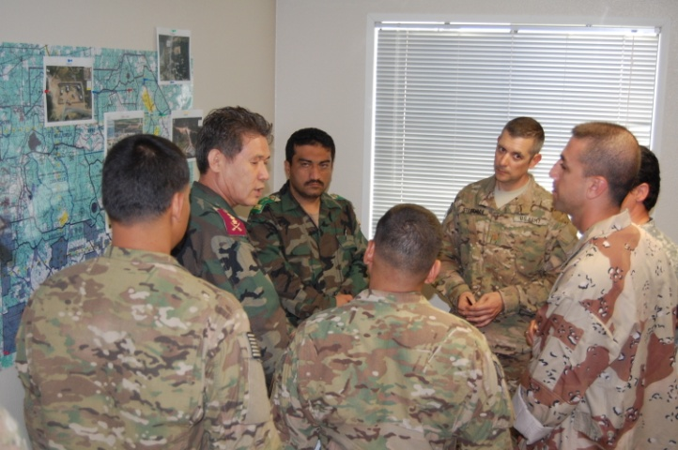
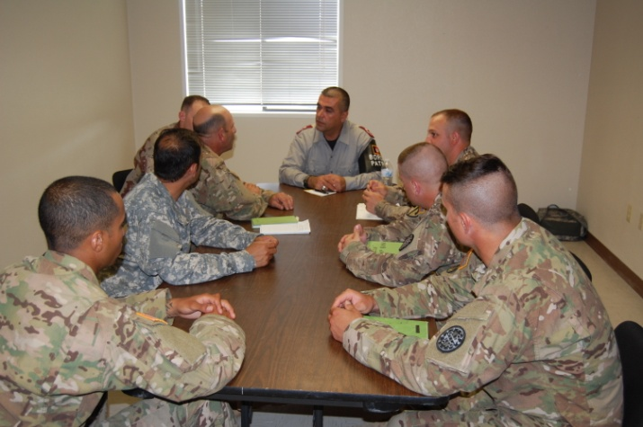
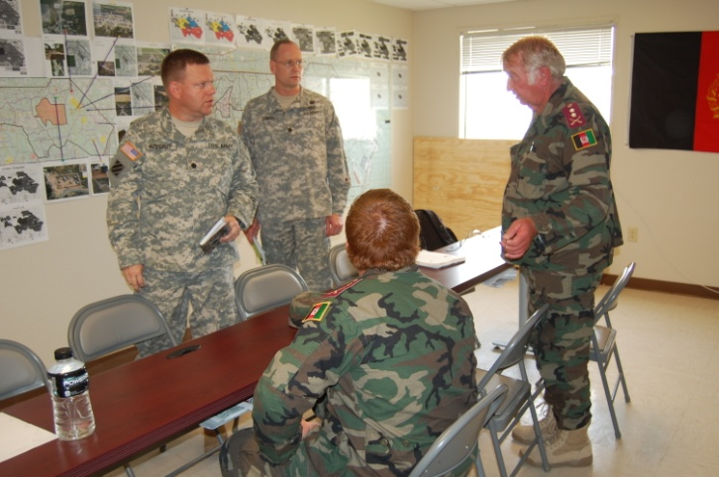
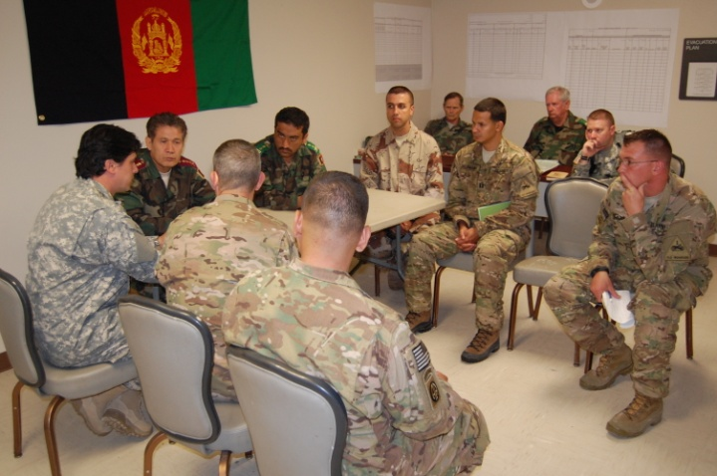
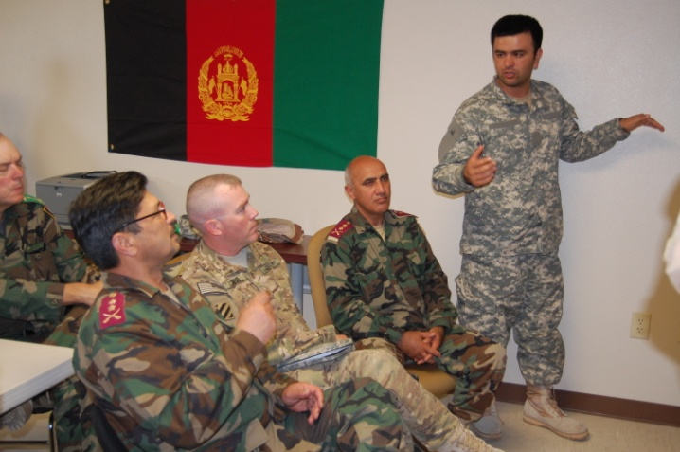
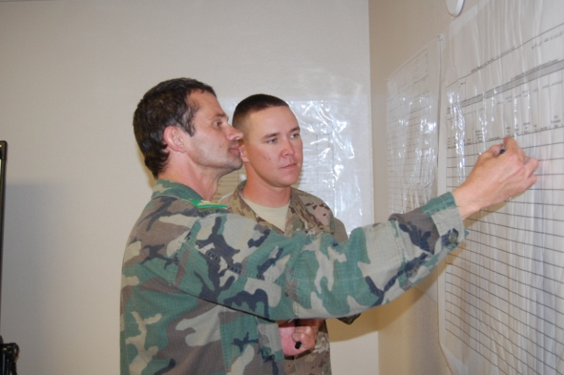
Advisor Training Practical Exercises
Analog Tactical
Operation Centers
Continuous
Counterpart Engagements
Afghan
Systems and Networks
Afghan
Led Planning
Afghan
Led Operations
Self Sustaining
Afghan Security Force
As of: 021200 MAY12
8

Slide 9
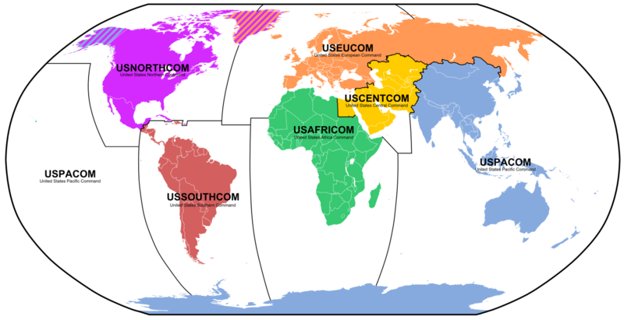
162nd IN BDE RAF Support
9
Notes:
9

Slide 10
Projected RAF Implementation
FY 13 | FY 14 | FY 15
1 RAF with Dedicated BDE
3 RAFs with Dedicated BDEs
5 RAFs with Dedicated BDEs
AFRICOM RAF Proof of Principle
AFRICOM RAF
AFRICOM RAF
PACOM RAF
CENTCOM RAF
EUCOM RAF
EUCOM RAF
PACOM RAF
WESTHEM RAF

Slide 11
Regional Focus Order of Battle
7th
SFG
II
1 MISO
X
…
…
…
…
X
II
A
S
S
I
G
N
E
D
F
O
R
C
E
S
8MISOG
RAF
SPP
Regl Ops
GCC Br
RTB
350CACOM
81 CA
ASCC
TSOC
20th
SFG
II
21partners
USASAC
SATMO
162BDE
85BDE
SC Sec
98 CA
95BDE
II
8 MISO
X
…
…
…
…
X
II
5th
SFG
4MISOG
RAF
SPP
Regl Ops
GCC Br
RTB
352CACOM
83 CA
ASCC
TSOC
II
6 partners
USASAC
SATMO
162BDE
85BDE
SC Sec
96 CA
1st
SFG
95BDE
Includes forces from the Corps to Brigade level and below
II
X
…
…
…
…
X
II
5 MISO
RAF
SPP
Regl Ops
GCC Br
RTB
84 CA
ASCC
TSOC
8MISOG
351CACOM
SC Sec
II
6 partners
USASAC
SATMO
162BDE
X
85BDE
19th
SFG
97 CA
322 CA
95BDE
II
Includes forces from the Brigade level and below
10th
SFG
6 MISO
…
…
…
…
RAB
X
X
II
ASCC
TSOC
4MISOG
RAF
SPP
Regl Ops
GCC Br
RTB
353CACOM
80 CA
SC Sec
II
22partners
USASAC
SATMO
162BDE
X
85BDE
92 CA
361 CA
95BDE
II
X
…
…
…
…
II
3rd
SFG
7 MISO
RAF
SPP
Regl Ops
GCC Br
RTB
Supports
AFRICOM
82 CA
ASCC
TSOC
4MISOG
SC Sec
II
8 partners
USASAC
SATMO
162BDE
85BDE
91 CA
95BDE
3d Group Operates in another region
- 10th Group covers EUCOM/AFRICOM
Army National Guard formation
Army Reserve formation
7th
SFG
X
RAF
ASCC
This slide does not portray all
assigned or theater committed forces
23JULY 2012
Notes:
REGIONAL FOCUS
Diagram shows common GCC structure. Note the Security Cooperation Section in the ASCC. And the fact that the TSOC works for the GCC (i.e. Special OPS component command).
Army conventional forces are expeditionary - predominantly CONUS-based – so having robust capacity in the US is important to ensure flexibility and operational depth
Diagram highlights the multiple organizations that have a regional focus in support of each OCONUS GCC. Many of these forces have operated in the CENTCOM AOR over the past 10 years, so we must enforce the regional focus. That was a caused by higher priority missions.
Significant impediment to larger capacity is priority – filling authorized billets, funding the program etc.
Conventional forces on left side, and SOF on right.
Multi-component. The CACOMs and CA Bdes are Army Reserve. The State Partnership Program is Army National Guard
EUCOM and PACOM have assigned forces (though globally available) that are first available to execute GCC missions – additional forces may be allocated via the GFM process to meet GCC requirements. GCCs without assigned forces may receive forces via the GFM process (apportioned for planning and/or allocated for mission execution)
Units identified have the capability to scale their operations.
11

Slide 12
FORSCOM Commander Guidance
Near-Term Vision
JRTC and 162nd IN BDE build capacity and capability to train and prepare Security Force Assistance and Security Cooperation forces for designated COCOM CDRs.
Specified Tasks
ICW FORSCOM, develop a flexible training construct that is adaptable to each COCOM based on their unique requirements to prepare SFA and SC forces.
Create the model for a mobile training capability to be utilized if required to help prepare SFA or SC forces.
Develop the model and requirements to produce and sustain up to ten SFA/SC training rotations per year to meet potential COCOM requirements.

Slide 13
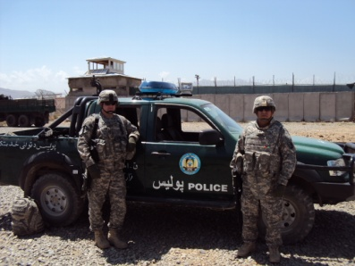
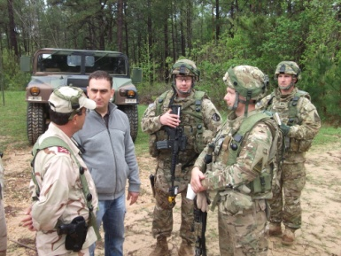
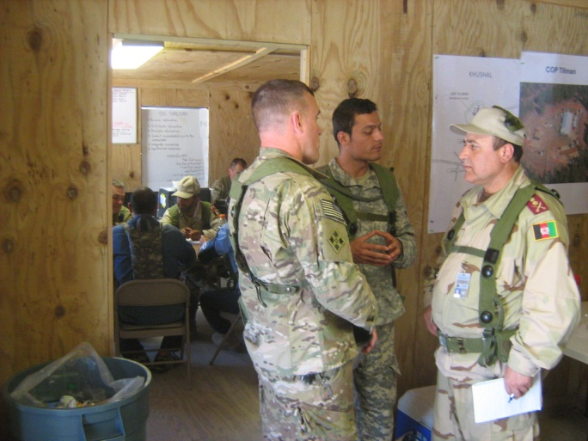
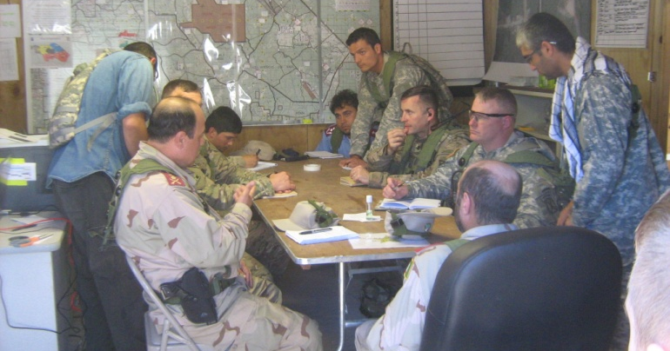
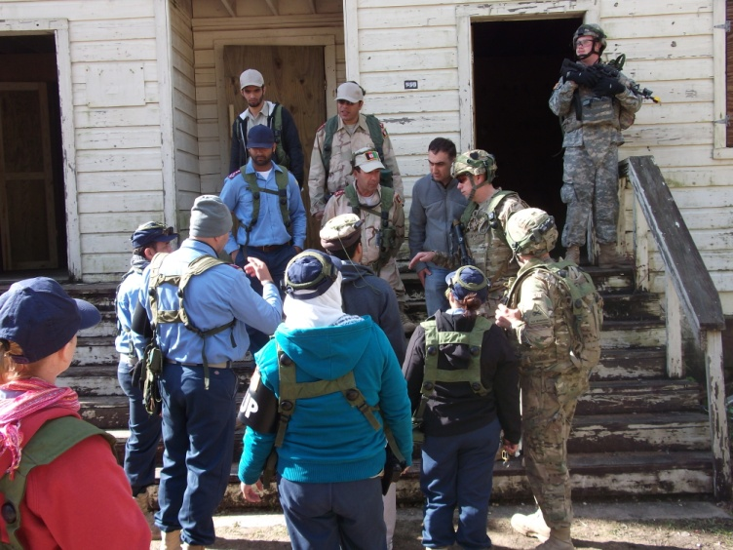
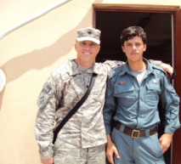
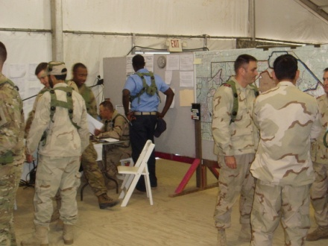
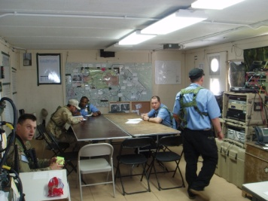
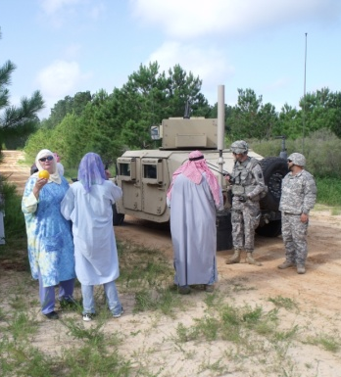
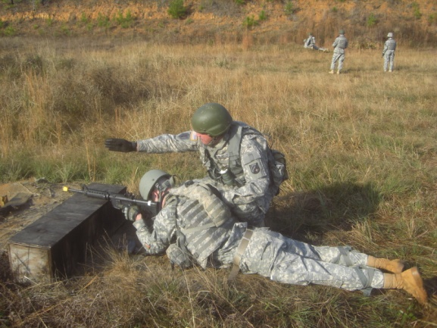
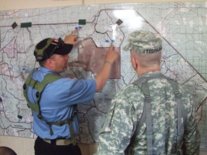
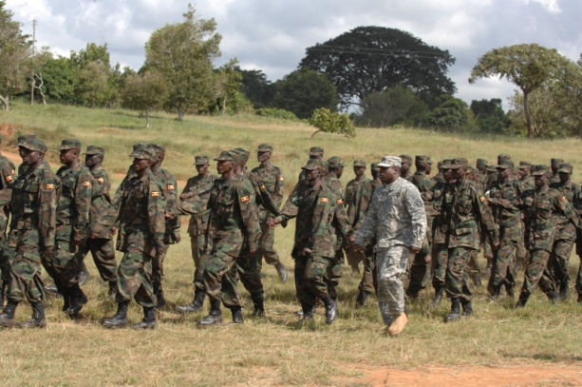
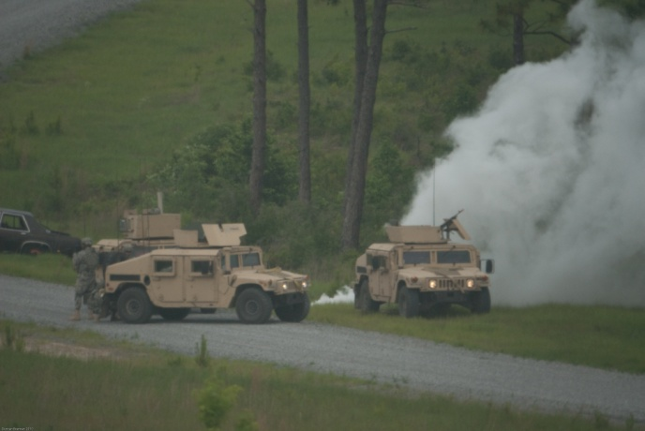
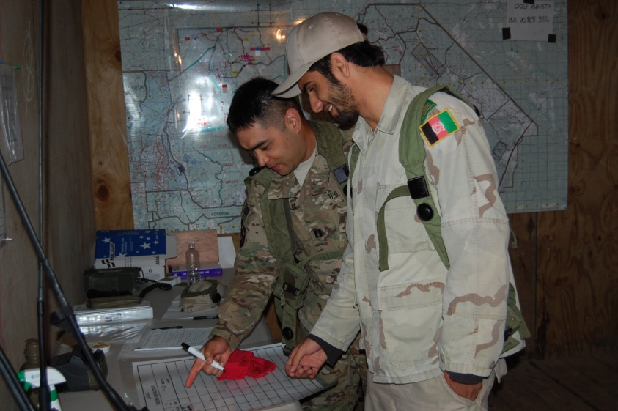
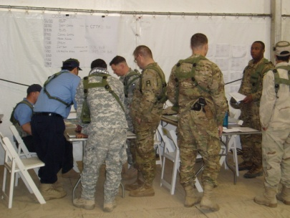
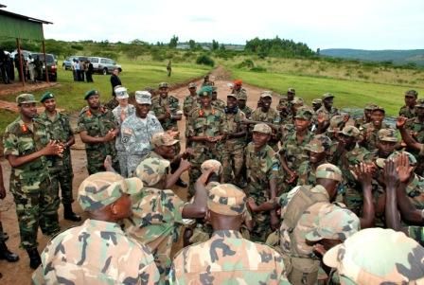
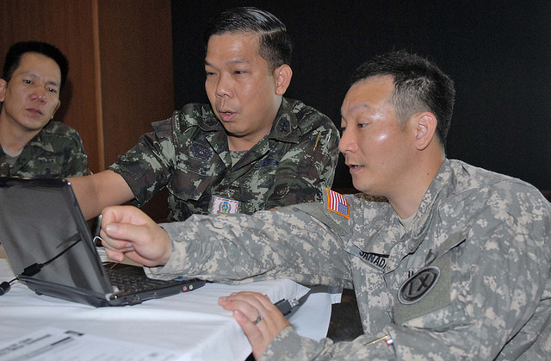
162nd IN BDE Output for the Army of 2020
Training Security Force Assistance/Security Cooperation for the Army and for
Joint Force Commanders to Build Partner Capacity in Priority Countries
1. FUTURE FOCUS:
Phase 0 Prevent Operations
Security Force Assistance
Security Cooperation
Regionally Aligned Forces
3. Rapid Deployment of Small Distributed Teams of Regionally Orientated Experts from 162nd IN BDE to Conduct SFA/SC Missions
4. Build Partner Capacity In COCOM Priority Countries
2. Training Advisor Teams with the requisite Military Skills, Regional and Cultural Knowledge, Language Ability and Advising Experience to Conduct SFA/SC Missions
13

Slide 14
Proposed 162nd Task Organization
X
162
1000
I
100
I
100
HHC
SUPORT
II
120
II
120
II
120
II
120
II
120
II
200
1
AFRICOM
353
West Hem
EUCOM
353
CENTCOM
PACOM
SFA/SC BN
3
4
353
6
353
2
353
5
353
BUILDING SECURITY CAPACITY IN COMBATANT COMMANDER’S PRIORITY SECURITY COOPERATION COUNTRIES
ENDURING CAPABILITY TO SUPPORT COCOM SFA/SC ACTIVITIES WITH GENERAL PURPOSE FORCES
ABILITY TO SUPPORT THROUGH ALL PHASES OF ARFORGEN CYCLE
TRAINING SUPPORT TO BUILD ARMY AND POLICE SECURITY CAPACITY
RAPID DEPLOYMENT TO CONDUCT SFA/SC MISSIONS
14

Slide 15
162nd Infantry Brigade Mission Expansion
FACTS
APPROVED ADDITION OF 175 PAX TO 162D IN BDE TDA
ENDURING CAPABILITY TO SUPPORT GEOGRAPHIC COMBATANT COMMANDER’S THEATER SECURITY COOPERATION OBJECTIVES
TRAIN THE TRAINER CAPABILITIES AND RESOURCES
162D IN BDE RAF TRAINING TEAMS
COORDINATING STAFF = 3
AFRICOM
CENTCOM
SOUTHCOM
EUCOM
PACOM
Police/Border
Section
COORD
CELL
Branch HQ
RAF Training Team
TEAM X3
4/1/3
OIC
TEAM LDR
TEAM X3
4/1/3
TEAM LDR
(O3)
OIC
TEAM LDR
(O3)
TEAM LDR
(O3)
TEAM LDR
(O3)
NCOIC
Team NCO
NCOIC
TL/FAO
TL/FAO
Team NCO
(E7)
Team NCO
(E7)
Team NCO
(E7)
Team NCO
(E7)
Trng NCO
OPS
Trng NCO
Regional Specialists
POLICE TRAINING SECTION = 12
Log NCO
OPS NCO
ADMIN
CA SPC
FACTS
REGIONALLY ALIGNED BRIGADES WILL BE ALIGNED TO ARMY SERVICE COMPONENT COMMANDS BEGINNING IN JANUARY 2013
162ND IN BDE WILL PROVIDE TRAINING SUPPORT TO REGIONALLY ALIGNED BRIGADES THROUGHOUT THE ARFORGEN CYCLE
Signal
Country
Culture
HNSF
Culture
Cultural Specialists
Intel
OPLAW
HN LOG
HN Ordnance/Logistics Specialist
GCC LNO
GOV
Governance Specialist
32 TRAINERS X 5 TEAMS DEDICATED TO TRAINING UNITS FOR PHASE ZERO “PREVENT” THEATER SECURITY COOPERATION MISSIONS
Notes:
15

Slide 16
Foreign Area Officers (FAOs)
Joint FAOC + Language + ICT + ACS + ILE = Initial FAO Training
Language
In-Region Training
(IRT)
Advanced Civil Schooling
(ACS)
Joint
FAO
Course
Intro to FAO
Conducted in Monterey, CA
Army and Joint phases
Language – between 26 and 63 weeks
Must achieve 2/2
Language selection dependant on AOC
DLI East or West
Immerse Officer
Typically 12 months
“Internships”-more specialized experiences
Language goal 3/3 upon completion
Regionally focused
Select disciplines of study
12-18 Months
Large diversity of schools desired

Slide 17
RAF Coordination Battle Rhythm
Bimonthly:
Building Partner Capacity VTCs: FORSCOM, HQDA, MCCoE, PKSOI, JCISFA, ARCIC
Monthly:
RAF VTCs: FORSCOM, HQDA, USARAF, 1 ID, TRADOC, NGB, OCAR
Quarterly:
RAF Working Group (within ASRC): FORSCOM, HQDA, USARAF, 1 ID
Semi-Annual:
ASCC and GCC Theater Security Cooperation Conferences
162d Training Enabler Working Groups: LDESP, AWG, DLI, Cubic CORs, TRADOC, National Language Service Corps, NG
Annual:
ASCC issues Campaign Plan to RAF BDE
Army Campaign Support Plan Conference: USARAF, FORSCOM, HQDA 3/5/7

Slide 18
AFRICOM RAF (2/1 ID)
HQDA Proof of Principle
- Completed 162nd Proof of Principle Event:
Training for 8 pax deploying to Operation Onward Liberty in Liberia (15-18 NOV 11)
- Continuing instructor certification and currency
Namibian Defense Force Senior NCOs Development presentation (5-9 MAR 12)
Foreign Service Institute (DoS-run) Course on Sub-Saharan Africa (23 APR-4 MAY 12)
Malawi MTT to teach NCO Roles and Employment (14-18 MAY 12)
3-week Africa immersion trips through Cadet Command (Summer 12)
AFRICOM FAO language sustainment programs (Summer 12)
Army Security Cooperation Planner Course (DEC 11)
162d SFA Course, Ops Group OC/T Certification, Army Basic Instructor Course

Slide 19
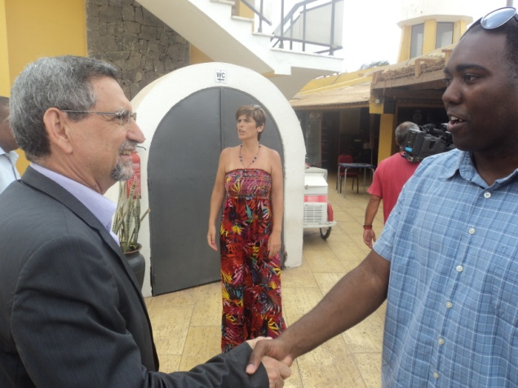
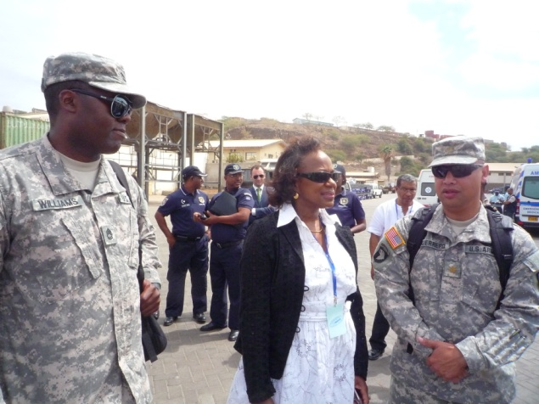
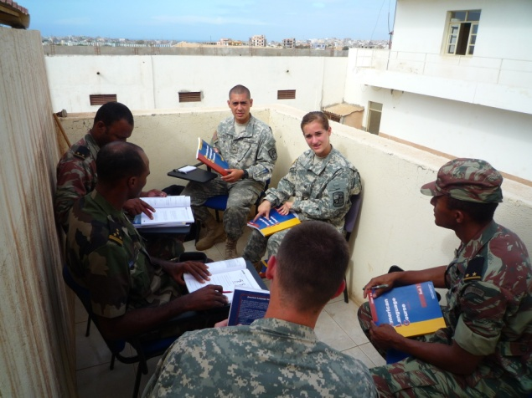
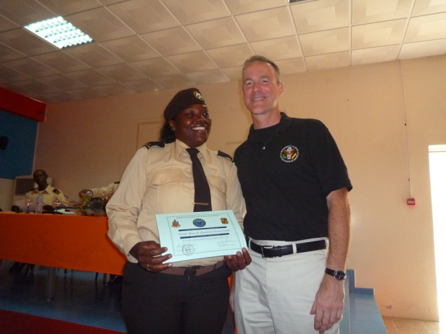
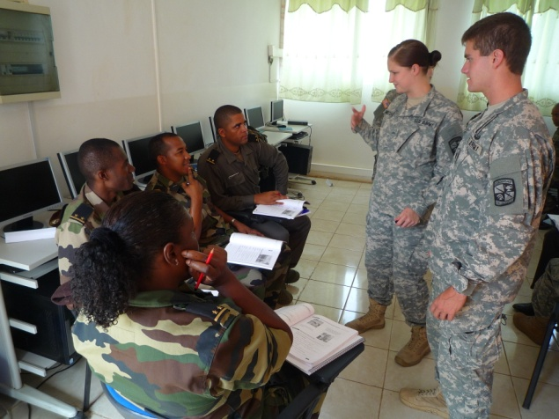
SFC Williams - Cape Verde
WHO: 12 X Cadets, 1 X Cadre, 1 X 162ND INF BDE RAF-TT (AFRICOM) NCO
WHAT: Conducts Basic English Training
WHERE: Cape Verde, Africa
President of Cape Verde
MISSION: NLT 8 July 2012, Cadets from throughout Cadet Command deploy to Cape Verde, Africa, to assist with English Language Training and develop enhanced cultural understanding and foreign language capability.
KEY TASKS:
English Language Training
Develop enhanced cultural understanding
Develop foreign language capability
US Ambassador
Classroom Training
SUMMARY: In a classroom environment trained 30 Cape Verde NCOs and Officers in English. Attended country’s first Anti-immigrations exercise and military reform conference. This gave both a better understanding for language, culture, and history for both Cape Verde and the United States participants.
Graduation Ceremony
Classroom Training
Notes:
SFC Tony T Williams, July 2012 Rotation

Slide 20
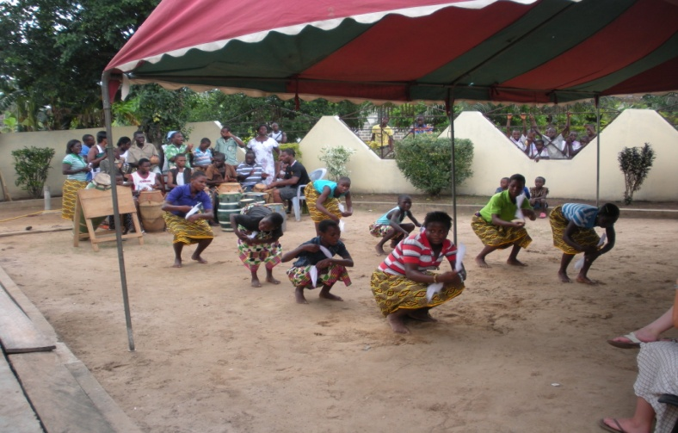
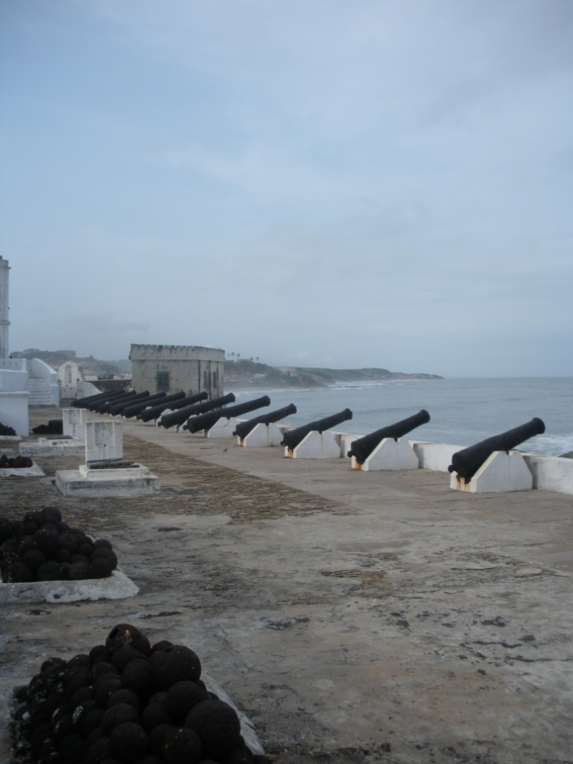
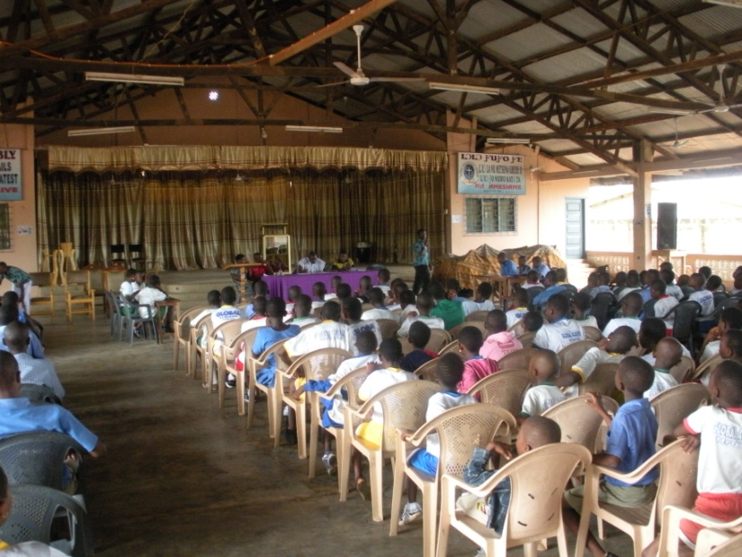
CPT Ready - Ghana
Training Advisors and Security Force Assistance Teams for the Army and for
Joint Force Commanders to Build Security Capacity in Designated Countries
WHO: 12 X Cadets, 2 X Cadre, 1 X 162ND INF BDE RAF-TT (AFRICOM) Officer
WHAT: Partner with Cross Cultural Solutions NGO
WHERE: Ghana, Africa
MISSION: NLT 23 Jun 2012, cadets and cadre deploy to Ghana, Africa to develop partner relationships with Ghanaian organizations IOT facilitate a better cultural understanding between both host nation and visiting personnel.
KEY TASKS:
Develop enhanced cultural understanding
Strengthen host/partner relationship through volunteer efforts
SUMMARY: Cadets and cadre work in a volunteer capacity with different local Ghanaian medical and educational organizations. Working with host nation personnel helped facilitate a cultural exchange between both parties, improving our understanding and appreciation for each other.
Notes:
`

Slide 21
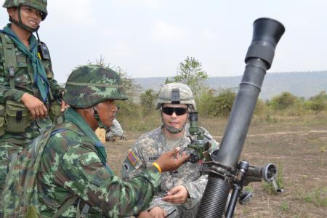
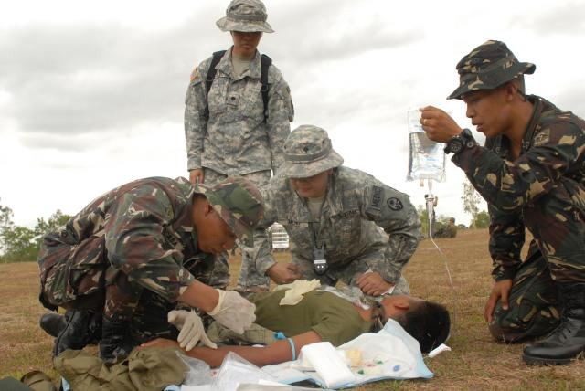
162nd IN BDE Proof of Principle for PACOM
- Completed 162nd PACOM Proof of Principle Events:
Training for 50 pax from 585th EN Co. at Ft. Lewis deploying to Thailand for EXERCISE BALANCE TORCH; 162d team augmented by 300th MI BN (Utah ARNG) and TRADOC Culture Center (4 MAY)
Training for 3 pax at Ft. Jackson deploying to the Philippines for a Drill Sergeant exchange (8 MAY)
Ongoing POI support being provided for 18th MEDCOM international engagement trips
- Continuing instructor certification and currency
Asia-Pacific Center for Security Studies Orientation Course (23-27 JAN)
Foreign Service Institute (DoS-run) Course on Southeast Asia (1-14 JUL)
3-week Asia immersion trip through Cadet Command (Summer 12)
162d SFA Course, Ops Group OC/T Certification, Army Basic Instructor Course

Slide 22
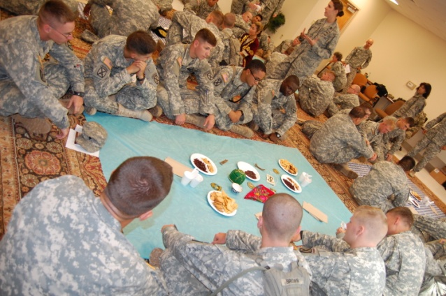
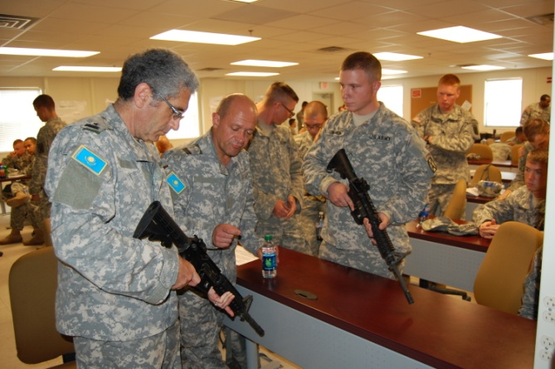
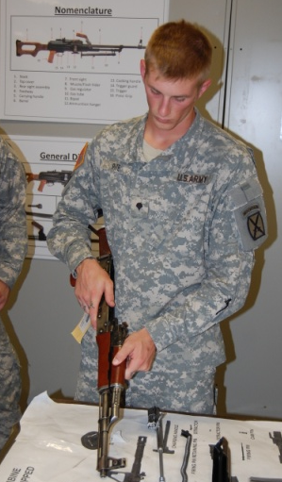
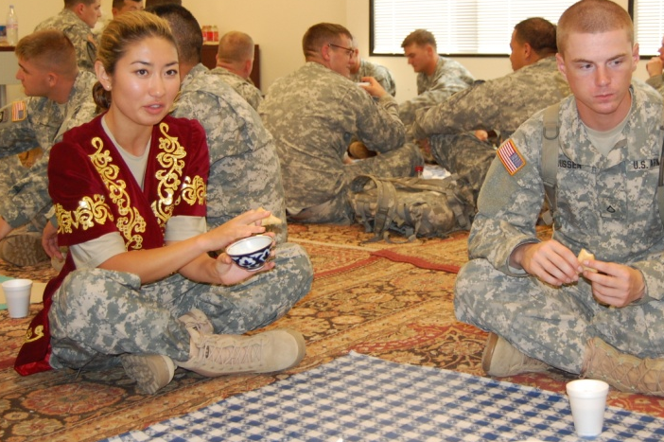
162nd IN BDE CENTCOM RAF Training Proof of Principle: Exercise Steppe Eagle Training
Training for C Co./2-30 IN from 4/10 MTN deploying to Kazakhstan (141 Soldiers)
1. Steppe Eagle:
- Host Nation Force: Kazakhstan Air Mobile Forces
- What: Exercise led by ARCENT ICW NATO
- Where: Illisky Training Area, Southeast Kazakhstan
- When: 6-20 SEP 12
- Why: Refine PKO TTPs at Company level and below
2. Regionally-Focused, Culturally Based Training:
- Regional and Cultural Knowledge
- Language
- SFA/SC Skills
4. Leveraged SFA/SC Training Network:
Joint
Interagency
Intergovernmental
Multinational
3. Hands-On, Performance Oriented Training:
- Culture-Based Scenarios (Professional and Social)
- Cross-Cultural Leadership
- Foreign Weapons Familiarization

Slide 23
Proposed RAF Training Concept
0
3
6
9
12
15
18
21
24
P2
S2
T3
P1
S1
T2
T1
T1/T2
RESET
TRAIN/READY
AFPD
AVAILABLE
PLT Mnvr/ Live Fire
& BDE/BN
Staff Sec Prof
STAFFEX
(LTP)
FTX
(MCTC)
Region Specific Training
CPX
(BWFX)
CO Mnvr/
Live Fire &
BDE/BN
Staff Prof
BN Mnvr/
Live Fire &
BDE/BN
Staff Prof
SQD: STX
PLT: STX, LFX
CO: STX
BDE/BN STAFF TRNG
SQD: STX
PLT: STX, LFX
CO: GNRY, STX, FTX , CALFX
BDE/BN: FTX, STAFFEX, CPX
CO: GNRY, STX
BDE/BN: FCX, STAFFEX, CPX,FTX (MCTC), DEPEX
SQD: STX
PLT: STX
BDE/BN: STAFFEX
SQD : STX, LFX
PLT: STX, LFX
CO: GNRY, STX, FTX, CALFX
BDE/BN: FTX, FCX, STAFFEX, CPX,
SQD: STX, LFX
PLT: STX, LFX
CO: GNRY, STX
BDE/BN: STAFFEX
RESET
TRAIN / READY
AFPD
AVAILABLE
Commanders/Staff:
3-Day Seminar
Home
Station
Quarterly Training Tailored to Upcoming Missions
AOR ORIENTATION/ OVERVIEW
Commanders/Staff: 3-Day Seminar
AOR UPDATE
CDR
SPECIAL
TOPICS
Home
Station
RAF Unit Training: 2 Weeks of Education +
Hands-On, Performance-Oriented Training to
Build Partner Nation Capacity
Ft. Polk
AOR OVERVIEW
REGIONAL TRAINING (LANGUAGE,REGIONAL EXPERTISE,CULTURE)
MISSION-FOCUSED PLANNING AND REHEARSALS (ADVISE/PARTNER/AUGMENT)
Language Training at Home Station
Tailored, Scaled, Regionally-Focused,
Culturally-Based Training Conducted at Ft. Polk

Slide 24
RAF Unit Training
Education + Hands-On, Performance-Oriented Training
To Build Partner Nation Capacity
AOR OVERVIEW
+
ADVISING INTRO
(2 Days)
REGIONAL TRAINING (LANGUAGE,REGIONAL EXPERTISE,CULTURE)
(1.5 Days)
MISSION-FOCUSED PLANNING AND REHEARSALS (ADVISE/PARTNER/AUGMENT)
(1.5 Days)
Baseline knowledge for RAF members
Training complete for Traveling Contact Teams and short-duration missions
Tailored training continues for exercises and other missions in priority areas, of longer duration, or greater complexity

Slide 25
Proposed RAF Training Concept
0
3
6
9
12
15
18
21
24
P2
S2
T3
P1
S1
T2
T1
T1/T2
RESET
TRAIN/READY
AFPD
AVAILABLE
PLT Mnvr/ Live Fire
& BDE/BN
Staff Sec Prof
STAFFEX
(LTP)
FTX
(MCTC)
Region Specific Training
CPX
(BWFX)
CO Mnvr/
Live Fire &
BDE/BN
Staff Prof
BN Mnvr/
Live Fire &
BDE/BN
Staff Prof
SQD: STX
PLT: STX, LFX
CO: STX
BDE/BN STAFF TRNG
SQD: STX
PLT: STX, LFX
CO: GNRY, STX, FTX , CALFX
BDE/BN: FTX, STAFFEX, CPX
CO: GNRY, STX
BDE/BN: FCX, STAFFEX, CPX,FTX (MCTC), DEPEX
SQD: STX
PLT: STX
BDE/BN: STAFFEX
SQD : STX, LFX
PLT: STX, LFX
CO: GNRY, STX, FTX, CALFX
BDE/BN: FTX, FCX, STAFFEX, CPX,
SQD: STX, LFX
PLT: STX, LFX
CO: GNRY, STX
BDE/BN: STAFFEX
RESET
TRAIN / READY
AFPD
AVAILABLE
162nd Prep:
Commanders/Staff:
3-Day Seminar
Home
Station
Quarterly Training Tailored to Upcoming Missions
Cadre Recruitment and Regional Education and Immersion
Reset -9 Months:
AOR ORIENTATION/ OVERVIEW
Commanders/Staff: 3-Day Seminar
AOR UPDATE
CDR
SPECIAL
TOPICS
Home
Station
RAF Concept Development Support for HQDA and FORSCOM
RAF Unit Training: 2 Weeks of Education +
Hands-On, Performance-Oriented Training to
Build Partner Nation Capacity
Reset -6 Months:
ASCC/GCC Conferences and Discuss RAF Mission
Ft. Polk
AOR OVERVIEW
REGIONAL TRAINING (LANGUAGE,REGIONAL EXPERTISE,CULTURE)
MISSION-FOCUSED PLANNING AND REHEARSALS (ADVISE/PARTNER/AUGMENT)
Coordination and POI Development with RAF Training Network
Language Training at Home Station
Reset -3 Months:
Initial Contact and Planning With Designated RAF Units
Tailored, Scaled, Regionally-Focused,
Culturally-Based Training Conducted at Ft. Polk

Slide 26
SFA/SC Course – 14 Day Model Proposed Model
Classroom instruction Followed by
Hands-on Performance Oriented Training
Train RAF Units in Advisor and Security Force Assistance/ Security Cooperation skills tailored to specific regions and key countries
Understand Partner, capabilities, systems and networks
Provide RAF Units with the tools to Build Partner Capacity
PLAN
PREPARE
EXECUTE/ASSESS
PLAN
PREPARE
EXECUTE/ASSESS
Practical Exercises focused on reinforcing skills learned during classroom instruction
Train RAF Units with cultural role-players to replicate mission region (assisted by 162nd Training Network applicable to specific regional expertise)

Slide 27
AFRICOM RAF Draft POI (Short Version)
Day 01 | Day 02 | Day 03 | Day 04 | Day 05
T6 Brief LTC Stokes Remarks CSM Admin Remarks 0800-0900 | MUTUAL PERCEPTIONS | JIIM | Socio-Cultural Dynamics and Identity | History of Peacekeeping
AFRICA OVERVIEW | AFRICA IS NOT IRAQ/AFGHANISTAN – PHASE 0 | HOTEL MEDICINE | Drivers of instability | AFRICOM/ USARAF
Welcome / Academy Overview (1 HR) | EMBASSY 101 | Geography of the African Continent | African Economy | REGIONAL and CONTINENTAL ORGANIZATIONS
Use of Interpreter (1 HR) | USFP AFRICA | history of major regional conflicts | Health Challenges | RECAP
Lunch | Lunch | Lunch | Lunch | Lunch
Engagements (1 HR) | Language – MEET GREET AND EAT | Language – MEET GREET AND EAT | Language – MEET GREET AND EAT | Coordination Mtg
Rapport/Human Behavior (1 HR) | Tm SOPs and Battle Drills |  | POI REHEARSAL | MDMP
CROSS CULTURAL COMS | CULTURAL PANNEL | POI PLANNING | POI BRIEF | BACK BRIEF
Meet and Greet with counterparts | LOGISTICS PLANNING |  | ACTIONS ON THE OBJECTIVE
CULTURAL MEAL | TEAM TIME | TEAM TIME | TEAM TIME | GREENBOOK AAR 1500 HRS

Slide 28
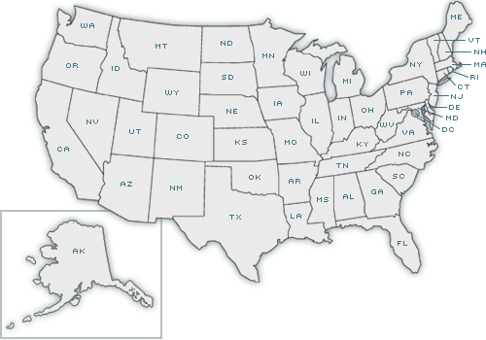
Security Force Assistance/Security Cooperation Training Network
Combined Arms Center/Mission Command CoE – Future Organization and Mission Constructs
Joint Center for International Security Force Assistance – SFA Doctrine
Cadet Command –
Cadre Regional Immersion
Asymmetric Warfare Group – Operational Advising
HQDA SSI and SSO – Army-wide RAF Coordination
National Guard Bureau – State Partnership Program
National Language Service Corps – Linguist/Role Players
Dept. of State Foreign Service Institute – JIIM Training
Defense Language Institute – Language Skills
Leadership Development Education for Sustained Peace – Regional Expertise
FORSCOM – Transformation Integration
Special Forces Command/Special Warfare Center and School – Foreign Internal Defense
Civil Affairs & Psy Ops Command – Governance
Security Assistance Training Management Organization – Security Assistance Teams
4th Military Information Support Group – MISO
300th MI BDE (Utah Army National Guard) – Linguists
162d IN BDE: Coordinates and Synchronizes RAF Training Effort
SFA Skills
SC Skills
Advise/Partner Skills
Regional Expertise
Culture Skills
Language Skills
Combat Skills
TRADOC Culture Center
– Regional Expertise
Navy Center for Language, Regional Expertise, and Culture – Cultural Expertise

Slide 29
Recent Training Network Lessons Learned for AUG 12 Steppe Eagle (Kazakhstan) Training
Foreign Military Studies Ofice (TRADOC G-2) – Kazakhstan Army Subject Matter Experts
AKO People Search Function – Identified Massachusetts National Guard Soldiers with Steppe Eagle experience
National Training Center – Has dedicated Translator Interpreter Company whose linguist skills differ from Ft. Polk’s
National Language Service Corps – Linguists/Role Players for TDY costs
National Defense University – Kazakh O-5 Exchange Officer
Arizona Army National Guard – Kazakhstan State Partnership Program
Academia – FAO grad school ties to Indiana University’s summer language workshop produced referrals to Kazakhstan experts
DLI English Language Center – has Kazakh exchange officers enrolled
Local Community – 52nd TICO soldier referred a Soldier with Russian and Kazakh language skills who did not appear on DoD databases
Defense Readiness Reporting System – Joint search for language ability found O-1 Kazakh linguist with MA in Central Asian Studies at Shaw Air Force Base

Slide 30
Questions?

