Slide 1
3BCT (BLST)
Brigade Logistics Support Team
Supporting the Warfighter
3BLST

Slide 2
3BCT (BLST)
Brigade Logistics Support Team
Provide a single face for acquisition
logistics, and technology support to the
3rd BCT, 82nd Airborne Division at all levels to
integrate AMC’s forward logistics capabilities
to equip, sustain, and assist the Soldiers
in support of Global Response Force or
world-wide contingency mission.
AFSBn – Bragg
Provide Logistical assistance as in AR 700-4, which is to provide WWL assistance and professional guidance under AMC footprint.
Ensures LBE, RESET, PTDE are met to the BCTs need while monitoring daily readiness status.
Notes:
Utilize organization assets and resources to maintain equipment and supply readiness to accomplish assigned missions and tasks through efficient and effective supply, maintenance, and transportation.
Identify shortfalls through the reporting system and in command channels.
Task organize their assigned and attached units/organizations to ensure maximum efficiency and effectiveness in maintaining readiness through unit level supply, maintenance, and transportation.
Consider the priorities established by AFSB-FE Commander as appropriate. Inform next higher headquarters and through the reporting chain, as to how assigned or attached units ensure maximum level of support is available and provided.
Utilize STAMIS reporting system to identify readiness problems for correction through actions planned and executed in coordination with the staffs of the MSCs or DRU/Os.
Tailored support can be provided through a variety of means to include host nation contracts and the Logistics Civil Augmentation Program LOGCAP. Examples include Base ops support (force provider) EPW, Graves registration, Mortuary Affairs or the full spectrum of maintenance and logistics capabilities.

Slide 3
(BLST)
Brigade Logistics Support Team
MAJ Mosby
3BCT BLST Chief
Gary Kandarczyk
Logistics Mgmt Specialist
John Arato
CECOM IT Switch
Ray Noftz
TACOM Automotive
Kevin Ravenell (Deployed)
CECOM IT Radio
Don Schiller
TACOM Armament
Bernie Ford
CECOM Sensor
ASC
CECOM
TACOM

Slide 4
BLST Team
Team serves as AMC face to the field
Supports every field exercise
Coordinate and provide AMC coordination
Provide timely assistance within 24hour of notification if possible
Deploys in support of unit assigned
Submits necessary documentation in accordance w/civilian regulations
Serves atleast an 8hour duty day with options of overtime if mission permits
Oversee LBE/RESET in support of ARFORGEN

Slide 5
BLST CHIEF
Logistics Management Specialist (LMS)
Provide a single face to bring Army Materiel Command/ Acquisition Logistics Technology capabilities into the brigade.
Work closely with the Brigade XO, Support Operations Officer(SPO) Brigade Logistics Officer (S4) and the Brigade Signal Officer(S6)
Coordinate and provide AMC,AMCOM, CECOM, TACOM, and JMC Logistics Assistance Representative (LAR) to support the BCT mission
Provide timely reach-back Field Service Representative (FSR) support for contractor supported, non-standard and newly-fielded equipment and systems
Advise AFSBn Commander and Deputy on BCT logistic related issues
MAJ Detrice Mosby
BLST Chief
E-Mail: detrice.mosby@us.army.mil
Office: 643-9630
BB# 910 -364-7067
Mr. Gary Kandarczyk
AMC Logistics Management Specialist (LMS)
E-Mail: gary.t.kandarczyk@us.army.mil
Office: 643 - 2833
Cell: 910-366-7110

Slide 6
Tank-Automotive/Armament (TACOM) LAR
Provide technical and logistical assistance
Maintenance standard
Policies and procedures
Equipment weapons systems
Monitor and analyze readiness trends or problems
Take corrective actions to optimize readiness rates
Provide maintenance diagnostic training
Assist other agencies i.e. AMCOM & CECOM in resolving systems of system vehicle problems
Support the following equipment: HMMWV, FMTV/MTV, HEMTT, HET, STRYKER, M900 series trucks, ASV, Quartermaster equipment, Small Arms & Crew-Serve Weapons, Mortars, Howitzers, etc.
Mr. Ray Noftz
TACOM Automotive LAR
E-Mail: raymond.noftz@us.army.mil
Office: 643-2834 Cell# 910-578-0617
Mr. Don Schiller
TACOM Armament LAR
E-Mail: don.schiller@us.army.mil
Office: 643-2836 Cell# 910-728-3863
SLAR : ASC
Mr. Stephen Crain
Supply LAR
Email: stephen.a.crain.civ@mail.mil
Office: 643-2832
Cell# 910-309-4775

Slide 7
Tank-Automotive/Armament (TACOM) LAR

Slide 8
COMMUNICATION - ELECTRONIC (CE) LCMC
Technical and Logistical Advisor
Operation and maintenance of CECOM systems
Resolves maintenance and supply problems
Provide maintenance and operation training for all military personnel
Provide BLST Chief an assessment of the units maintenance and operation of equipment to ensure combat readiness
Investigate operational, maintenance and repair problems and provide recommendations where appropriate
Assist other agencies i.e. AMCOM & TACOM in resolving systems of system vehicle problems
Mr. John Arato
CECOM IT SWITCH
E-Mail: john.arato@conus.army.mil
Office: 643-2837
Cell# 910-920-8985
Mr. Bernie Ford
CECOM Sensor
E-Mail: bernie.ford1@us.army.mil
Office: 643-2838
Cell# 910-920-8982
Mr. Kevin Ravenell (Deployed)/
Mr. Marshall Phelps
CECOM IT RADIO
E-Mail: kevin.ravenell@conus.army.mil
Office: 907-4640
Cell# 910-922-1476
Regional Support
Mr. Chris Peeples/Paul Russel
CECOM Pwr Gen & Environmental (P&E)
E-Mail: c.peepls@us.army.mil
Office: 643-2344
Cell# 910-728-3411
Mr. Robie Scott
Long Haul Transmission (LHT)
E-Mail: robie.scott@us.army.mil
Office:
Cell# 910-920-8994

Slide 9
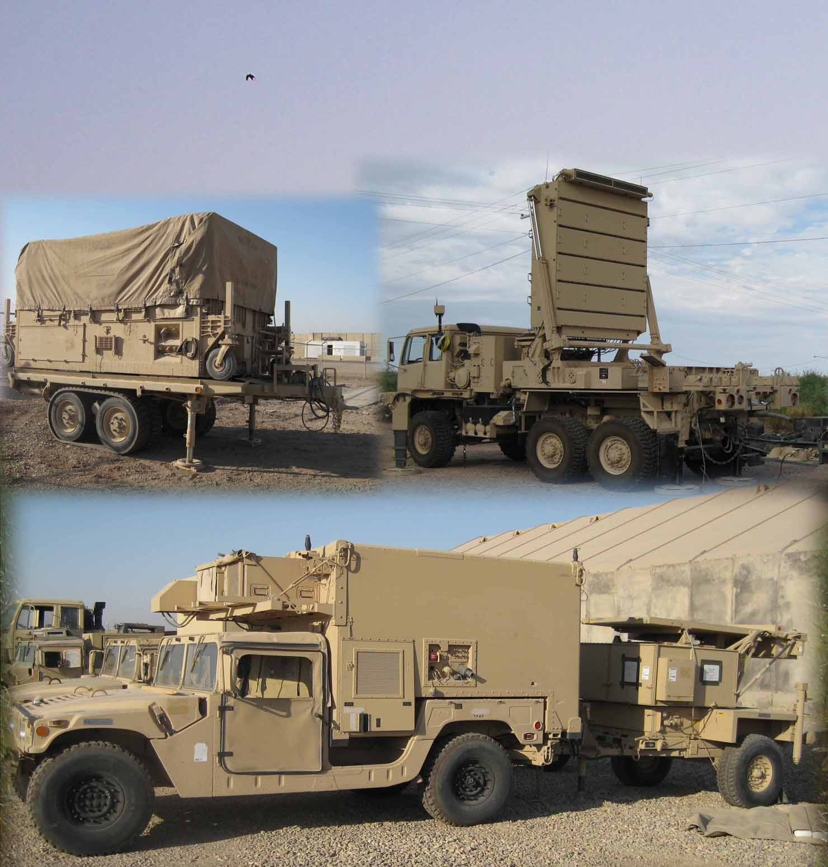
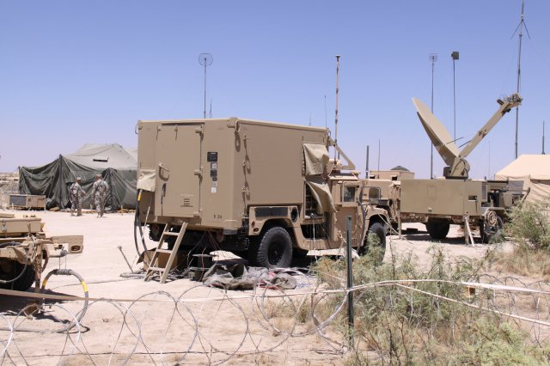
COMMUNICATION - ELECTRONIC (CE) LCMC

Slide 10
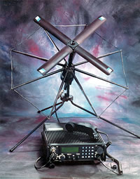
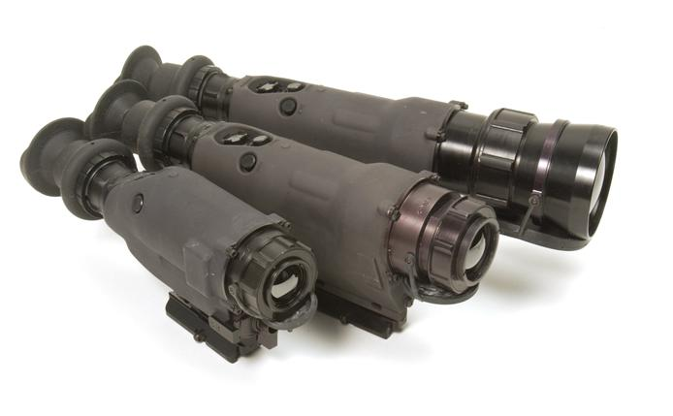
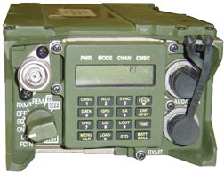
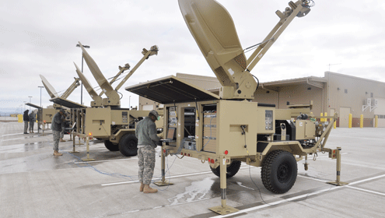
COMMUNICATION - ELECTRONIC (CE) LCMC

Slide 11
Aviation-Missile Command (AMCOM)
Advise and Assist Commanders, maintenance & supply personnel
Provide technical and logistical assistance
Monitor and analyze readiness trends or problems - keep AMC & AMCOM informed of system readiness
Take corrective actions to optimize readiness rates
Provide maintenance training
Provide technical feedback to units
Intensively manage items that are NMC for
over 24 hours and validate requisitions status
Assist other commands i.e. TACOM & CECOM in resolving systems issues
Support field exercises, emergency operations & deployments
Provide assistance during fielding and monitor rebuild/retrograde program
Mr. Venturo Avila
AMCOM SSTR
E-Mail: venturo.avila@us.army.mil
Office: 396-3389
Cell# 910-305-2517
Mr. Alberto Labsan
AMCOM Missile LAR
E-Mail: alberto.f.labsan@us.army.mil
Office: 907-2602
Cell# 910-633-9435
Mr. Jonathan Lawrence
AMCOM UAS LAR
E-Mail: kevin.ravenell@conus.army.mil
Office: 907-4640
Cell# 910-922-1476
Ms. Dorla France
AMCOM UAS LAR
E-Mail: dorla.france@us.army.mil
Cell#: 910-703-0820

Slide 12
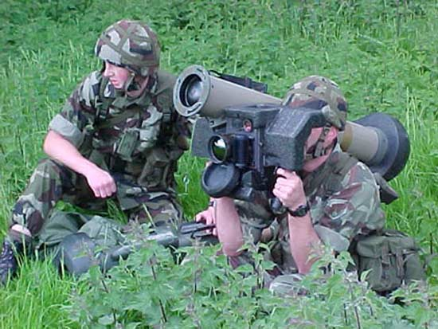
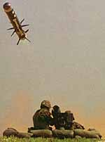
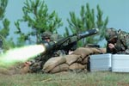
JAVELIN
JAVELIN
JAVELIN ANTI-ARMOUR MISSILE, USA
Javelin is a portable anti-tank weapon, supplied by Raytheon/Lockheed Martin JAVELIN Joint Venture. It is shoulder-fired and can also be installed on tracked, wheeled or amphibious vehicles.
In 1989, the US Army awarded a contract for the development of Javelin as a replacement for the M47 Dragon anti-tank missile. Javelin entered full-rate production in 1994 and the systems were first deployed in June 1996 by the US Army at Fort Benning, Georgia. The Javelin system saw operational service with the US Army, Marine Corps and Australian Special Forces during Operation Iraqi Freedom in March/April 2003.

Slide 13
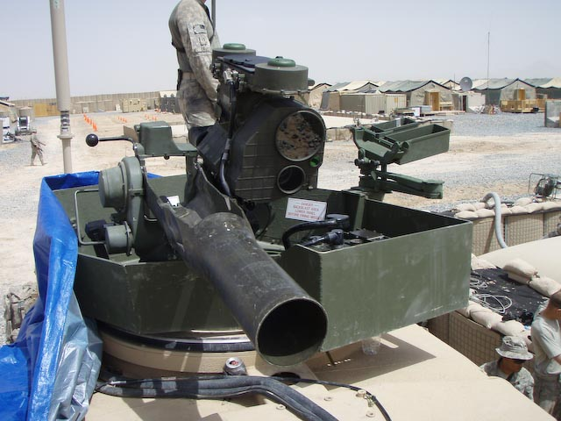
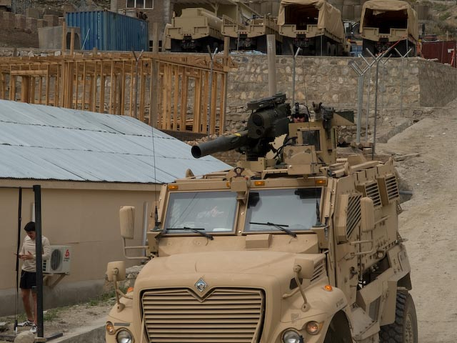
TOW/ITAS
TOW/ITAS
The TOW ITAS mission is to defeat enemy armored vehicles.
The TOW Improved Target Acquisition System (ITAS) is a material change to the current target acquisition and fire control subsystem used by first-to-fight, light infantry forces. ITAS increases target detection, acquisition, recognition and engagement ranges; fires all versions of the TOW missile from both the M41 ground launcher (dismount mode) and the M1167 high mobility multipurpose wheeled vehicle (HMMWV) platform; and provides a growth path for future missiles.
The ITAS includes a second-generation FLIR that uses Standard Advanced Dewar Assembly (SADA II) technology, an eye safe laser rangefinder, and other digital components to address user-identified operational deficiencies. These improvements increase detection and identification ranges by a factor of 2X, increasing the probability of hit over the existing TOW 2.

Slide 14
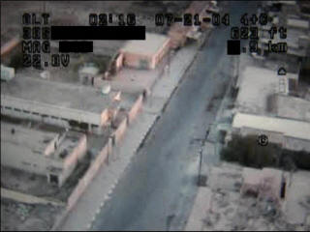
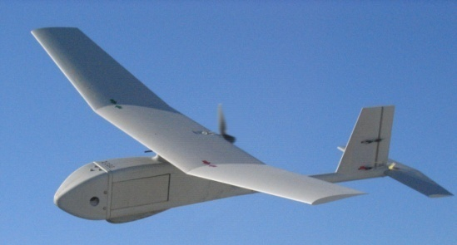
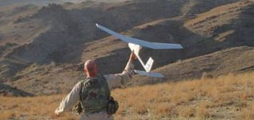
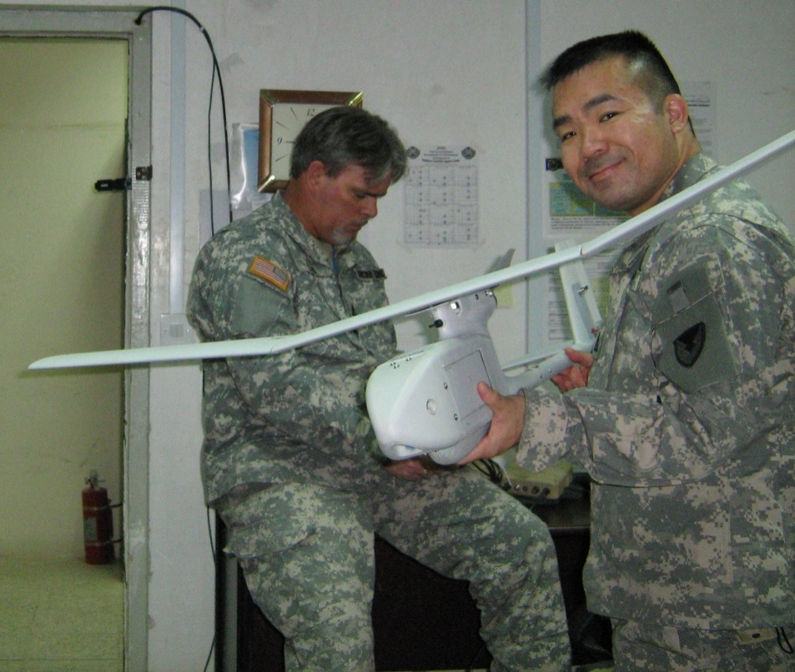
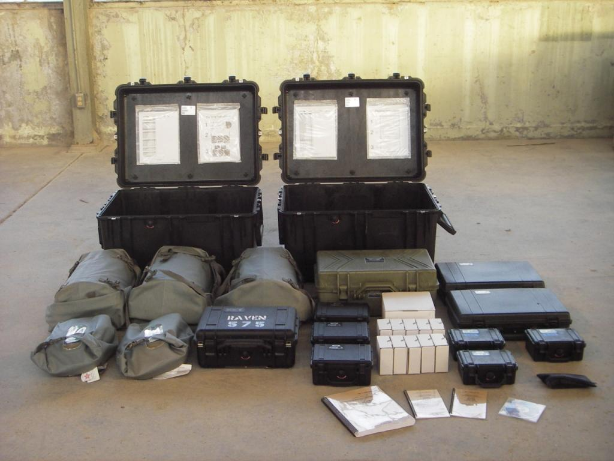
STRIKER/G/VLLD
UAV
RAVIN
The compact 3.8 pound Raven is an airplane, although a tiny one, with a wingspan of 4.5 feet. Launched by hand, it can observe targets up to 15 kilometers away from altitudes up to 1,000 feet. However, most missions are flown at 100 to 300 feet. '

Slide 15
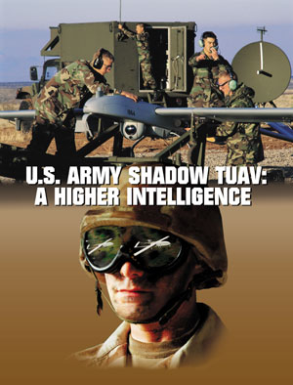
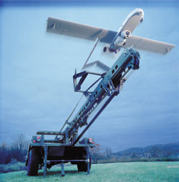
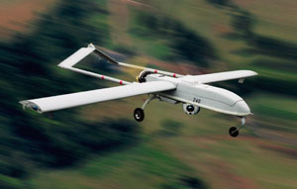
STRIKER/G/VLLD
UAV
SHADOW
The first in a new generation of UAVs, the compact Shadow™ TUAV system provides U.S. Army brigade commanders with crucial intelligence — delivered efficiently from its electronic payload directly to tactical command centers.

Slide 16
Logistics Asst. Reps (LARs) vrs Field Service Reps (FSRs)
LARs
Government personnel
Assigned to Unit to coach, mentor and teach
Monitors readiness on a daily basis
Actively supports Field exercises
Required to visit supported unit at least twice weekly and attend maintenance meetings
Not wrench turners
Unit contacts BLST Chief or LMS for concerns
FSRs
Contracted under various program managers within the LCMCs as primary technicians to service army equipment
Works w/BLST during NTC/JRTCs and when deployed
Wrench turners
Unit contact COR or PM for concerns

Slide 17
BLST TASK ORGANIZATION ISO ARFORGEN
BCT BLST
04 / CW4-5
LMS
DAC
BLST
LARS
FSRs
AMCOM- LCMC
CECOM-LCMC
TACOM -LCMC
JMC-LCMC
ASSIGNED
ASSIGNED (ASC)
OPCON WHEN REQUIRED
OTHER CMDs
COORDINATION

Slide 18
AMC BLST SUPPORT TO ARFORGEN
Resetting the Force
LOGFORGEN
Sustaining the Force
Reset
Left Behind Equipment (LBE)
Available
3
Reconstitute
APS
New
Equipment
APS
Contractor
Logistics
Support
Depots
LOGCAP
Depots
Director
of Logistics
Director
of Logistics
Field
Logistics Readiness
Centers
Theater Provided Equipment (TPE)
Field
Logistics Readiness
Centers
Technology
Insertion
Reestablish
Ammo War
Reserves
Life
Cycle
Mgmt Commands
Army
Life
Cycle
Mgmt Commands
Army
Sustainment
Sustainment
Brigades
Sustainment
Sustainment
Brigades
Joint
Logistics
Integration
Command
Command
Army
Field Support
Brigades
Army
Field Support
Brigades
Distribution
Management
Repair IAW TMs (10/20)
Reset
1
Training
Equipment
Train/Ready
2
Return
Logistics Synchronizer and Integrator for ARFORGEN
Notes:
AMC’s support to Army Force Generation is called LOGFORGEN.
This slide shows the steps and procedures for resetting and sustaining the force.

Slide 19
3BCT (BLST)
Brigade Logistics Support Team
BLUF: As the “Single Face for AMC”, BLST synchronizes and integrates all of AMC’s National Logistics Base capabilities to mitigate technical and sustainment material readiness problems for the BCT by commanding and controlling LCMC personnel and assets ISO ARFORGEN.

Slide 20
3BCT (BLST)
Brigade Logistics Support Team
Supporting the Warfighter
BLST
MAJ Dee’ Mosby (BLST Chief)
Mr. Gary Kandarczyk (LMS)

