Slide 1
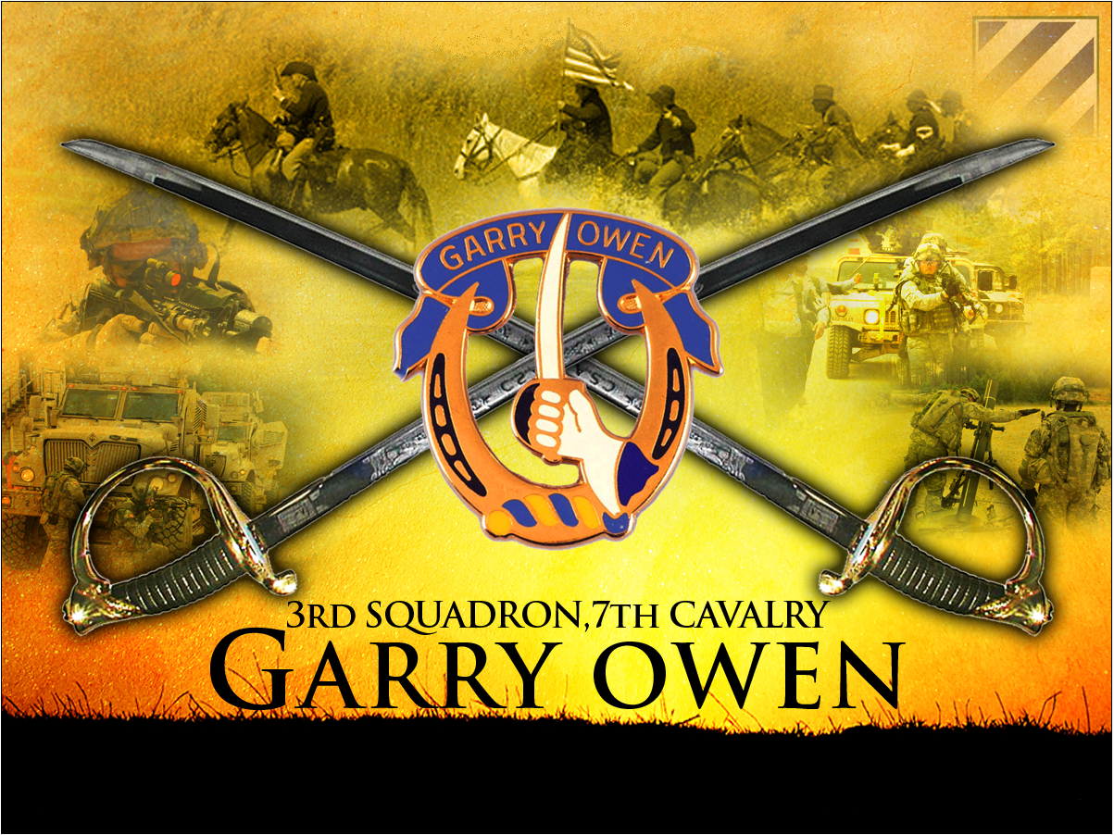
TACSOP
Draft Version: 15 June 2012

Slide 2
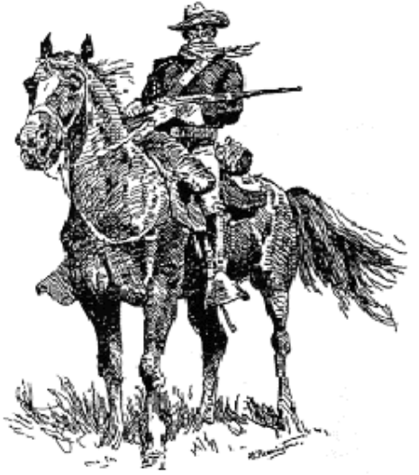
Saber Guidelines
LIVE THE ARMY VALUES
INTERNALIZE THE WARRIOR’S ETHOS
BUILD COHESIVE, CONFIDENT TEAMS
DON’T ACCEPT MEDIOCRICY IN PEACTIME
THAT YOU WOULD ACCEPT IN COMBAT
MASTER THE BASICS
MAINTAIN YOUR EQUIPMENT AS IF YOUR LIFE
DEPENDS ON IT – IT DOES
TREAT EVERYONE WITH DIGNITY AND RESPECT
TAKE CARE OF SOLDIERS, FAMILIES, AND
EACH OTHER
BE PHYSICALLY HARD, MENTALLY TOUGH, AND
MORALLY STRAIGHT
BE MORE THAN YOU APPEAR
IN ALL THINGS BE SAFE
MAINTAIN A POSITIVE ATTITUDE AND ACCOMPLISH GREAT THINGS
EVERY DAY
“Old Bill”
- Frederic Remington
“The discipline that makes the Soldiers of a free country reliable in battle is not to be gained by harsh or tyrannical treatment. On the contrary, such treatment is far more likely to destroy than to make an Army. It is possible to impart instructions and to give commands in such a manner and such a tone of voice to inspire in the Soldier no feeling but an intense desire to obey, while the opposite manner and tone of voice cannot fail to excite strong resentment and a desire to disobey. The one mode or the other of dealing with subordinates springs from a corresponding spirit in the breast of the commander. He who feels the respect which is due to others cannot fail to inspire in them regard for himself, while one who feels, and hence manifests disrespect toward others, especially his inferiors, cannot fail to inspire hatred toward himself”.
Definition Discipline—MG John M. Schofield, 11 August 1879

Slide 3

DEPARTMENT OF THE ARMY
HEADQUARTERS, 3RD SQUADRON, 7TH U.S. CAVALRY REGIMENT
FORT STEWART, GA 31315
2ND BRIGADE COMBAT TEAM, 3RD INFANTRY DIVISION
AFZP-VBE-C
15 June, 2012
MEMORANDUM FOR RECORD
SUBJECT: SABER TACSOP
Purpose. This TACSOP standardizes routine operations and procedures for how this
squadron organizes and fights in support of our higher headquarters. This will facilitate the
planning, preparation and execution of tactical operations. This TACSOP focuses on the
squadron’s core competencies of reconnaissance and security as conducted during Unified Land
Operations (ULO) in support of Overseas Contingency Operations (OSO)
Application and Scope. This TACSOP applies to all squadron operations during both combat
and training exercises. It applies to all organic, assigned, attached, OPCON units and
Supporting units operating within the squadron’s area of responsibility. Where the TACSOP and
subordinate unit SOPs are in conflict, the TACSOP takes precedence.
Organization. The TACSOP contains multiple sections that cover a myriad of topics from
task organization, to various checklists for specific operations. Whereas this SOP covers
multiple areas, it does not look to replace existing doctrine. Rather, it serves to outline points
specific to this squadron for both internal and external understanding.
4. Review and Changes. The Squadron Commander is the approval authority for all changes to this SOP. S3 CUOPS will coordinate proposed changes and periodically publish consolidated change documents. Submit recommended changes to the Squadron Operations Officer.
ACKNOWLEDGE:
//ORIGINAL SIGNED//
LANCE C. VARNEY
LTC, IN
Commanding
DISTRIBUTION: A
OFFICIAL: S3

Slide 4
Table of Contents 1
CARD | INTRODUCTION
100 | Squadron's Role
101 | Task Organization
102 | METL
103 | Fundamentals & Principles
104 | Marking SOPs / Battle Roster Numbers
 | CHECKLISTS
200 | Packing List
201 | Personnel PCC
202 | Vehicle PCC
203 | Leader PCC
204 | Weapon PCC / PCI
205 | General PCC / PCI
206 | Weapons & Uniform Postures
 | PLANNING
300 | Roles/Responsibilities and Enablers
301 | Task/Purpose & Terminology
302 | Graphic Control Measures
303 | Types of Rehearsals
304 | Confirmation Brief Format
305 | Commander Back Brief Format
 | MISSION COMMAND
400 | Succession of Command & Communications Structure
401 | Call Signs/Net Matrix
402 | Net Structure, Call Signs and Identifiers
403 | Net Control Station, Jamming/Deception & RETRANS
404 | COMSEC Compromise Procedure
G
G
G
G
G
G
G
G
G
G
G
G
G
G
G
G
G
G
G
G
G
G
G

Slide 5
Table of Contents 2
CARD | MOVEMENT & MANEUVER
500 | REDON Status
501 | Near/Far Recognition Signals & Linkup
502 | Passage of Lines
503 | Assembly Area Procedures
504 | Reconnaissance Fundamentals
505 | Establishing OPs
506 | Zone Reconnaissance
507 | Route Reconnaissance - Route Classification Formula
508 | Reconnaissance Overlay Symbols
509 | Screen & Area Security
510 | Movement to Contact
511 | Cordon & Search/Knock
512 | Air Ground Integration
513 | Establish HLZ
514 | 9 Line MEDEVAC w/MIST
515 | Air Assault Operations
516 | Urban Operations
517 | Dismount Drill for Hasty Reconnaissance
518 | Relief in Place
519 | Reconnaissance Handover & Adjacent Unit Coord.
520 | Tactical Road March
521 | Quick Reaction Force
522 | Traffic Control Point
523 | Vehicle Load Plans
524 | Patrol Checklist (AKA Trip Ticket)
G
G
G
G
G
G
G
G
G
G
G
G
G
G
G
G
G
G
G
G
G
G
G
G
G

Slide 6
Table of Contents 3
CARD | MOVEMENT AND MANEUVER (CONTINUED)
525 | Fundamentals of Security
 | FORCE PROTECTION
600 | FOB/ Combat Outposts
601 | Sector Sketch Example
602 | CBRNE
603 | NBC Warnings and Alarms
604 | Risk Management
 | FIRES AND EFFECTS
700 | Risk Assessment Distance
701 | Crater Analysis
702 | Artillery and Mortar Ranges
703 | Fire Missions
704 | Air to Ground Integration
 | INTELLIGENCE
800 | Processing EPWs / Refugees
801 | Detainee Packet
802 | Tactical Sensitive Site Exploitation
803 | Tactical Questioning
804 | Patrol Debrief Report
805 | Key Leader Engagement (KLE) Report
806 | TrIST SOP
 | SUSTAINMENT
900 | Organization
901 | Classes of Supply
902 | FLIPLs, Battle Loss & Absentee Baggage
G
G
G
G
G
G
G
G
G
G
G
G
G
G
G
G
G
G
G
G
G

Slide 7
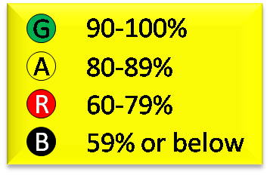
Table of Contents 4
CARD | SUSTAINMENT CONTINUED
903 | Recovery Procedures
904 | Medical Operations
 | REPORTS
1000 | Red 1 Personnel Daily Summary Report
1001 | Red 2 Personnel Battle Loss Report
1002 | Red 3 Personnel Requirements Report
1003 | Red 4 Casualty Feeder Card
1004 | Blue 1 SPOT Report/SPOTREP; SALUTE
1005 | Blue 2 Commander’s Report
1006 | Blue 3 Critical Information Report
1007 | Blue 4 Bridge, Overpass, Underpass, Culvert or Tunnel
1008 | Blue 5 Crossing Report/CROSSREP
1009 | Blue 7 Route Report/ROUTEREP
1010 | Blue 8 Closing Report
1011 | Blue 9 Obstacle Report
1012 | Blue 10 Bypass Report
1013 | Blue 12 UXO Report w/Instructions
1014 | Green 2 Sensitive Items Report
1015 | Green 3 Request for Information
1016 | Green 9 Detainee Report
1017 | Yellow 1 Equipment Status Report/ESTAT
1018 | Orange 1 Supply Status Report/Request
1019 | Orange 3 LOGSITREP
1020 | Orange 5 Battle Loss Report
1021 | NBC1 Report
G
G
G
G
G
G
G
G
G
G
G
G
G
G
G
G
G
G
G
G
G
G
G
G

Slide 8

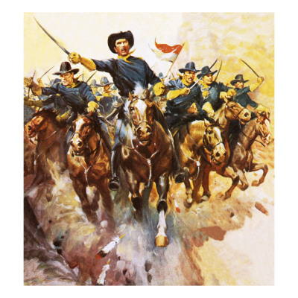


INTRODUCTION
100 | Squadron's Role
101 | Task Organization
102 | METL
103 | Fundamentals & Principles
104 | Marking SOPs / Battle Roster Numbers

Slide 9
100
Introduction
Squadron’s Role
The fundamental role of the squadron is conducting reconnaissance or security missions in support of its higher headquarters. The squadron progressively builds situational awareness (SA) of the OE for the higher commander. The combat information provided by the squadron enables the higher commander to develop situational understanding (SU), make better and quicker plans and decisions, and visualize and direct operations. The squadron employs unique combinations of reconnaissance and security capabilities to successfully meet the information challenges intrinsic to the spectrum of conflict. The squadron’s reconnaissance operations yield an extraordinarily high payoff in the areas of threat location, disposition, and composition, early warning, protection, and battle damage assessment (BDA). This preserves its parent unit’s freedom of maneuver and initiative over the enemy. Skillful reconnaissance operations allow the commander to shape the battlefield, ideally accepting or initiating combat at times and places of his choosing and applying combat power in a manner most likely to achieve his desired effects.
-FM 3-20.96, Role of the Squadron

Slide 10
Card 101
Introduction
Task Organization (1 of 3)
1. TASK ORGANIZATION: The Squadron organizes to accomplish assigned missions. To the extent possible, the Squadron maintains habitual associations of combat support units. The Squadron cross-attaches units in accordance with the brigade task organization.
HHT
SQDN COMMAND GROUP
2 X M3A3CFV (Squadron Commander and S-3)
3 X M1038 HMMWV (XO, CSM and Squadron Commander [when not in CFV])
S-1 / S-4 Section
2 X M1038 (S-1 and S-4) (S-4 has M1101 Trailer High Mobility)
1 X M1068 (Supply) w/ M1101 Trailer High Mobility
1 X M1078 (Human Resource) w/ M1082 Trailer Cargo
S-2 / ISR Section
1 X M1068 (Tactical Intel. Officer) w/ M1101 Trailer High Mobility
1 X M1038 (S-2) w/ M1101 Trailer High Mobility
S-3 Section
1 X M1038 (S-3 [when not in CFV])
1 X M1068 (2 ASST S-3, OPS SGM, CHEMO)
1 X M1078 (NBC NCO) w/ M1082 Trailer Cargo
1 X M1114 HMMWV
Troop HQ
2 X M1038 (HHT Commander and 1SG [1SG w/ M1101 Trailer High Mobility])
1 X M1083 (Supply) w/ Trailer Tank Water 900 Gal. (Camel)
1 X M1078
S-6 Section
4 X M1038 (S-6 and 3 X RTRNS TMS) w/ M1101 Trailer High Mobility
1 X M577 (Section Chief)
1 X M1097 w/ PU 798
1 X CPN: OM-XXX
Medic Treatment Platoon
1 X M1025 (MEDO)
Treatment Squad w/ 2 X M977A1 Medical Treatment Vehicle & 1 X M1078 LMTV
4 X Ambulance Squad w/ 2 X M113A3 Ambulance
Unit Ministry Team
1 X M1025 (Chaplain)
USAF Augmentation
1 X M1025 (USAF Personnel)
Fire Support Element
1 X M1068 (FSO)
3 X Fire Support Platoon w/ 1 X M7 Fire Support Vehicle (Troop FSOs)

Slide 11
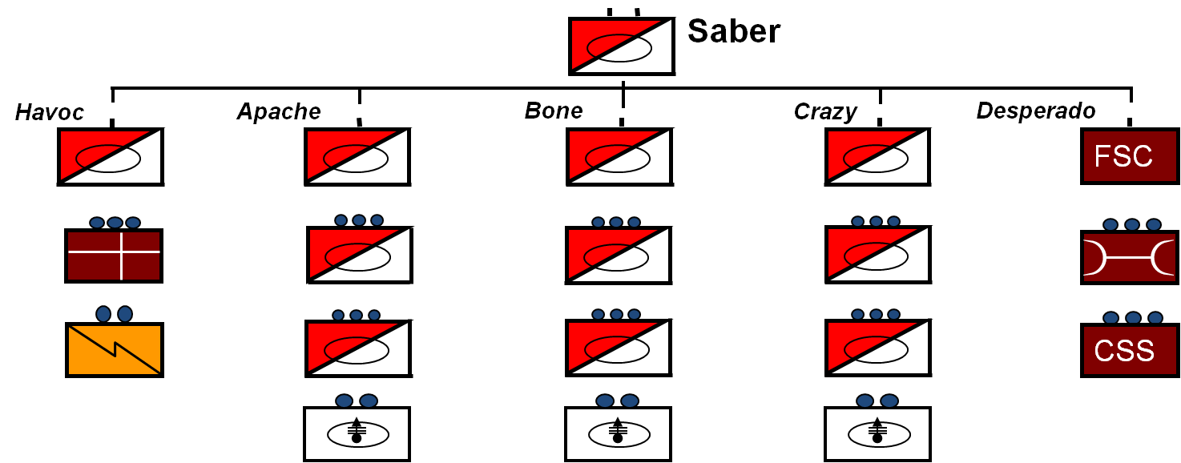
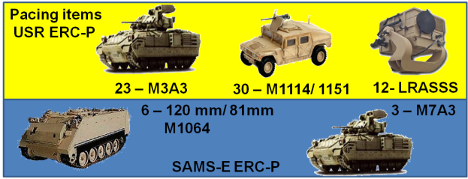
Card 101
Introduction
Task Organization (2 of 3)
LINE TROOPS (A, B, C):
HQ Section
1 X M3A3CFV (Troop Commander)
1 X M1068 (Troop XO)
1 X M113A3 (Troop 1SG)
1 X M1083 (Supply) w/ Trailer Tank Water 900 Gal.
(Camel)
2 X M1038 HMMWV (Commander and XO when not in CFV)
2 X Scout Platoons
3 X M3A3CFV Each
5 X M1114 HMMWV Each
Mortar Section
1 X M1038 HMMWV w/ M1101 Trailer High Mobility
1 X M1064 Mortar Carrier
1. The following standard sustainment packages accompany detached Troops.
BFIST(optional)
Medical Evacuation Team (M113)
Maintenance Team
M88 Recovery Vehicle
Maintenance M113
PLL Truck with Trailer
Tool Truck with Trailer
Basic Loads (UBL) of CL I, II
III (P), IV,V,VIII, and IX
2 Fueler
2 Cargo HMMT
2. All attached units will keep their organic call signs IAW the BDE TACSOP. In addition the attached unit will operate using their organic SOI frequencies.
3. Maintenance and Medical Team relationships are habitual.

Slide 12
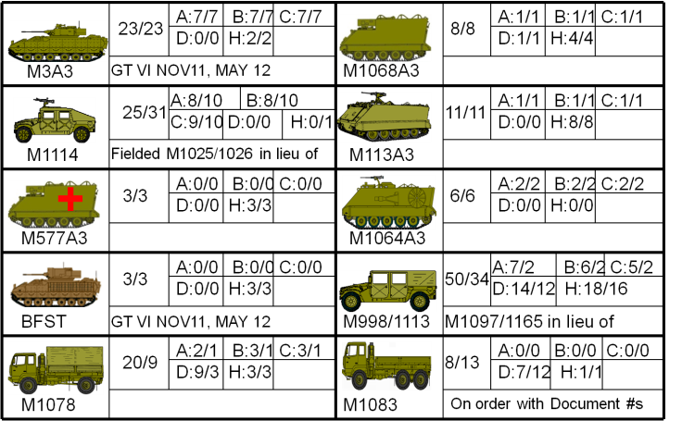
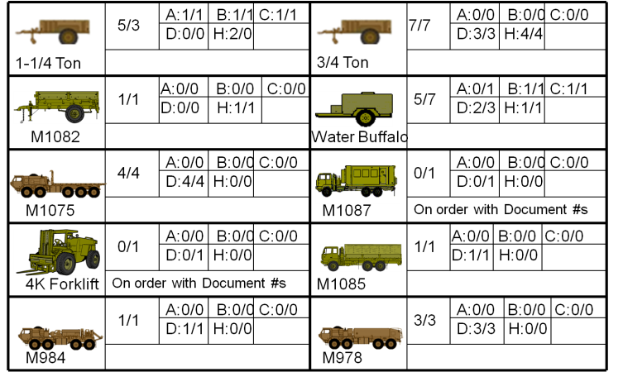
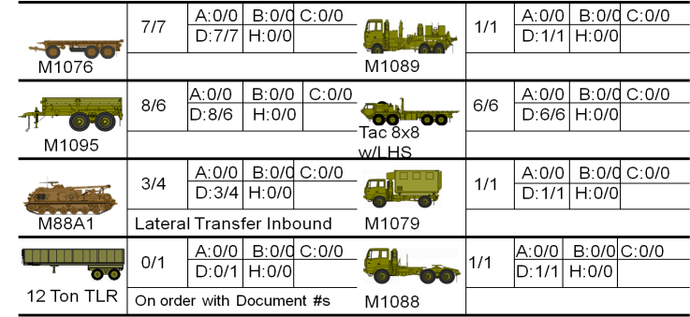
Card 101
Introduction
Task Organization (3 of 3)
DESPERADO TROOP
HQ Section
1 X M1038 HMMWV (Troop Commander)
1 X M1068
2 X M1078 w/ 1 X M107A2 & 1 X M1101 Trailer High Mobility
Field Feeding Section
3 X M1038 HMMWV w/ M1101 Trailer High Mobility
2 X M1083 w/ M107A2
Distribution Platoon
1 X M1038 HMMWV (PL)
General Supply Section
  3 X M1075 HEMTT
  2 X M1083 MTV
CLIII and Water Section
  1 X M1083 MTV
  1 X M985 HEMTT w/ M1095 Trailer Cargo
  3 X M978 HEMTT POL Tanker
CLV Section
  3 X M1075 HEMTT w/ M1076 Trailer PLS
  2 X M1083 MTV w/ M1082 Trailer Cargo
Maintenance Platoon
1 X M1038 HMMWV (PL)
Maintenance Control Section
  1 X M1088 MTV w/ M129A3
  2 X M1038 HMMWV
Service / Recovery Section
  1 X M88A1
  2 X M984A1
  1 X M1089 HEMTT
  1 X M 1078 LMTV
Maintenance Section
  1 X M1038 HMMWV
  1 X M1113 HMMWV
  3 X M1083 MTV w/ M1095 Trailer Cargo
  5 X M 1078 LMTV w/ 3 X M1082 Trailer Cargo
3 X Maintenance Support Section
  1 X M1113 HMMWV
  1 X M1038 HMMWV
  1 X M1083 MTV w/ 1 X M1095 Trailer Cargo & 1 X M1082 Trailer Cargo
  1 X M88A1
Squadron Roll-up
Vehicle | Max Range
M3A3 | 300 miles
M1114 | 275 miles
M1064A3 | 300 miles
M1068A3 | 216 miles
M113A3 | 275 miles
M577A3 | 275 miles
M998/M1113 | 275 miles

Slide 13
102
Introduction
METL
Conduct Mission Command
Execute the Operations Process
Conduct the MDMP Process (71-8-5111)
Execute Tactical Operations (71-8-5131)
Develop ISR Plan (71-8-2321)
Control ISR Ops (17-6-1007)
Coord. AGI and CCA (01-6-0436)
Conduct Tactical Reconnaissance
Conduct Area Reconnaissance
Conduct Zone Reconnaissance
Conduct Route Reconnaissance
Conduct Security Operations
Conduct Screen
Provide Area Security
Conduct Stability Operations
Conduct Public Order and Safety
Conduct Sustainment Operations
Conduct Sustainment Operations
Conduct Tactical Movement (07-2-1342)
Conduct Bypass (07-2-9002)
Conduct a Linkup (07-2-9005)
Conduct Passage of Lines as Passing Unit (07-2-9006)
Conduct Fire and Movement (17-2-0222)
Infiltrate/Exfiltrate (17-2-0320)
Breach Covertly (17-2-3071)
Conduct Route Reconnaissance (17-2-4000)
Reconnoiter an Area or Zone (17-2-4010)
Conduct Reconnaissance Handover (17-2-4025)
Conduct Tactical Convoy (55-2-4003)
Integrate Indirect Fire Support (07-2-3036)
Conduct Passage of Lines as Stationary Unit (07-2-9006)
Conduct Target Acquisition (17-2-4017)
Conduct a Screen (17-2-9225)
Conduct a Raid (07-2-9008)
Conduct Area Surveillance (17-2-0415)
Conduct Site Exploitation (17-2-9400)
Secure Civilians during Operations (07-2-4054)
Conduct Presence Operations (17-2-0404)
Secure a Base camp (17-2-2633)
Supervise Escort of Detainees (19-2-3503)
Conduct Convoy Security (19-3-2007)
Conduct Roadblock and Checkpoint Ops. (19-3-2406)
Perform Risk Management (63-2-4326)
Treat Casualties (08-2-0003)
Conduct Hasty Displacement (63-2-4-23)
Defend Unit Area (63-2-4024)
Perform Withdrawal Under Fire (63-2-4025)
Reorganize Unit Defense (63-2-4026)
Provide Class I, II, III(P), IV,) VII and IX Supplies (10-2-4002)
Conduct LOGPACK Ops. (63-2-4546)
Perform Vehicle Recover (43-2-0001)
Perform BDAR (43-2-0002)
Conduct Field Maintenance Ops. (43-2-4373)
Maintain Communications (63-2-4017)
Perform Field Sanitation (08-2-0002)
Conduct Food Service Ops. (10-2-0057)
Establish a Field Kitchen Site (10-2-0058
Conduct Replenishment/Sustainment Ops (63-2-4000)
Note: Duplicated tasks are not repeated within yellow boxes for each task group.

Slide 14
103
Introduction
Fundamentals & Principles
Mission | Squadron | Troop
Zone Recon- A form of reconnaissance that involves a directed effort to obtain detailed information on all routes, obstacles, terrain and enemy forces within a zone defined by boundaries
Considerations: Threat, Society, Infrastructure, Terrain, Reporting | Zone recon may transition into screen along LOA. In this case the SQDN will BPT transition into a 20-30km frontage. | May be tasked to conduct Zone, Area or Route recon in support of SQDN mission.
Area Recon- A form of reconnaissance operations that is directed to obtain detailed information concerning the terrain or enemy activity within a prescribed area.
Considerations: Threat, Society, Infrastructure, Terrain, Reporting | May closely resemble a zone recon in that subordinate units may execute, zone, area or rte recon in support of the SQDN mission | May be tasked to conduct Zone, Area or Route recon in support of SQDN mission
Route Recon - A directed effort to obtain detailed information of a specific route and all terrain from which the enemy could influence movement along that route
Considerations: Tempo and Focus (enemy, and or trafficability) | Can recon up to 6 routes simultaneously | Can recon up to two routes simultaneously
Fundamentals of Reconnaissance
1. Ensure continuous reconnaissance.
2. Do not keep reconnaissance assets in reserve.
3. Orient on the reconnaissance objective.
4. Report all information rapidly and accurately.
5. Retain freedom of maneuver.
6. Gain and maintain enemy contact with the smallest
element possible.
7. Develop the situation.
Troop Leading Procedures
1. Receive and Analyze the Mission
2. Issue WARNORD
3. Make a Tentative Plan
4. Initiate Necessary Movement
5. Conduct Reconnaissance
6. Finalize the Plan
7. Issue the OPORD
8. Supervise
Forms of Contact
1. Visual
2. Direct Fire
3. Indirect Fire
4. Obstacle
5. Aircraft
6. Electronic
7. NBC & Smoke
8. Non-Hostile (Non-Lethal)
Actions on Contact
1. Deploy and report
2. Evaluate and Develop the Situation
3. Choose and Recommend A COA and Maneuver the Force
4. Execute the Course of Action

Slide 15

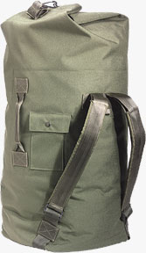
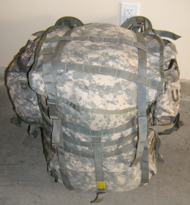
104
Introduction
Marking SOPs
JS1234
J- First Initial
S- Last Initial
1234- Last 4 of SSN
Kevlar Band
Right Ear
Last Name
Left Ear
Battle Roster
Number
COLORED 100-MILE/HOUR
TAPE WITH SOLDIER’S
NAME AND UNIT
COLOR CODES
2 BCT
BN colors: IN BN is blue, AR BN is yellow etc..
CO colors: HHCs are yellow, A Cos are blue etc..
SHOE TAG IN DUFFLE BAG POCKET and RUCKSACK INSIDE FLAP
BDE color
BDE TAPE COLOR
BDE
BN
CO
NAME
UNIT
Duty Station
1-30 IN (BLUE)
1-64 AR (YELLOW)
3-7 CAV (GREEN)
1-9 FA (RED)
2-3 BSTB (WHITE)
26 BSB (OLIVE)
HHC BDE (BLACK)
HHC (YELLOW)
ACO (BLUE)
BCO (GREEN)
CCO (ORANGE)
DCO (OLIVE)
ECO (WHITE)
FCO (RED)
GCO (BLACK)
HHT
2BCT
CO TAPE COLOR
BDE TAPE COLOR
BN TAPE COLOR
3-7 CAV
BLACK
BN TAPE COLOR
NOTE: Units will wrap the appropriate color tape around the bags as shown in the illustration. Tape should be marked with a permanent marker with the soldier’s name and unit. Soldiers should also place a shoe tag with name, unit and duty station in the pocket of the duffel bag and in on e of the cargo pockets on the rucksack. The bottom of the duffle bag will be painted desert tan with the last 4, last name, and unit stenciled in black 2” letters. The colored 100 mile/hour tape can be purchased at the local VIP store, SSSC, or through the supply channel.
4321
SMITH
HHT 3-7 CAV

Slide 16
CHECKLISTS
200 | Packing List
201 | Personnel PCC
202 | Vehicle PCC
203 | Leader PCC
204 | Weapon PCC / PCI
205 | General PCC / PCI
206 | Weapons & Uniform Postures

Slide 17
200
Checklists
Packing List (1 of 2)

Slide 18
200
Checklists
Packing List (2 of 2)
Commanders may modify the packing list based on the season and specific mission.

Slide 19
201
Checklists
Personnel PCC
 | ITEM | COMMENTS
 | Green 2/SI List
 | ACH with NVG Mount
 | Eye Protection
 | ID Tags & ID Card
 | Driver’s License & Accident Avoidance
 | 9 Line MEDEVAC w/ MIST format
 | 9 Line UXO
 | CBRNE (mask/JLISS) as needed
 | Casualty Feeder Card
 | Sensitive Items List (Leaders)
 | Battle Roster Numbers
 | Pen/Paper
 | Spare Batteries
 | Body Armor
 | Groin Protector
 | Neck Protector
 | Camelbak
 | Gloves
 | Knee Pads
 | Ammunition Basic Load
 | IFAK
 | NVG's
 | Weapon
 | Mission & ROE/EOF Back Brief
 | PIR, BOLO List Back Brief

Slide 20
202
Checklists
Vehicle PCC (1 of 2)
 | ITEM | COMMENTS
 | Green 2/SI List
 | 9 Line MEDEVAC w/MIST Format
 | Commo Card
 | Vehicle Bump Card
 | Current 5988E
 | Fuel Status
 | Fluids (UBL of POL on board)
 | Lights
 | Fire Extinguisher
 | Windows Cleaned
 | Equipment Tie Down
 | Litter
 | Fire Blanket
 | Tow Strap
 | Concertina Wire
 | Cones
 | 5 Gallon Water Can
 | MRE's
 | Binos (PSG/PL)
 | CLS Bag
 | Warning Triangle
 | Slave Cables
 | Vehicle Jack
 | Tool Bag
 | Pamphlet Bag

Slide 21
202
Checklists
Vehicle PCC (2 of 2)
 | ITEM | COMMENTS
 | Radio Checks
 | FBCB2 on and Tracking
 | Basic Load for Crew Serve Weapons
 | Weapons Lubed
 | Mounted
 | Function Check
 | Cleaning Kit
 | Turret Operational
 | SSE Kit
 | Hooligan Tools
 | HLZ Marking Kit
 | Smoke
 | IR Chemlights
 | VS-17 Panel w/Radio Freq. on Veh.
 | Extra Batteries (PSG)
 | Dismount Kit
 | Applicable FMs
 | Copy of TACSOP
 | CIED Equipment as needed/available
 | Duke System in ready pos. (prior to SP)
 | Rhino is on and functional

Slide 22
203
Checklists
Leader PCC
 | ITEM | COMMENTS
 | Communications (FH/SC, TIME, ANCD, SOI)
 | DAGR / PLGR
 | Map / Compass / Protractor
 | Binoculars
 | Control Measures / Graphics / FS Plan
 | Chalk Cards
 | Assembly Aids
 | Acetated Sector Sketches (2)
 | Terrain Model Kit (1 x Plt)
 | Universal Borelight Target
 | Convoy Briefing Card
 | Sensitive Items Inventory Card (PL/ PSG/SL)
 | Unit Status Card (PL/PSG)
 | Chemical Defense Equipment/M256 KIT
 | CL V for Signaling
 | Whistle
 | Risk Assessment Card
 | Alcohol Pens / Paper
 | Extra 1155 / 1156s
 | Distress Panel (ACH)
 | 9 Line w/MIST Format
 | Call for Fire & 9 Line CAS Format
 | PIR & BOLO Lists

Slide 23
204
Checklists
Weapons PCC / PCI (1 of 3)
M9
Serviceable holster w/ lanyard attached
Passes function check
All magazines are serviceable and properly feed and release from weapon
Adequately lubed
M4
Passes function check
M68/PEQ-2 / PEQ-15 & Tac-Light secured IAW SQDN SOP
PEQ-2 / PEQ-15 w/pressure switches bore sighted and zeroed
x2 AA batteries & x1 M68 battery in pistol grip of in pistol grip with green 100mph tape
All magazines are serviceable and properly feed and release from weapon
Adequately lubed
Serviceable sling
M320/M203
Passes function check
M68/PEQ-2/PEQ-15 & Tac-Light secured
PEQ-2 / PEQ-15 w/pressure switches bore sighted and zeroed
Day/Night Sight & Leaf sight operational
M320/M203 ammo pouches present and serviceable
M249
Passes function check
M145/PEQ-2/PEQ-15 secured
PEQ-2 / PEQ-15 w/pressure switch bore sighted and zeroed
x2 100 rd assault pouch present and serviceable
Serviceable sling (Bulldog Sling ideal)

Slide 24
204
Checklists
Weapons PCC / PCI (2 of 3)
M240B
Passes function check
PEQ-2/PEQ-15/M-145 mounted / secured / borelight zeroed
Tripod complete
Spare barrel / case / BII complete
T&E / Pintle
Ammunition bag
Acetated Range Cards
Serviceable sling
M2
Leaders check headspace & timing (if required due to model)
Passes function check
PAS-13/PEQ-2 mounted / secured / borelight zeroed
M3 Tripod complete
Spare barrel and bag complete (glove)
T&E / Pintle
Acetated Range Cards
Head Space & Time Gauge
Carrying Handle
MOD 93 serviceable and pins lightly lubed
T&E Present, zeroed, and serviceable
CLP present
MK-19
BEFORE” PMCS TM 9-1010-230-10 STANDARDS ALWAYS!
Passes function check
M3 Tripod / Gun cover / Cleaning Kit
T&E / Pintle / MK64 w/ pins / MOD 9
Ammo Tray / Feed Throat / Brass Catcher Bag
LSAT present
Acetated Range Cards

Slide 25
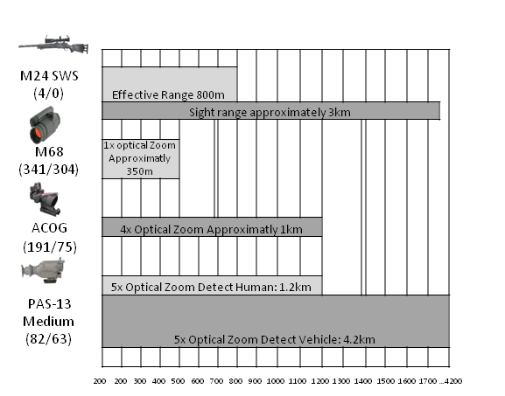
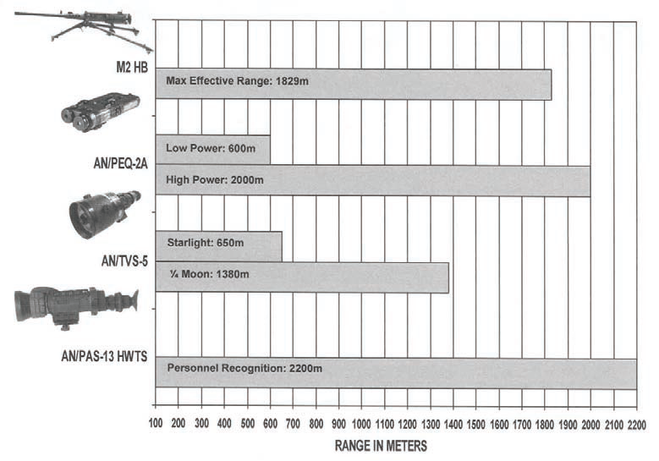
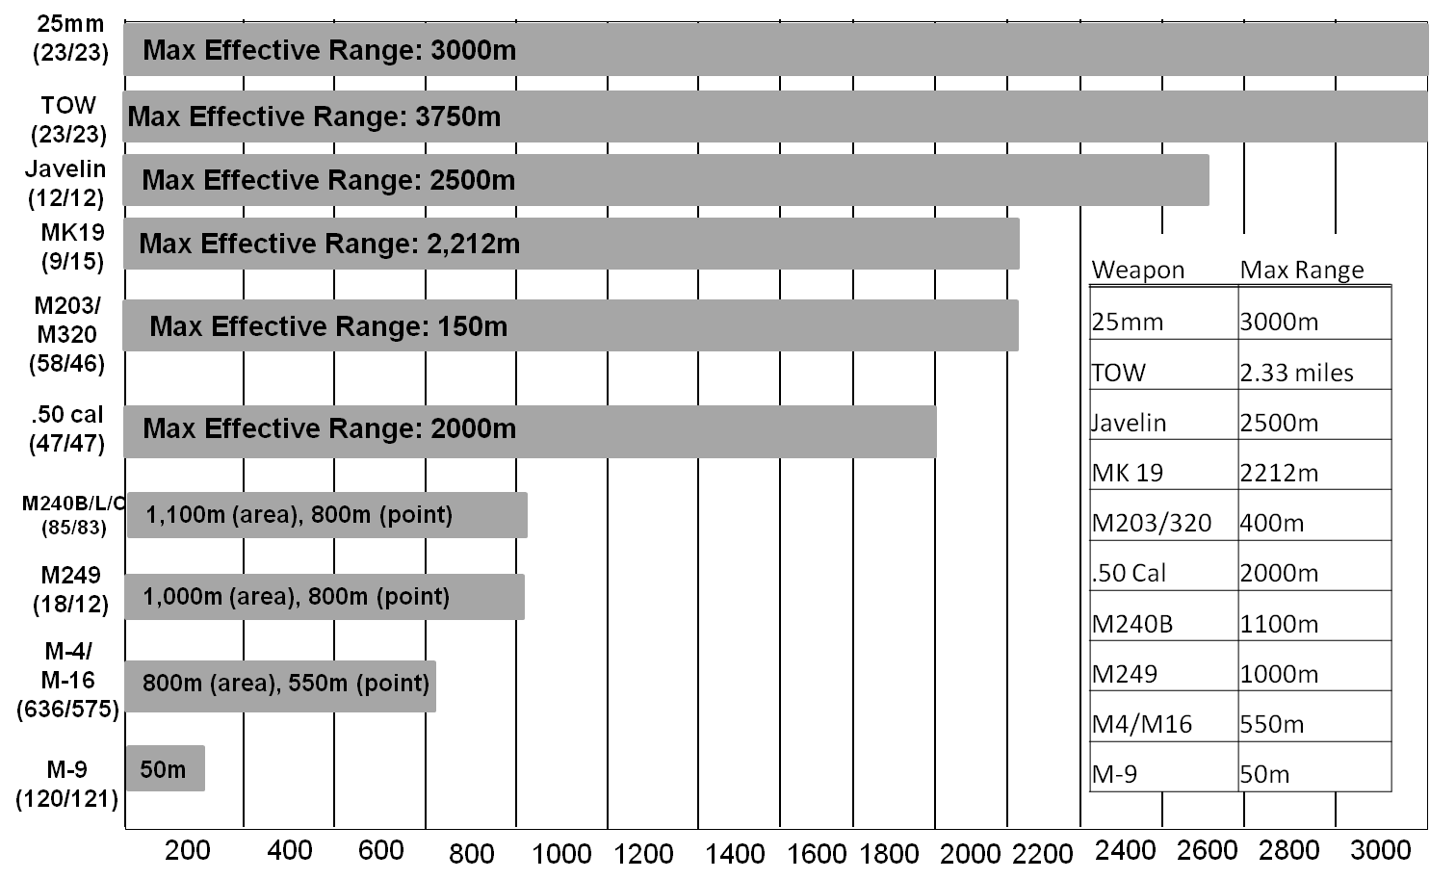
204
Checklists
Weapons PCC / PCI (3 of 3)
AT-4
Front/rear membrane present and serviceable
Transport safety pin and lanyard present
Front/rear sight posts present and spring loaded
No cracks or damage to tube body
PEQ-2/PEQ-15 mounting bracket
TOW
Tripod
Traversing unit
Day / Night sight operational
Collimator
Cables / BPC / Spare Battery Box
Rechargeable batteries
Lens paper / soft brush / equipment
cover
Acetated Range Cards
JAVELIN
Command Launch Unit (CLU)
Extra Battery Cooling Unit (BCU)
Acetated Range Cards
Sling
Lens paper
/ rag

Slide 26
205
Checklists
General PCC / PCI (1 of 5)
GENERAL
Weapons and Ammunition
  Complete Basic Load
  Weapons clean and function checks
  Weapons zeroed / sights zeroed
  Mounted items tied down
Maps and Graphics
  All operation graphics on each vehicle
  Compass/ GPS
Uniforms and Equipment
  Body armor with plates
  Ballistic Eye Protection, Gloves, knee & elbow pads
Soldier understanding of mission and individual responsibilities
Communications and ANCD, to include operating frequencies in area
  Mounted and Dismounted Commo (batteries, handsets)
  Short and Long Range Commo Checks
  MEDEVAC Freq
Binoculars
Class IV UBL
Rations and water (3 DOS)
Pyro, Smoke, Panels
Zip Ties / Flex Cuffs / Blindfolds
Surgical Gloves
CLS Bags
Interpreter or Language Smart Book
Detainee Sheets
Knowledge of Air units in area
Locations of contact prior 48 hours
Waypoints entered into GPS/BFCB2
  AXP, CCP, Routes (Primary and Alternate)

Slide 27
205
Checklists
General PCC / PCI (2 of 5)
NVGs
  Operational
  Spare Batteries
  Helmet mounts mounted
  Security strap for NVGs
Test Fire
Deficiencies noted in earlier inspection
Rehearsals
RTO / COMMUNICATIONS
Equipment operational
FREQs / FH set
Time correct
Commo / MEDEVAC / Call for Fire card
Short whip / long whip serviceable
Two hand sets operational / waterproofed / attached
Antennas operational / tied down
ANCD / SOI
Wire / Black electrical tape
COMMEX
spare batteries
PLGR
Execution checklist
reports / TACSOP

Slide 28
205
Checklists
General PCC / PCI (3 of 5)
MEDIC / CLS / AID & LITTER
Litters / SKEDCOs / Pole-less Litters
Class VIII inspection (CLS / medic bag)
Chemlights (blue / IR)
CLS Bags (1 per maneuver unit)
Aid bags (1 per medic)
IVs / starter kits
Field dressings
Flashlights (white and red lens)
Book of DA Form 1155/56s
EPW & SEARCH TEAM
Flex cuffs / prussic ankle / handcuffs
Gags
EPW processing tags
Black / gray / white list
Blind folds
Sand bags
White light
100 mph tape
ROE
DEMO TEAM
Explosives inspected / prepped
Time fuse tested / cut
DET cord inspected
Crimpers / tape measure
Electrical / Non-Electrical initiating devices
Cross leveling of explosives / detonators
Stop watch / chronograph
100 mph tape
Black electrical tape

Slide 29
205
Checklists
General PCC / PCI (4 of 5)
AIRBORNE OPERATIONS
ACH complete
M1950 weapons case w/ personnel weapon
NODS w/ ¼” inch cotton webbing tired around neck
MOLLE rigged w/ single point harness release
Camelbak / knee pads / IR flag
HPT lowering line
Assembly Aid (Steiner Aid)
Red / Green chemlight
Airborne Buddy
AIR ASSAULT
TD Point marking kit
Safety gear (goggles / gloves / hearing protection / grounding rod)
Chemlights / VS-17 panels / BB lights
Antennas removed / tied down
Communication / COMMEX
LDR Chalk cards
Sling sets
100 mph tape / 550 cord / ¼’” cotton webbing
Extra handsets for C2 AC (headsets)
Marking for bump personnel
Load certification cards
AMB products (key leaders)
Vehicles ¾ full
Copies of manifests for PZSO / Pilots
URBAN PATROLLING
Laser Pointers
Dismount Commo Kit
Location of Adjacent Units

Slide 30
205
Checklists
General PCC / PCI (5 of 5)
RAID/CORDON AND SEARCH
Breaching materials
Weapons Lights
CLS / Trauma Aid Bag
Cleared Building Marking Material
Mine Detectors
Detainee Kits
STATIC SITE SECURITY
Classes I/III/IV/V for three days
Binos and tripods
Sandbags
Other barrier materials
Overlay for Sectors of Fire
Fires Matrix for localized TRPs
BUILDING DEFENSE IN MOUT
Laser Pointers
Sandbags
Class IV
Sectors of Fire
TRAFFIC CONTROL POINT
Class IV
Flashlights
Pry Bar
Mirrors
Dual Language Signs
NVGs / Batteries

Slide 31
206
Checklists
Weapons & Uniform Postures
Uniform Status.
1. Uniform Posture Level 1 (U1).
A. Duty uniform (ACU or IPFU), weapon, ballistic goggles, and one magazine of ammunition.
B. Normal uniform at MOPP 0 (available within two hours).
2. Uniform Posture Level 2 (U2).
A. Duty uniform, Kevlar, Interceptor body armor, full basic load of ammunition, and ballistic goggles.
B. Temporary wear of elevated posture with a time frame.
C. MOPP level dictated by higher.
3. Uniform Posture Level 3 (U3).
A. Same as U2 posture, but maintained until further notice.
B. MOPP level dictated by higher.
4. Uniform Posture Level 4 (U4).
A. Same as U3 posture with combat earplugs and AMBER arming stance.
B. MOPP level dictated by higher.
5. Uniform Posture Level 5 (U5).
A. Same as U3 posture with combat earplugs and RED arming stance.
B. MOPP level dictated by higher.
Ammunition Status.
A. Red: Round chambered and magazine loaded.
B. Yellow: Magazine loaded and chamber clear.
C. Green: Magazine out and chamber clear.
2. Weapons Control Status.
A. Hold: Engage only if engaged or ordered to do so. Must have PID.
B. Tight: Can engage if target is positively identified as enemy.
C. Free: Can engage unless target is positively identified as friendly.
NOTE: Do not carry your weapon on anything but safe – you will transition only when prepared to fire.

Slide 32
PLANNING
300 | Roles/Responsibilities and Enablers
301 | Task/Purpose & Terminology
302 | Graphic Control Measures
303 | Types of Rehearsals
304 | Confirmation Brief Format
305 | Commander Back Brief Format

Slide 33
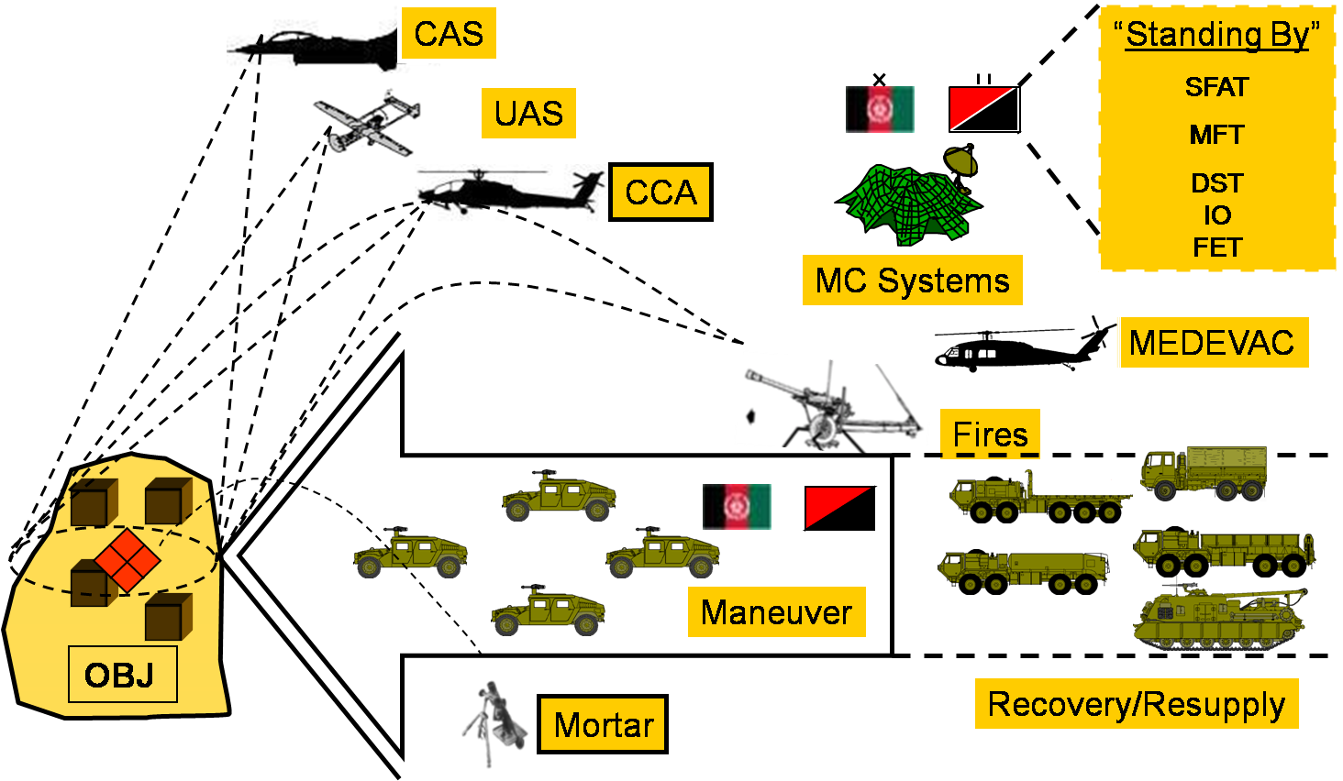
300
Planning
Roles, Responsibilities & Enablers
Squadron
Troop
Determine priorities / provide focus and guidance
Develop / Refine / Submit CONOP
- Receipt of time-sensitive-intelligence
- Review/Refine BDE’s target packet and send to subordinate units
- CM: KLE, Resource, Synch
FSCM
Refine / establish control measures
SOF integration – planning, resourcing, Mission Command
Issue FRAGO
- HCT employment
- Coordinate with local Government
- AASLT: AATFC or GTC
- ISF assessment / integration
- Lethal/ non-lethal targeting
- Synchronize airspace
PZ Security (Control?)
- Tactical Screening
Detainee processing
Casualty evacuation
Route Clearance nomination
CERP management/ contracting
Quick Reaction Force
CIED AO Assessment
- Determine priorities / provide focus and guidance
- Nominate CONOP, Troop Leading Procedures
- Surveillance / security
- CM: KLE, Immediate Action
- Call For Fires
Positive target identification
SOF – TLPs, Execution, TTPs
Site Exploitation
Tactical questioning
Front line for engagement with populace
AASLT ---GTC, Actions on OBJ
ISF training/ integration
Lethal/ non-lethal targeting
Air Ground Integration
Detainees at POC
1st responders / EMTs / MEDICs
- Route Clearance nomination
CERP payment
CIED Execution
Enabled, Synchronized Operations

Slide 34
301
Planning
Task/Purpose & Terminology (1 of 2)
TASK: What must be done--clearly defined and measurable activity accomplished by individuals and units:
PURPOSE: (In order to…)Why it must be done & takes precedence over TASK
The main effort’s purpose relates to your unit’s purpose; Supporting effort’s purpose relates to the accomplishment of your own unit’s main effort’s purpose
It is the unique contribution only your unit makes to the commander’s concept at the decisive point and time
Ambush: A surprise attack by fire from concealed positions on a moving to temporarily halted enemy.
Attack by Fire: A tactical msn task in which a Cdr uses direct fires, supported by indirect fires, to engage an enemy with out closing with him to destroy, suppress, fix, or deceive him.
Breach: A tactical msn task in which the unit employs all available means to break through or secure a passage through an enemy defense, obstacle, minefield, or fortification.
Block: Denies the enemy access to an area or prevents his advance in a direction or along an avenue of approach.
Bypass: A tactical msn task in which the unit maneuvers around an obstacle, position, or enemy force to maintain the momentum of the opn while deliberately avoiding combat with an enemy force.
Canalize: The Cdr restricts enemy movement to a narrow zone by exploiting terrain coupled with the use of obstacles, fires, or friendly maneuver.
Clear: The commander removes all enemy forces and eliminates organized resistance within an assigned area.
Contain: Requires the Cdr to stop, hold, or surround enemy forces or to cause them to center their activity on a given front and prevent them from withdrawing any part of their forces for use elsewhere. Counterattack: A form of attack by part or all of a defending force against an enemy attacking force, with the general objective of denying the enemy his goal in attacking.
Delay: Slow & defeat as much of the enemy as possible without sacrificing tactical integrity of the unit; presents low risk to the unit.
Destroy: Physically renders an enemy force combat-ineffective until it is reconstituted. To destroy a combat system is to damage it so badly that it cannot perform any function or be restored to a usable condition without being entirely rebuilt.
Disrupt: Cdr integrates direct and indirect fires, terrain, and obstacles to upset an enemy formation or tempo, interrupt his timetable, or cause his forces to commit prematurely or atk in a piecemeal fashion.
Fix: Commander prevents the enemy from moving any part of his force from a specific location for a specific period.
Follow and Assume: A 2nd committed force follows a force conducting an offensive opn and is prepared to cont. the msn if the lead force is fixed, attritted, or unable to cont.
Follow and Support: A committed force follows and supports a lead force conducting an offensive operation.
Enemy |  | Terrain | Friendly
Assault Attack By Fire Block Bypass Canalize Contain Defeat Delay Demonstrate Destroy Exploit | Feint Fix Interdict Isolate Neutralize Penetrate Pursue Recon Rupture Suppress | Clear Occupy Recon Retain Secure Seize | Breach Cover Disengage Displace Follow Follow and Support Follow and Assume Guard Exfiltrate Infiltrate Occupy | Overwatch Screen Support by fire Disengage Reserve Retire
Allow Cause Create | Deceive Deny Divert | Draw Enable Envelope | Influence Open Prevent | Protect Support Surprise

Slide 35
301
Planning
Task/Purpose & Terminology (2 of 2)
Infiltration: Entails movement through or into an area occupied by an enemy or friendly force by small groups or individuals at extended or irregular intervals in which contact with then enemy is avoided.
Interdict: Commander prevents, disrupts, or delays the enemy's use of an area or route.
Isolate: Requires a unit to seal off-both physically and psychologically-an enemy from his sources of support, deny him freedom of movement, and prevent him from having contact with other enemy forces.
Lane: A route through an enemy or friendly obstacle that provides a passing force safe passage. The route may be reduced and proofed as part of a breach opn. or constructed as part of a friendly obstacle. It is a clear route that moves all the way through an obstacle.
Main Effort: The activity, unit, or area that commanders determine to be the most important task at the time. Neutralize: results in rendering enemy personnel or materiel incapable of interfering with a particular operation.
Occupy: Moving a friendly force into an area so that it can control that area. Both the force's movement to and occupation of the area occur with out enemy opposition.
Penetrate: A form of maneuver in which an attacking force seeks to rupture enemy defenses on a narrow front to disrupt the defensive system.
Relief in place: A tactical enabling opn in which, by the direction of higher authority, all or part of a unit is replaced in an area by the incoming unit.
Retain: A tactical msn task in which the Cdr ensures that a terrain feature controlled by a friendly force remains free of enemy occupation or use.
Retirement: A form of retrograde in which a force out of contact with the enemy moves away from the enemy.
Secure: Involves preventing a unit, facility, or geographical location from being damaged or destroyed as a result of enemy action.
Security Operations: Opns undertaken by a Cdr to provide early and accurate warning of enemy opns, to provide the force being protected with time and maneuver space within which to react to the enemy, and to develop the situation to allow the commander to effectively use the protected force.
Screen: A form of security operations that primarily provides early warning to the protected force.
Cover: A form of security opns whose primary task is to protect the main body by fighting to gain time while also observing and reporting info and preventing enemy ground observation of and direct fire against the main body.
Guard: A form of security opns whose primary task is to protect the main body by fighting to gain time while also observing and reporting info and preventing enemy ground observation of and direct fire against the main body. Units conducting a guard msn cannot operate independently because they rely upon fires and CS assets of the main body.
Seize: A tactical mission task that involves taking possession of a designated area by using overwhelming force.
Support by Fire: A maneuver force moves to a position where it can engage the enemy by direct fire in support of another maneuvering force.
Turn: Involves forcing an enemy element from one avenue of approach or movement corridor to another.
Withdraw: a form of retrograde, is a planned operation in which a force in contact disengages from an enemy force.
Definitions are from FM 3-90, dtd. July 2001 or FM 101-5-1, dtd. Sept. 2010 unless otherwise stated.

Slide 36
302
Planning
Graphic Control Measures
Graphic | Squadron | Troop
Phase Lines | Cavalry Commanders | Presidents
Areas-Objectives, AAs, BPs | Cavalry Weapons | N/A
Routes-Air, MSR, Lanes, etc. | Horses | Cars
Points NAIs | 2e2200-2299 (2e = 3-7 Cav identifier followed by 4 sequence numbers) C100-C199 | Hxx (H= HHT identifier followed by 2 sequence numbers) EXAMPLE: CP C-01 is Crazy Troop’s 1st Checkpoint
7th Cavalry Regimental Commanders
 | Custer | Grant | Morton | Sturgis
Bacon | Dade | Harris |  | Summer
 | Davidson | Henry | Nicholson | Thayer
Beach | Edgerly | Herr | Otis | Tilford
 | Elliot | Hoge | Polk | Tompkins
Brown | Erwin | Hunter | Rayburn | Traub
 | Finnegan | Keller |  | Varnum
Carpenter | Forsyth | Leary | Sands | Ward
Chase | Gibbs | Lee | Shunk | Wells
Connell | Glover |  | Smith | West
Cooney | Godfrey | Martin | Stillman | Wing
Cussack | Gorden | Merrill | Strong | Woodward
Cavalry Weapons |  |  | Lance | Revolver
Axe | Carbine | Garand | Musket | Saber
Bayonet | Colt | Hatchet | Pike | Sharps
Horse Breeds |  | Draft | Mustang | Quarter Horse
Appaloosa |  | Hackney |  | Saddlebred
Arabian | Carpathian |  |  | Shetland Pony
Barb | Clydesdale | Holsteiner | Paint Horse | Shire
Bay | Cob | Lipizzan | Palomino | Thoroughbred
Breton |  | Morgan | Pinto | Trotter
Brumby | Donkey | Mule | Pony | Zebra
Presidents |  |  | Kennedy | Polk
 |  | Harding |  | Reagan
Arthur | Coolidge
Buchanan | Eisenhower | Hayes |  | Taft
Van Buren | Fillmore |  | McKinley
Bush | Ford |  |  | Truman
Carter |  |  | Nixon
 | Grant | Johnson | Pierce
Cars | Daewoo | Jeep | Mercury | Saab
Audi | Fiat | Lamborghini | Nissan | Saturn
Bentley | Ferrari | Lexus | Oldsmobile | Subaru
Buick | Ford |  | Plymoth | Suzuki
Cadillac | Holden | Lotus | Porsche
Chevrolet | Honda | Maserati | Renault | Volkswagen
Chrysler | Jaguar | Mazda | Rover | Volvo

Slide 37
303
Planning
Types of Rehearsals (1 of 2)
Confirmation Brief
The confirmation brief is routinely performed by a subordinate leader immediately after receiving any instructions, such as an OPORD, a FRAGO, and so forth. Subordinate leaders brief the higher commander on their understanding of his intent, their specific task and purpose, and the relationship between their unit’s missions and the other units in the operation.
Back brief
A back brief is a briefing by subordinates to the commander to review how subordinates intend to accomplish their mission. Normally, subordinates perform back briefs throughout preparation or at specified times as required by the SCO. These briefs allow commanders to clarify the commander’s intent early in subordinate planning. Commanders use the back brief to identify any problems in the concept of operations.
Combined Arms Rehearsal
A combined arms rehearsal is a rehearsal in which subordinate units synchronize their plans with each other. A maneuver unit headquarters normally executes a combined arms rehearsal after subordinate units issue their operation order. This rehearsal type helps ensure that subordinate commanders’ plans achieve the higher commander’s intent.
Support Rehearsal (CSS Rehearsal)
The support rehearsal helps synchronize each warfighting function with the overall operation. This rehearsal supports the operation so units can accomplish their missions. Throughout preparation, units conduct support rehearsals within the framework of a single or limited number of warfighting functions. These rehearsals typically involve coordination and procedure drills for aviation, fires, engineer support, or casualty evacuation. Support rehearsals and combined arms rehearsals complement preparations for the operation. They may be conducted separately and then combined into full-dress rehearsals. Although these rehearsals differ slightly by warfighting function, they achieve the same result.
Fires Rehearsal
The fires rehearsal is led by the FSO and serves to synchronize all assets for a given operation. This rehearsal preferably occurs prior to the CAR and includes TRP FSOs, JTACs and ALO personnel. All pre-planned targets are reviewed IAW T/P method of delivery and effects desired to ensure that planned fires support the ground maneuver plan.

Slide 38
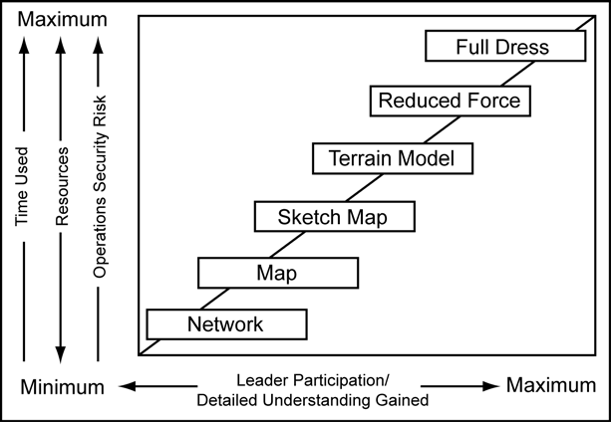
303
Planning
Types of Rehearsals (2 of 2)
Battle drill or Standing Operating Procedure rehearsal
A battle drill is a collective action rapidly executed without applying a deliberate decision-making process. A battle drill or SOP rehearsal ensures that all participants understand a technique or a specific set of procedures. Throughout preparation, units and staffs rehearse battle drills and SOPs. These rehearsals do not need a completed order from higher headquarters. Leaders place priority on those drills or actions they anticipate occurring during the operation. For example, a transportation platoon may rehearse a battle drill
on reacting to an ambush while awaiting to begin movement.
All echelons use these rehearsal types; however, they are most common for platoons, squads, and sections. They are conducted throughout preparation and are not limited to published battle drills. They can rehearse such actions as a command post shift change, an obstacle breach lane-marking SOP, or a
refuel-on-the-move site operation.

Slide 39
304
Planning
Confirmation Brief Format
CONFIRMATION BRIEF
STATUS OF UNITS (ASSETS AVAILABLE):
TROOP MISSION STATEMENT:
SQDN MISSION
2. TASK ANALYSIS
  SPECIFIED
  IMPLIED
  ESSENTIAL
  CONSTRAINTS
3. MISSION STATEMENT
4. STATUS OF UNIT
- PLT STRENGTH
(pers./equip.)
- CSS/ENABLIERS
5. TROOP TIMELINE
6. ISSUES / FRICTION POINTS
ISSUES/ FRICTION POINTS:
TROOP TIMELINE:
SPECIFIED TASKS:
IMPLIED TASKS:

Slide 40
305
Planning
Commander Back Brief Format
BACK BRIEF
TROOP MISSION:
INTENT:
Key Tasks:
End state:
Enemy:
Friendly:
Terrain:
1. MISSION STATEMENT
2. CDR’S INTENT
3. TASK ORGANIZATION
4. CONDUCT OF THE OPN
- SCHEME OF MANEUVER
- FIRE SUPPORT
- M/CM/S
- SUPPORT
- COMMAND AND SIGNAL
5. KEY TIMELINE
6. COORDINATIONS
7. ISSUES
ME:
SE1:
SE2:
SE3:
TIMELINE
CONCEPT OF THE OPERATION:
EXTERNAL COORDINATION:
ISSUES:

Slide 41
MISSION COMMAND
400 | Succession of Command
401 | Call Signs/Net Matrix
402 | Net Structure, Call Signs and Identifiers
403 | Net Control Station, Jamming/Deception & RETRANS
404 | COMSEC Compromise Procedure

Slide 42
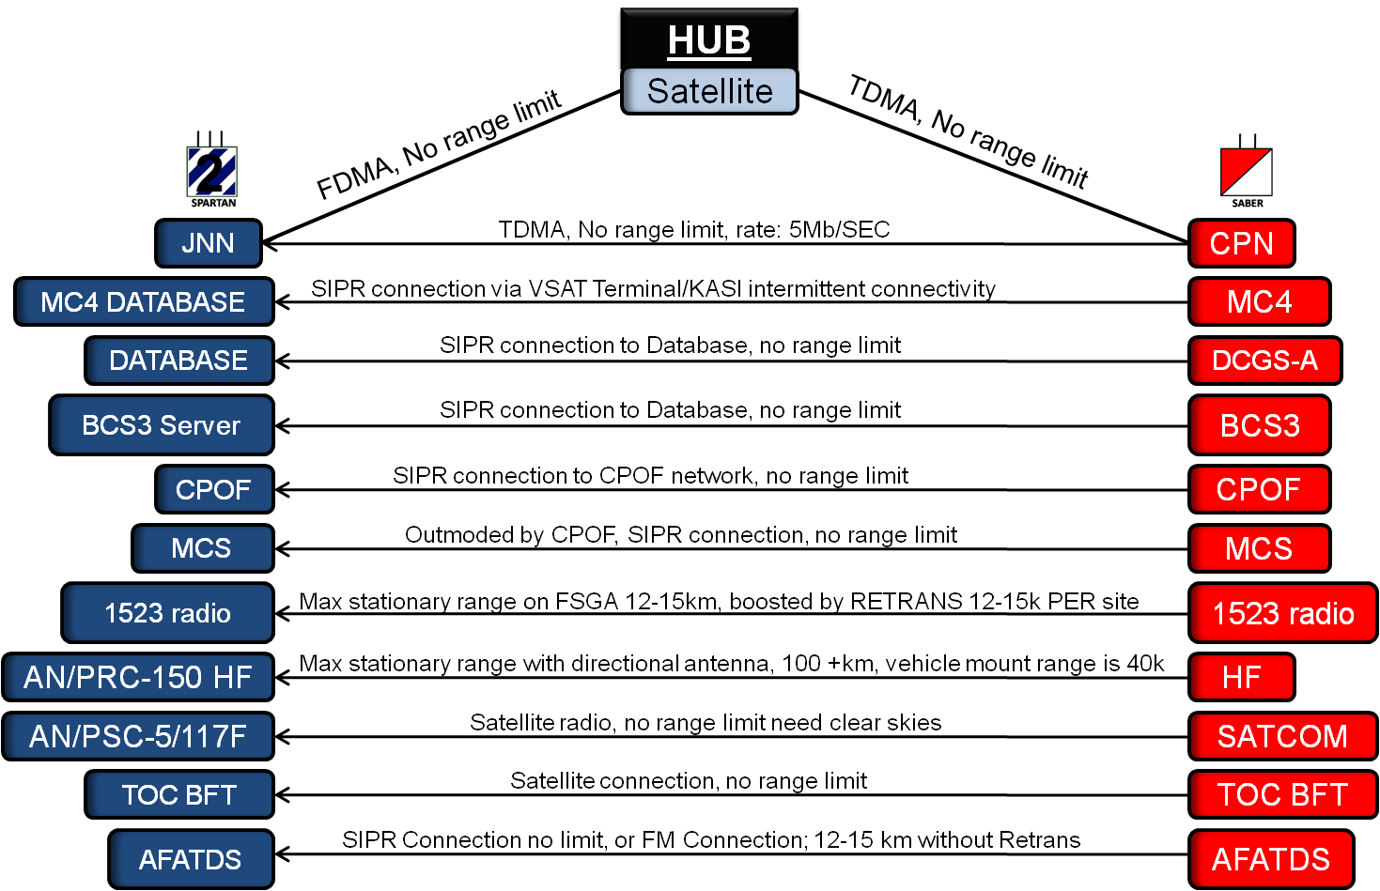
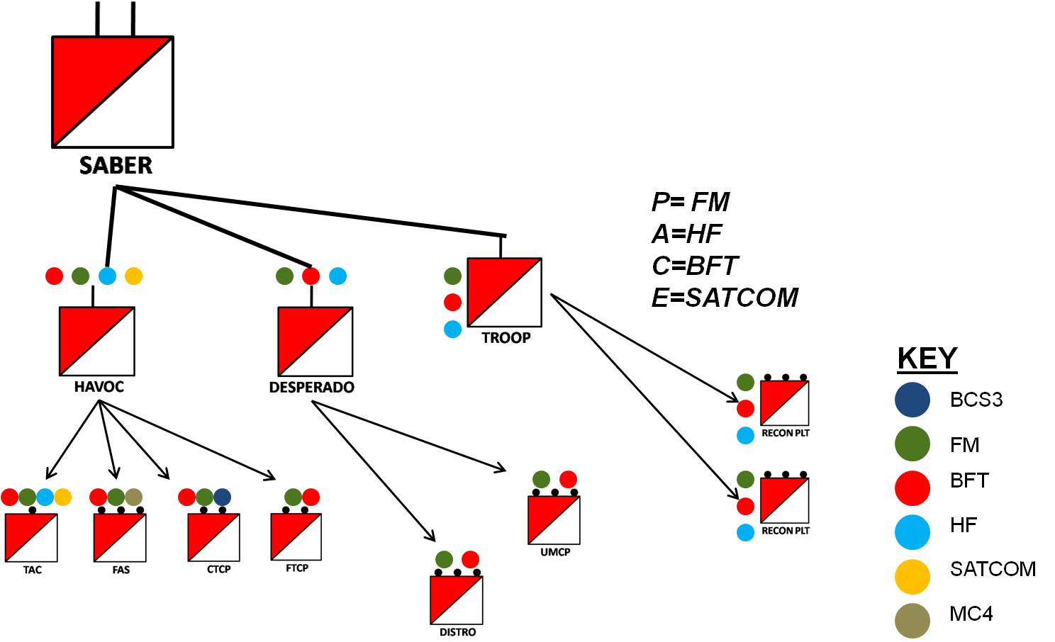
400
Command and Control
Succession of Command & CommunicationsStructure
Succession of Command is established IAW with Squadron Commander’s guidance. Commanders may be killed, wounded, medically incapacitated, or, for whatever reason, relieved of command. In these situations, the second in command normally assumes command. At brigade and lower echelons, XOs normally assume command. At higher echelons, deputy or assistant commanders may not be senior to subordinate unit commanders. In this case, the operations order specifies succession of command, and the second in command exercises command until the designated successor assumes command. However, commanders may designate a second in command who is junior to subordinate commanders as their successor in command. (See AR 600-20 for statutory guidance.)
TACSAT unusable with EWO (electronic interference), but ideal for TOC communications
HF Signal greatly degraded while on the move, (30-40 km with a vehicle mount, 10-15 km man pack), however great range with stationary directed antenna (across hundreds of km)
HF greater range can be best utilized by Troop CPs, still rely on FM for primary PLT Control
BCS3 can only be located with the CTCP when co-located with TOC. Requires NIPR Connection. Moble VSAT/SNAP terminal can alleviate this.
MC4 needs to be co-located with a VSAT to connect to MC4 data base by SIPR, or be close enough to the receive point (currently Desperado MP) to utilize a CASI System (no more than 4-5 km).
Communications Structure

Slide 43
401
Command and Control
Call Signs/Net Matrix

Slide 44
402
Mission Command
Net Structure, Call Signs and Identifiers (1 of 2)
NET STRUCTURE | BDE CMD | BDE A/L | SQDN CMD | SQDN O/I | SQDN A/L | FS
TOC | X |  | NCS | X | X | NCS
TAC |  |  | X | A/NCS |  | X
SCO |  |  | X
S3 |  |  | X
SXO |  |  | X |  | X
CSM |  |  |  |  | X
S-2 |  |  | X | NCS
TRP TOCs |  |  | X | X | X
TRP 1SGs |  |  |  |  | X
TRP FIST |  |  |  |  |  | A/NCS
CTCP |  | X | A/NCS |  | NCS
S4 |  |  | X |  | X
FTCP |  |  | X |  | A/NCS
SMO |  |  |  |  | X
SPT PLT |  |  |  |  | X
S6 |  |  | X
MED PLT |  |  |  |  | X
AID STATIONS |  |  |  |  | X
ATTACHMENTS |  |  | X |  | X | X
NET Structure
A. Squadron Command Net (SQDN CMD)
(1) Control of the close fight.
(2) Pertinent, real time information.
(3) Tight control.
(4) Used for sending/receiving decisions/conclusions.
B. Operations and Intelligence Net (O&I)
(1) Control of the deep or future fight.
(2) Used for sending/receiving data requiring analysis.
a. Intel reports from Scout Platoons upon finding an obstacle.
b. Reports of equipment found at abandoned enemy OP.
C. Administrative and Logistics Net (A&L)
(1) Sustainment operations.
(2) Routine, non-critical information.
a. Orange reports.
b. LOGPAC and convoy control.
c. Routine Aid Station reports / requests.
d. Maintenance.
2. Fixed Call Signs
A. Prefixes
Fixed Call Signs
Unit | Call sign
3ID (M) | Marne
2D BCT | Spartan
CMD Group / Staff | Saber
HHT | Havoc
Alpha | Apache
Bravo | Bonecrusher
Charlie | Crazy
Delta | Desperado
Suffixes Squadron Level:
Element | Suffix | Element | Suffix | Element | Suffix
CDR | 6 | FIST | 1 | Maintenance | 8
XO | 5 | Troop TRNG | 2 | Commo | 9
1SG | 7 | TOC NCO | 3 | NBC | 10
TOC | X-Ray | Supply/Distro | 4 | Troop MG | “Mike Golf”
HQ | Black | 1st PLT | Red | 2nd PLT | White
 |  |  |  | Attachment | Silver

Slide 45
402
Mission Command
Net Structure, Call Signs and Identifiers (2 of 2)
Suffixes Troop
Level:
Element | Suffix | Element | Suffix | Element | Suffix
CDR | 6 | CHEMO | Viper | TAC | Oscar
XO | 5 | Chaplain | Shepherd | TOC | X-Ray
CSM | 7 | Support PLT | Support | CTCP | Yankee
S1 | 1 | Engineer | 34 | FTCP | Zulu
S2 | 2 | Mess | Spoon | S3 OPS SGM | 37
S3 | 3 | Safety | 99 | S3 Plans | 3P
S4 | 4 | RETRANS 1 | 91 | S3 Training | 33
S6 | 9 | RETRANS 2 | 92 | S3 Air | 32
FSO | 30 | RETRANS 3 | 93 | LNO | 36
ALO | "ALO" |  |  | S3 MG | “Mike Golf”
Suffixes Platoon
Level:
Element | Suffix | Element | Suffix | Element | Suffix
PL | 1 | Wingman | 2 | Wingman | 5
PSG | 4 | Wingman | 3 | Wingman | 6
General Suffixes
Element | Suffix | Element | Suffix | Element | Suffix
Officer Asst | A | Driver | D | NCOIC | N
NCO Asst | B | RTO | R | Loader | L
Enl Asst | C | Observer | O | Gunner | G
EXAMPLE: The Platoon Sergeant’s Driver of 3rd Platoon, Apache Troop would be “Apache Blue 4 – Delta”
Medic / Aid Station HQ
Medic PL | Band-Aid 1
Medical PSG | Band-Aid 4
Forward Aid Station | Band-Aid Jump
Main Aid Station | Band-Aid Main
Consolidated Aid Station (FAS & MAS) | Saber Band-Aid
Troop Medics
Apache Medics | Apache Band-Aid
Bonecrusher Medics | Bonecrusher Band-Aid
Crazyhorse Medics | Crazyhorse Band-Aid
Medical Call Signs
SQUADRON
NET ID | UNIT | NET ID | UNIT
572 | SQDN CMD | 587 | 1/B
573 | CMD RETRANS | 588 | 2/B
574 | SQDN O/I | 589 | CMD / C
575 | SQDNA/L | 590 | MORTAR / C
576 | FIRE SUPPORT | 591 | 1/C
578 | HHT CMD | 592 | 2/C
580 | MED | 593 | CMD / D
581 | CMD / A | 594 | SPT PLT
582 | MORTAR / A | 595 | MAINT
583 | 1/A | 596 | RECOVERY
584 | 2/A | 597 | RETRANS 1
585 | CMD / B | 598 | RETRANS 2
586 | MORTAR / B | 599 | RETRANS 3
NET Identifiers

Slide 46
403
Mission Command
Net Control Station, Jamming/Deception & RETRANS Ops (1 of 2)
Net Control Station (NCS)
A. Assignments:
(1) The TOC (Saber X-Ray) is the Squadron NCS for the Command (CMD), Operations & Intelligence (O&I), and Fire Support (FS) Nets.
(2) The CTCP (Saber Yankee) is the NCS for the Admin & Logistics (A&L) Net.
B. Duties:
(1) Open and close radio nets, grant permission to enter nets and maintain net discipline.
(2) Maintain a log of all stations that have entered the net.
(3) Maintain SINCGARS time sync (GPS time, Zulu, last 2 digits of Julian date). Update time daily at 0600 and 1800 hours.
(4) Issue net call prior to beginning operations and whenever changing frequencies or fills.
(5) Send ERF as required.
(6) Make hourly checks with all stations to maintain synchronization.
(7) Report any possible compromise of the SINCGARS loadset data to the Squadron Signal Officer.
(8) Impose or lift radio listening silence based on tactical situation.
Alternate NCS
A. Assignments:
(1) Saber Yankee (CTCP) is the Squadron Alternate Net Control Station (A/NCS) for the CMD Net.
(2) Saber Zulu (FTCP) is the A/NCS for the A&L Net.
(3) Apache Troop Fire Support element is the A/NCS for the FS Net.
B. Duties:
(1) Answers cue and ERF requests.
(2) Assumes control of net on order or in emergency.
Net Stations
A. Outages - Both stations work to regain communications.
B. Keep transmissions to 5 seconds or less.
Late net entry (frequency sync) twice daily at 0605 and 1805 hours.
SOI time periods change at 2400 hours.
Radio Listening Silence (broken during contact)
A. Squadron Nets
(1) Green - Unrestricted use.
(2) Amber - Commanders, TXOs, CPs only.
(3) Red - Commanders only.
B. Troop Nets
(1) Green - Unrestricted use.
(2) Amber - Commander, XO, PLs only.
(3) Red - Commander only.

Slide 47
403
Mission Command
Net Control Station, Jamming/Deception & RETRANS Ops (2 of 2)
5. Actions During Jamming
A. Continue to transmit on frequency being jammed – do not indicate that net is being jammed.
B. Disconnect antenna. If noise continues you may have a faulty radio.
C. Check antenna ground strap.
D. Move to higher ground or raise antenna.
E. Speak slowly, double words.
F. Increase power.
G. Send MIJI report to higher headquarters.
Wait for instructions from NCS.
6. Change to an alternate frequency
A. NCS determines that net is compromised through jamming, interference or other causes.
B. NCS will send code word to initiate switch of frequency.
C. The NCS maintains the original net to ensure all stations complete the switch.
7. Anti-jamming
A. Offense – Go to 1st Base 30 minutes prior to LD.
B. Defense – Go to Red radio listening silence at Troop level.
C. Minimize voice traffic over digital nets.
D. Establish radio contact at lowest power level possible (use PA only when necessary).
Code word | Normal Net | Alternate Net
1st Base | MAN | CUE
2nd Base | Squadron CMD | Retrans 1
 | Squadron O/I | Retrans 3
 | Squadron FS | Apache Mortar Voice
 | Squadron A/L | Retrans 2
 | Troop Command | 1st Platoon Net
 | Troop 1st & 3rd Platoons share nets
3rd Base | Return to Primary Net
RETRANS Operations
1. The Squadron has three dedicated mobile retrans teams to extend radio nets as required. Priority for retrans nets is Command, O&I and FSE, in that order.
2. During Retrans operations, the NCS will continue to operate with assigned Net ID.
3. The outstation will stay on the same Net ID. Do not change the NET ID until directed to by Signal Officer.
4. The NCS will continue to operate in “FH-M.” The Retrans Team will operate the radio communicating with the NCS and outstations in “FH.” The outstation continues to operate in “FH.”
The Retrans radios will be set to CT to enable operators to monitor communications.
RETRANS Instructions (Same Net)
1. Setup OE-254/GRC. Note: Under most circumstances, increasing antenna height will improve communications quality.
2. Insert end of antenna cable to J1 port on power amplifier.
3. Select DATA (Keypad 4) and press MENU/CLR (Keypad 7) until you see RXMT TX and RX.
4. Select bottom radio in RXMT TX and top radio in RXMT RX.
5. Install Dogbone on AUD/DATA ports on the radio. Note: AUD/DATA ports are the only ports that Dogbone (CX-13298) can be placed.
6. Turn selection knob to RXMT on radios.

Slide 48
404
Mission Command
COMSEC (1 of 4)
1. General. Comply with the Division or higher HQ’s COMSEC guidelines.
2. Access
A. Access to COMSEC material is strictly limited to those soldiers possessing an appropriate clearance (as verified by the S-2) and having “THE NEED TO KNOW.”
B. Soldiers will not be authorized access to COMSEC material or an “unauthorized” area where COMSEC is used merely because of their rank or duty position.
C. Attempted violations of this rule will be reported immediately to the Squadron Signal Officer and/or the S-2.
3. Security of COMSEC information or equipment. . The safeguarding, accounting and control of communications security (COMSEC) information, material and equipment are the responsibility of all commanders at all times. Commanders will ensure that their soldiers are well trained on COMSEC procedures.
B. The provisions of AR 380-5 and 380-40 will be complied with at all times.
C. COMSEC custodians will also
A. General
(1) These procedures supplement TB 380-41, which is the basic guide for safeguarding and controlling COMSEC information.
(2) The COMSEC Custodian or alternate will maintain, store, account for issue and Destroy COMSEC material IAW AR 380-40 and TB 380-41.
(3) When a Controlled Cryptographic Item (CCI) contains a key that cannot be extracted from the device, it shall be protected in a manner consistent with the classification of the information it is processing.
(4) Where a CCI contains a key that can be extracted (esp. Automated Net Control Device), it shall be protected in a manner with the classification of the key.
(5) Filled ANCDs must be protected and locked in an approved safe when not in use.
(6) When CCI fill devices do not contain COMSEC variables, they must be protected IAW DA PAM 25-380-2.
B. Operating Procedures
(1) Users will physically secure COMSEC equipment or materials in a suitable GSA-approved security container.
(2) If in use within a staff section (e.g. S2 vehicle), COMSEC equipment or materials will be otherwise secured in such a way as to preclude its unauthorized removal from the area.
(3) Only NSA produced/approved COMSEC keys will be used on secure nets in COMSEC/CCI equipment.
(4) STU-III telephones and communications devices will be clearly marked with the security classification authorized.
C. Security of COMSEC filled equipment (i.e., Radios)
(1) Personnel must keep CCI fill devices protected at all times.
(2) When CCI devices are filled with COMSEC variables, the user must protect the device to the level of the classification of the fill.
4. COMSEC Change Delay Procedures
A. COMSEC Change will be delayed to avoid confusion with units conducting operations during specified COMSEC changeover time.

Slide 49
404
Mission Command
COMSEC (2 of 4)
B. Saber X-RAY identifies COMSEC Changeover time based on operational timeline and notifies Troop X-RAY and all attached elements. COMSEC Change will occur after current operations are completed.
C. Saber X-RAY will change Squadron A/L net to new COMSEC at the standard COMSEC change time.
D. At specified COMSEC Changeover time, all elements will change COMSEC and report COMSEC Change to Troop X-RAY. Troop X-RAY will notify Saber X-RAY when subordinate elements have changed COMSEC.
E. After verifying COMSEC Change for all Troops, Saber X-RAY will change Squadron net to new COMSEC.
5. Signal Operating Instructions (SOI)
A. The Squadron COMSEC custodian issues SOIs.
B. The user is responsible for safeguarding the SOIs.
C. SOIs will be bound and covered and will have a cord or chain of sufficient strength and length to permit the cord to be placed around the neck (the SOI to be placed in a shirt pocket or under a shirt to preclude loss or compromise).
D. Users will destroy their SOI/Authorization tables/Operations codes and keys only to prevent them falling into enemy hands when capture is imminent.
E. Destruction of SOI will be reported at the first opportunity to the Squadron Signal Officer and or the S-2.
6. Keying Material
A. Keying material is the most sensitive component of a COMSEC equipment system.
B. The user IAW AR 380-40 will destroy keying material 12 hours after expiration.
C. Records of destruction will be maintained by the user and returned to the Signal Officer/COMSEC Custodian.
D. Users will destroy keying material to prevent capture of the material by the Enemy.
E. Keyed COMSEC equipment must be protected to the degree necessary to prevent the unauthorized extraction of its keying variable.
F. Military or civilian personnel who are not United States citizens, regardless of security clearance, will not be allowed to inspect, have direct access to or operate COMSEC equipment.
7. Keyed CCI Equipment A. Keyed CCI equipment will not be left unattended and must be protected IAW AR 380-40 and AR 380-5.
B. CCI equipment will be placed in the Z position when left unattended to ensure security of the system.
8. Un-keyed CCI Equipment
A. Units must keep un-keyed CCI under double protection (double locked) at all times.
B. Units must control un-keyed CCI IAW DA Pam 25-380-2.
COMSEC Compromise Procedures
1. If capture by enemy is imminent:
A. Destroy the keying material.
B. Zeroize the equipment.
C. Destroy the equipment

Slide 50
404
Mission Command
COMSEC (3 of 4)
2. Suspected or actual capture or compromise of COMSEC material will be reported by secure means when possible through the chain of command to the Squadron Signal Officer and/or the Squadron S-2.
3. Reportable COMSEC Incidents - The following incidents will be reported to the Squadron S-2 as soon as discovered:
A. Loss of accountability or control of COMSEC material.
B. Any loss of material due to technical surveillance, combat loss or capture, theft etc.
C. COMSEC material that had previously been reported as properly destroyed or COMSEC material left unsecured or unattended where unauthorized persons could have had access to it.
D. Unauthorized copying, reproduction or photographing of COMSEC material.
E. Unexplained removal of key from its protective packaging.
F. Unauthorized disclosure of COMSEC material and attempts by unauthorized persons to gain access to COMSEC material.
G. Destruction of COMSEC without a witness or destruction by other than authorized means. One set of initials or signature on a destruction certificate.
H. Use of COMSEC equipment having defective logic circuitry.
I. Deliberate falsification of COMSEC records.
J. Unauthorized retention of COMSEC material past supercession.
K. Use of unauthorized or locally produced key, unauthorized extension of crypto-period, use of compromised, superseded, defective or previously used key.
L. Premature exposure of COMSEC key.
M. Any other occurrence that may jeopardize the security of COMSEC material or the information it protects.
4. Reports
A. Initial report
(1) This report will be submitted for each reportable COMSEC incident.
(2) If all facts regarding the incident are included, the initial report will also become the final report and will state so.
B. Amplifying report. This report will be submitted when there is new information regarding an incident for which an initial report has been submitted or every 30 days until a final report has been submitted.
C. Final Report. This report is always required and must always contain a summary of the results of all inquiries and investigations.
D. Classification of Reports. COMSEC incident reports will be marked classified according to content.“FOR OFFICIAL USE ONLY” are exempt from automatic disclosure under AR 25-25.
5. Suspected SOI Compromise - Inform the Signal Officer immediately!
A. Concept. In the event of compromise, 3-7 CAV will have the capability to change COMSEC to the next key segment per guidance from Division.
B. Decision to Execute
(1) Squadron Commander will direct the switch of COMSEC Keys, weighing impact of compromise vs. impact of degraded communication during COMSEC changeover.
(2) Division must attain permission from the controlling authority to issue the “Reserve COMSEC Key”.
C. Execution.
(1) New key from Sqdn Commo at Sqdn HQs or via OTAR (Over The Air Re-key).
(2) Key will be in electronic form.

Slide 51
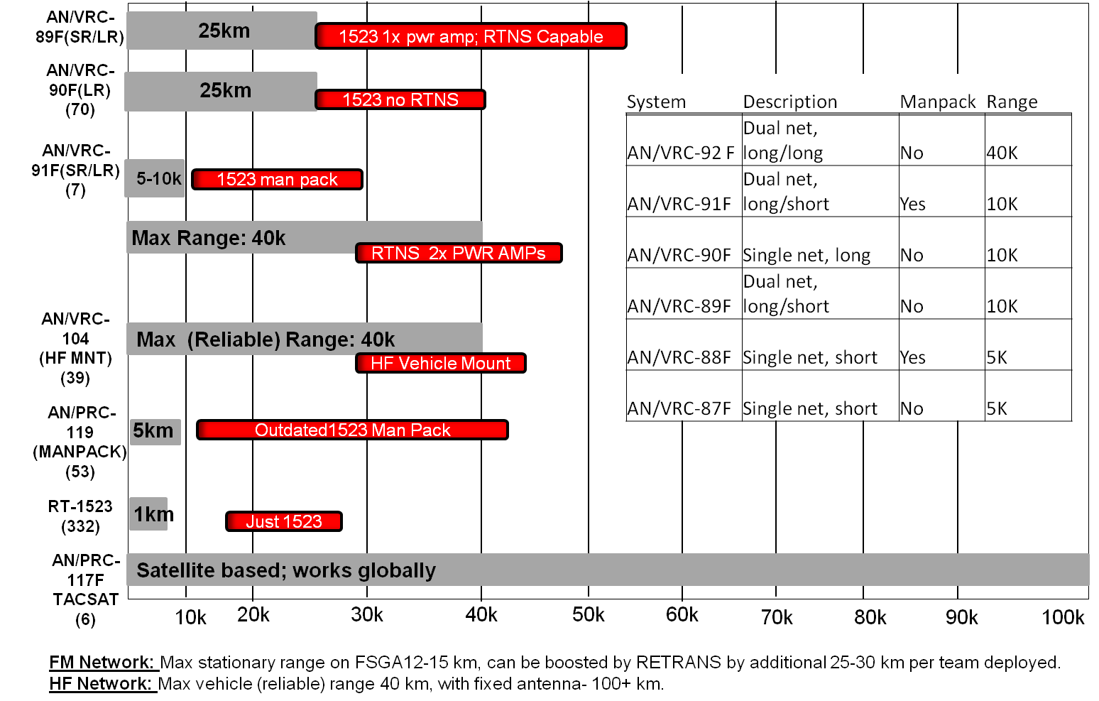
404
Mission Command
COMSEC (4 of 4)
6. COMSEC Compromise Confirmation or Threat of an Incident Taken as a Compromise
A. If the compromise is of an SOI edition, the codeword “Custer "will be given over the net, symbolizing the immediate switch to a new SOI edition. New Edition SOIs will be located with each Troop TOC, the SIGO at the TOC and the commo representative at all other locations.
B. If the compromise is of the FM variable fill (TEK), the following actions will be taken:
(1) NCS makes net call.
(2) Codeword “Buttnaked” is given. All users will change Julian date in SINCGARS to add three days. NCS will leave Squadron net on current julian date and add three days to A/L (Change A/L Net ID to Command Net ID).
(3) NCS makes NET call.
(4) All Stations change to new COMSEC.
(5) NCS makes NET call.
(6) NCS gives second codeword “Guinness.”
(7) All users will change the julian date in their SINCGARS RTs to subtract 3 days (back to the correct julian date. (FH only)
(8) NCS performs NET call.
(9) Resume radio traffic.
7. COMSEC Equipment. The following is a list of equipment containing COMSEC:
A. SINCGARS Radio
B. FBCB2
C. ANCD
D. PLGR
E. TACSAT
F. Warlocks (ICE, Green, Red, and Blue)
G. ICOM
H. Computers with “Secret” classified hard drives and access to SIPR.
HF: Beyond line-of-sight

Slide 52
MOVEMENT & MANEUVER
500 | REDON Status
501 | Near/Far Recognition Signals & Linkup
502 | Passage of Lines
503 | Assembly Area Procedures
504 | Reconnaissance Fundamentals
505 | Establishing OPs
506 | Zone Reconnaissance
507 | Route Reconnaissance - Route Classification Formula
508 | Reconnaissance Overlay Symbols
509 | Screen & Area Security
510 | Movement to Contact
511 | Cordon & Search/Knock
512 | Air Ground Integration
513 | Establish HLZ
514 | 9 Line MEDEVAC w/MIST
515 | Air Assault Operations
516 | Urban Operations
517 | Dismount Drill for Hasty Reconnaissance
518 | Relief in Place
519 | Reconnaissance Handover & Adjacent Unit Coord.
520 | Tactical Road March
521 | Quick Reaction Force
522 | Traffic Control Point
523 | Vehicle Load Plans
524 | Patrol Checklist
525 | Fundamentals of Security

Slide 53
500
Movement and Maneuver
REDCON Status
The Squadron will use the following readiness conditions to identify the speed with which a unit must be ready for combat or movement. This usually accompanies WARNOs.
Subordinate units will also report their readiness to move by stating their REDCON status. Additionally, mechanics, medics, and others should use these codes to estimate when elements (injured personnel, combat vehicles, supplies, etc) will be ready for combat.
1. REDCON 1 - Full alert; able to move or take off immediately.
A. Radio checks complete; FBCB2 fully operational.
B. Vehicles loaded, secured; weapons manned.
C. Personal equipment stowed, NBC alarms, and hot loop equipment stowed; all OP’s
pulled in. All personnel alert and mounted on vehicles.
D. Engines running. (Commander will initiate “Short Count” if deemed necessary.)
2. REDCON 1.5 – A variant of REDCON 1; ready to move in five minutes.
A. Engines are off; crews prepared to initiate “Short Count” O/O from Commander.
3. REDCON 2 - Full security; able to move in 15 minutes.
A. Vehicles loaded with all equipment. (Except hot loop and NBC alarms.)
B. Primary weapons manned and prepared to fire.
C. Vehicles shut down.
D. Mission fully briefed and understood by all members of patrol.
(All Pre-Combat Checks are complete.)
(Note: Depending on the tactical situation and orders from the commander,
dismounted OP’s may remain in place.)
4. REDCON 3 - Reduced security; able to move in 30 minutes.
A. 50 % of each crew stands down for maintenance, crew rest.
B. TC / BC positions manned and radios monitored.
C. PMCS performed with no major disassembly of equipment.
5. REDCON 4 - Minimum security; able to move in 60 minutes.
A. Minimum of 25% security. Digital and FM links with TOC’s and other platoon’s
maintained.
B. Primary weapon manned and operational.
C. Maintenance performed with minor disassembly allowed.
6. REDCON 5 – Reduced security to 10 – 20%, Ready to move in 2 hours.
A. Conduct thorough maintenance.
B. Consolidation and Reorganization.
C. Maintain continuous operations.

Slide 54
501
Movement and Maneuver
Near/Far Recognition Signals & Linkup Procedures
1. Day recognition signals.
A. Mounted
- Near: Visual U.S. Vehicle Identification
- Far: FM
B. Dismounted
- Near: Number Combination designated through FM or according to SOI
- Far: FM or ICOM
2. Night recognition signals.
A. Mounted
- Near: Phoenix Lights mounted on antennas, VS-17 panel on top of vehicles (for air identification). Number Combination method using IR flashlight or laser pointer
- Far: FM
B. Dismounted
- Near: Personnel moving on the ground marked with Phoenix lights or IR chemlight. Number Combination designated through FM or according to SOI
- Far: FM or ICOM
A linkup is a meeting of friendly ground forces. Linkup occurs in the following situations:
The troop conducts linkup to facilitate BHO or RHO.
The troop reaches an objective that has been previously seized.
An encircled element breaks out to rejoin friendly forces.
Converging forces meet.
The troop takes part in either a forward or rearward passage of lines.
PLANNING CONSIDERATIONS
The headquarters directing linkup establishes the command relationship between the forces involved and the responsibilities of each force. Both forces remain under the control of the headquarters directing the linkup. If this headquarters cannot adequately control the operation, responsibility is delegated to one of the forces involved. OPCON is the normal command relationship used. Often the moving force is placed under OPCON of the stationary force, or the force out of contact is placed under OPCON of the force in
contact.
When possible, the commanders of the forces involved establish liaison. Before initiating a linkup operation, the HQs elements of the stationary force and the linkup force must share SA data, including the following:
Digital graphic overlays with linkup graphic controls measures, obstacles, and FSCMs.
Manual/digital identification procedures.
Manual/digital recognition signals.
Enemy and friendly situation.
Communications.
Contingency plans.
Sustainment requirements.
Evacuation procedures for equipment and EPWs/detainees.

Slide 55
502
Movement and Maneuver
Passage of Lines
Stationary Units Provides
  Stationary unit ID
  Enemy Situation
  Mission
  Defense plan graphic
  Battle hand-off line
  Location of contact point, passage point, lane, RP
  Location of passage unit assembly area
  TCP
  TOC/CTCP/UMCP/Aid Station
  Recovery support available
  Casualty evacuation support available
  Emergency CL III and V
  Obstacles/contaminated areas
  SOI data
  Terrain analysis
  Routes through obstacles/marking system/overlay
  Alternate routes
  Number of guides available
Passing Units
  Passing unit ID
  Enemy situation
  Location of unit/composition/disposition
  Mission/withdraw plan graphics
  Time of passage
  Order of march/type of vehicles
  Priority traffic
  SOI data
  Recognition signals (Near/far)
  CS/CSS request
  Location of AA
  # of vehicles by type
  Passing unit provides recognition signal of last vehicle
Stationary Unit Assists
  Mans passage lanes and contact points
  Confirms lane is open
  Displays recognition signal
  Receives passing unit’s contact person
  Confirm original plan
  Provides assistance
  Closes passage lane on order with volcano
  Maintains operational control of passing unit until passage is complete
4. Passing Unit Performs
  Collocates CP w/stationary unit CP
  Mans Contact Point w/LNO
  Displays recognition signal
  Confirms original plan
  Moves directly thru passage lane without stopping
  Weapons oriented towards enemy during passage
  Constantly passes requirement for CL III and V and medical
  Calls in #/type of each march element as it enters passage lane
  Occupies AA on far side of stationary unit
  Recovery and medical assets with lead troop
Execution
  Passing units makes contact and displays recognition symbol
  Move to passage lane, guided by stationary unit guides
  Passing unit activates fire support channels, prepared to deploy if attacked
  Once first troop/company unit has crossed BHL the moving unit assumes control of the EA
  Report completion of passage
Recognition
  FAR
    Day: FM
    Night: FM
  Near
    Day : VS-17
    Night: Flashes of IR
Command and Control
  Squadron Toc will be responsible for coordinating passage
  Ground troops will move as one unit through the passage
  Squadron commo will assign and the man the squadron retrans through this process
  Squadron will send unit to other side of BHL and establish

Slide 56
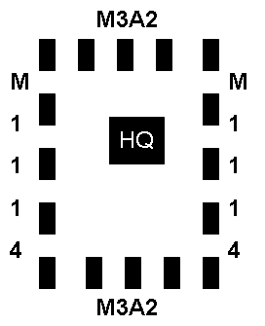

503
Movement and Maneuver
Assembly Procedures
1. Quartering Parties.
A. Composition.
(1) Squadron TOC: OIC (S-3) or NCOIC (Ops SGM), TAC (HQ63, HQ66, and HQ305 [Air Liaison Officer]), SQDN NBC NCO, SIGO, and any additional personnel needed to clear the area.
(2) Line Troop: OIC (XO) or NCOIC (1SG), guides from each platoon (NBC vehicles), and any additional personnel needed to clear the area.
(3) Combat Trains: S4 NCOIC, 2 guides from each section, and any additional personnel needed to clear the area or provide security.
(4) Field Trains: OIC (D TRP XO), 2 guides from each section, and any additional personnel needed to clear the area or provide security.
B. Equipment.
(1) M256 Kit.
(2) M8/M9 Paper.
(3) Mine detector(s).
(4) Engineer tape with stakes.
(5) Chemlight sticks.
(6) NVGs.
(7) SOI/Challenge and password.
(8) M22 alarm.
(9) Radiac test set.
2. Assembly Area.
A. After reconnoitering the AA, the quartering party from each unit/section will mark vehicle positions as METT-T dictates (chemlights at night, stakes during the day, engineer tape in wooded areas, etc.). The quartering party will establish a link-up point and the quartering party OIC/NCOIC will link up with the unit/section main body and guide the vehicles into the AA. Wheel or Laager formation will be METT-T dependent, with vehicles occupying their positions and facing out in the wheel formation, or facing the last direction of movement and only orienting main weapon systems out in the laager formation. After occupation is complete, the unit/section conducts a short count and simultaneously shuts down all vehicles. Unit TOCs will send closing reports (Blue 5) as soon as possible upon occupying the AA.
Laager Formation Wheel Formation
B. Nighttime Unit Marking Symbols.
(1) Chemlights will be placed on unit/section TOC or CP only. Tactical vehicles will not be marked.
a. A Troop: Blue chemlight.
b. B Troop: Green chemlight.
c. C Troop: Red chemlight.
d. TOC: Yellow chemlight.
e. Combat Trains: Blue and green chemlights.
f. Field Trains: Blue and red chemlights.
g. Squadron Aid Station: Yellow and red chemlights.

Slide 57
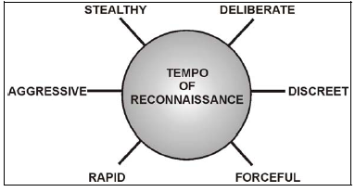
504
Movement and Maneuver
Reconnaissance Fundamentals
Commander’s Intent for Reconnaissance Operations:
FOCUS
Threat
Society
Infrastructure
Terrain
TEMPO
Deliberate operations are slow, detailed, and broad-based.
They require the accomplishment of numerous tasks.
Significant time must be allocated to conduct a deliberate
reconnaissance.
Rapid operations are fast-paced with focus on key pieces of
information. This type of operation entails a smaller number
of tasks. It describes reconnaissance operations that must be
performed in a time-constrained environment.
Stealthy operations are conducted to minimize chance contact
and prevent the reconnaissance force from being detected.
They are often conducted dismounted and require increased
allocation of time for success.
Forceful operations are conducted without significant concern
about being observed. They are often conducted mounted or
by combat units serving in a reconnaissance role. It is also
appropriate in a stability or support operation where the
threat is not significant in relationship to the requirement for
information.
Aggressive operations have very permissive engagement
criteria and allow the reconnaissance commander to engage
in combat in order to meet his information requirements.
Discreet operations have very restrictive engagement criteria,
and restrain the reconnaissance forces from initiating combat
to gain information.
2. Zone Reconnaissance – Critical Tasks:
Recon all terrain and man-made features within sector.
Include classification of all routes, bridges, bypasses, and overpasses in sector.
Inspect and classify all overpasses, underpasses, and culverts.
Report and bypass / breach all mines, obstacles, and barriers in zone within capabilities.
Clear built-up areas, obstacles, and contaminated areas within capabilities.
Locate enemy forces and report. NEVER break contact until the enemy forces are destroyed, neutralized, or bypassed.
Report reconnaissance information.
Understand the local dynamics and identify the persons of influence in the zone.
When time is limited, follow priority tasks in paragraph 4 below or as directed by higher.
Fundamentals of reconnaissance:
Orient on the reconnaissance objective
Ensure continuous reconnaissance
Maximize reconnaissance assets
Gain and maintain contact
Develop the situation
Report all information rapidly and accurately
Retain freedom of maneuver

Slide 58
505
Movement and Maneuver
Establishing an OP
Units will establish either overt or covert OPs. The overt OP disguises its true purpose by giving the appearance of conducting another type of operation such as overwatching a TCP, conducting a random vehicle search along an MSR, or conducting a short halt during a normal patrol. The covert OP is more slightly complicated because only dismounts have any chance of establishing a covert OP. The vehicles supporting the covert OP must also disguise their true purpose and leave the area of the covert OP in order to prevent ACM from adjusting their routine. The covert OP must maintain radio communications with the overwatch element and be equipped with adequate firepower to protect itself until the overwatch element can respond. Because of the many trade-offs in establishing a covert OP, the unit must conduct a thorough risk assessment and mitigation in order to best protect soldiers without allowing the mission to fail.
Overt OPs. Overt OPs are the most simple to establish, but achieving adequate deception to allow normal routines to continue is very difficult. Overt OPs are best utilized for initial reconnaissance of an NAI in order to determine the best method of emplacing covert OPs or during daylight when covert OPs are more likely to be compromised. Overt OPs must use their optics to the maximum extent possible to maintain standoff from the NAI and help conceal their true purpose. Anything that helps camouflage the true purpose of an OP helps the OP be successful.
Covert OPs. Covert OPs are much more complicated than overt OPs, but also much more effective. A covert OP consists of two elements, the dismount OP and the mounted overwatch element. The most critical part of establishing a covert OP is ensuring the dismount OP is not compromised, especially during infill and exfil. ACM are aware that US forces prefer to conduct operations at night, so they either establish OPs of their own to provide early warning of US patrols and conduct operations at times when US forces are not observing the NAI. Dawn and dusk, before and after US Forces are likely to infill and exfil, are the most likely times for ACM to conduct their covert operations. Because of this, US Forces must develop methods to infill prior to dusk and exfil after dawn.
Required equipment for Dismount OP:
a. Primary and alternate communications
1) MANPAC SINCGARS radios
2) ICOM Radios
3) Cell phones or Iridium phones
4) TACSAT/AM radio
b. Optics/Thermal sights
1) Binoculars/Spotting Scopes
2) AN/PAS-13
3) AN/PAS-10 (Sniper sight)
4) LRASS (Too bulky for dismount infill/exfil)
5) NVGs w/ 4x monocular
c. Map (AO and 0.5m satellite imagery of NAI)
d. Compass
e. Crew served weapon (M240)
f. Pyro (Signal flares and smoke)
g. CLS bag
h. LZ Marking kit
i. IR Strobe lights/IR chemlights
.CASEVAC – Both dismount OP element and overwatch element must ID CASEVAC LZ near their primary and alternate locations. Primary method of CASEVAC for routine patients is ground via overwatch element. Ensure a medic is with the overwatch element and combat lifesaver is with the OP.
CL I – Ensure all soldiers carry enough water for the duration of the mission. Planned consumption rate = 1L/hour. Avoid using water bottles unless absolutely necessary.
MANPAC SINCGARS radios provide the most reliable form of communications, but have limited range (2-5 km max). Cell phones or Iridium phones may be used, and have a nearly unlimited range, but are unsecure, unreliable.TACSAT/AM radios provide extended range over MANPAC SINCGARS radios and have increased reliability over cell phones, TACSAT/AM radio use may require relay from higher elements to the overwatch element. ICOM radios are simpler and much more available than cell phones or AM radios, but have very limited range (<2km).
B. Pyro – Ensure that OPs are equipped with signal flares and smoke for use in emergency situations if all other communications fail
j. Water (1L/soldier/hour)
k. MREs (for extended missions >6 hours)
l. Cold weather gear (for night OPs)
m. Crew served weapon

Slide 59
506
Movement and Maneuver
Zone Reconnaissance
Zone reconnaissance is the directed effort to obtain detailed information concerning enemy, terrain, society, and infrastructure in accordance with the commander’s intent. It is conducted within a location delineated by an LD, lateral boundaries, and a limit of advance (LOA). A zone reconnaissance is executed when the enemy situation is vague or when information concerning cross-country trafficability is desired. It is suitable when knowledge of the terrain is limited or when combat operations have altered the terrain. Zone reconnaissance may be threat-, terrain-, society-, or infrastructure-oriented, or a combination of two or more of these factors. Additionally, the commander may focus the reconnaissance effort on a specific enemy force, such as the reserve. A terrain-focused zone reconnaissance includes the identification of natural and man-made obstacles, as well as areas of CBRN contamination. Zone reconnaissance takes more time to execute than any other reconnaissance mission because the AO and the breadth of information to be gathered are larger.
CRITICAL TASKS
Threat. Find and report threat forces within the zone.
Society.
Determine the size, location, and composition of the populace, as well as applicable social demographics (such as race, sex, age, religion, language, national origin, tribe, clan, class, political affiliation, education, or any other significant social grouping).
Reconnoiter the society to determine local centers of gravity; the size, location, and composition of identifiable groups; and the interests and actions of these groups.
Establish and maintain contact with local civilian and military leadership.
Identify allegiances of the local populace to factions, religious groups, or other organizations.
Infrastructure.
Identify key municipal infrastructure that can affect military operations, including sewage, water, electricity, academics, trash, medical, safety, and other considerations (these constitute the memory aid/acronym of SWEAT-MSO).
Inspect and evaluate all bridges, overpasses, underpasses, and culverts.
Terrain.
Locate all obstacles; create and mark lanes as specified in orders.
Locate and determine the extent of CBRN contaminated areas.
Reconnoiter and determine the trafficability of all terrain, such as choke points and ambush sites that the enemy can use to dominate movement along routes in the zone.
Locate bypasses around urban areas, obstacles, and contaminated areas.
Locate fords or crossing sites near all bridges.
Conduct Tactical Movement (07-2-1342)
Conduct Bypass (07-2-9002)
Conduct a Linkup (07-2-9005)
Conduct Passage of Lines as Passing Unit (07-2-9006)
Conduct Fire and Movement (17-2-0222)
Infiltrate/Exfiltrate (17-2-0320)
Breach Covertly (17-2-3071)
Conduct Route Reconnaissance (17-2-4000)
Reconnoiter an Area or Zone (17-2-4010)
Conduct Reconnaissance Handover (17-2-4025)
Conduct Tactical Convoy (55-2-4003)
If you can accomplish Zone Reconnaissance, then you can also accomplish Route and Area Reconnaissance as well

Slide 60
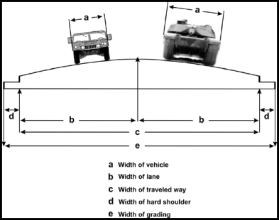
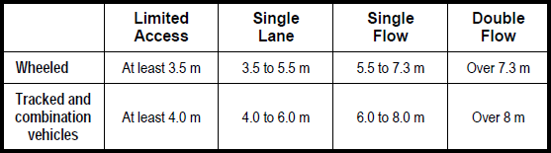
507
Movement and Maneuver
Route Reconnaissance- Route Classification Formula (1 of 4)
The Route Classification Formula is recorded on the ROUTEREP overlay and contains the
following:
  Route width, in meters.
  Route type (based on ability to withstand weather).
  Lowest military load classification (MLC).
  Lowest overhead clearance, in meters.
  Obstructions to traffic flow (OB), if applicable.
  Special conditions, snow blockage (T) or flooding (W), if applicable.
Example: 5.5m / Y / 30 / 4.6 (OB) (W)
Route Types:
  Type X: An all-weather route that, with reasonable maintenance, is passable
  throughout the year. This route is normally formed of roads having waterproof
  surfaces. This type of route is never closed because of weather effects other than snow or flood blockage.
  Type Y: A limited, all-weather route that, with reasonable maintenance, is passable
  throughout the year. This route is normally formed of roads that do not have
  waterproof surfaces. This type of route is closed for short periods (up to one day at a time) by adverse weather conditions.
  Type Z: A fair-weather route passable only in fair weather. This type of route is so
  seriously affected by adverse weather conditions that it may remain closed for long periods. Improvement of such a route can only be achieved by construction or realignment.
Traffic Flow Capability Based on Route Width
Military Load Classification (MLC)
MLC calculations are performed by engineer units. Recon units may perform temporary assessments of routes. Broad Categories are:
Class 50—average-traffic route.
Class 80—heavy-traffic route.
C lass 120—very heavy-traffic route.
Sample Vehicle MLCs (single vehicles):
MRAP (Maxxpro) – 21
LMTV –
LHS and Trailer - 28
Stryker - 25
M1A1/M1A2 -80
Bradley IFV -36
Un-armored HMMWV -4
Up-armored HMMWV - 6
Howitzer -10
Towed Vehicles (Combined Class Number (CCN)
CCN = 0.9 (A + B) if A + B < 60
CCN = A + B if A + B > 60
A = MLC of Vehicle 1
B = MLC of Vehicle 2
Example: UAH towing Howitzer CCN = .9 (6 +10) = 15
Route reconnaissance is the directed effort to obtain information, in accordance with the commander’s intent, along a specified route and the adjacent terrain from which movement could be influenced. The route is a prescribed course from a point of origin (SP) to a specified destination (RP). Route reconnaissance is conducted to analyze trafficability and determine whether the route is clear of obstacles and/or enemy forces. Route reconnaissance can be performed as either a stand-alone mission or an additional task during zone reconnaissance.

Slide 61
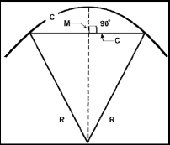
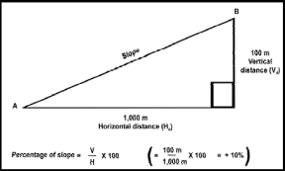
507
Movement and Maneuver
Route Reconnaissance- Route Classification Formula (2 of 4)
Obstructions:
The following are Obstructions:
Overhead obstructions with a clearance of less than 4.3 meters.
Reductions in traveled-way widths that are below the standard minimums.
Curves with a radius of 25 meters and less.
Slopes (gradients) of 7 percent or greater
The following method of determining a curve’s radius is based on the formula R = (C²/8M) +
(M/2) (all measurements are in meters):
R = radius of the curve.
C = the distance from the centerline of the road to the centerline of the road at the outer extremities of the curve.
M = the perpendicular distance from the center of the tape to the centerline of the road.
  Example: If C is 15 meters and M is fixed at 2 meters, the formula becomes R = (152/16) + 2/2 = 15.0625. This result is an obstruction to traffic flow and “OB” is entered into the Route Classification Formula”
  When conditions warrant, set M = 2 meters from the centerline, then measure C = 2
  meters from the centerline. Use this method when there is a time limitation or when natural or man-made restrictions prevent proper measurements.
Formula, Pace, and Map Methods
  Radius of a curve Degree of slope
Special Conditions
When snow blocks traffic on a regular and recurrent basis, the symbol following the route-classification formula is “T.”
When flooding blocks traffic on a regular and recurrent basis, the symbol following the route-classification formula is “W.”

Slide 62
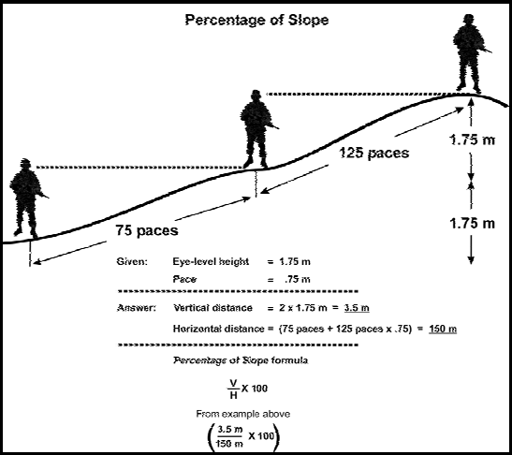
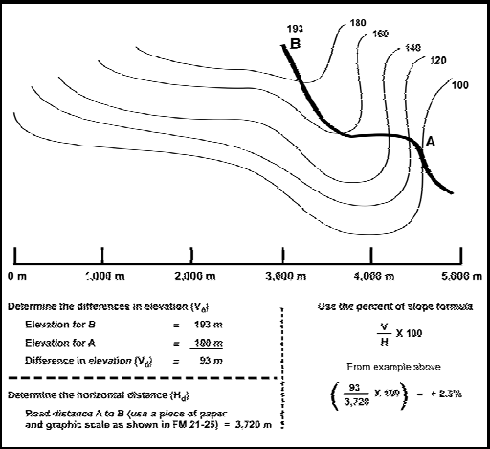
507
Movement and Maneuver
Route Reconnaissance- Route Classification Formula (3 of 4)
Pace method for Determining Slope Percentage
Map Method for Determining Slope Percentage

Slide 63
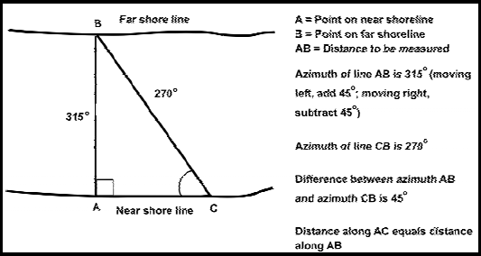
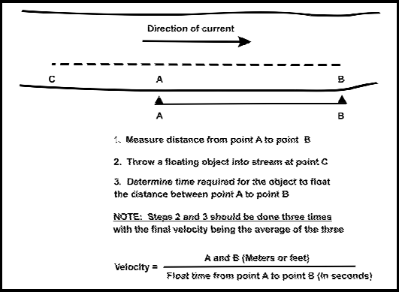
507
Movement and Maneuver
Route Reconnaissance- Route Classification Formula (4 of 4)
Measuring Stream Width with a Compass
Measuring Stream Velocity

Slide 64
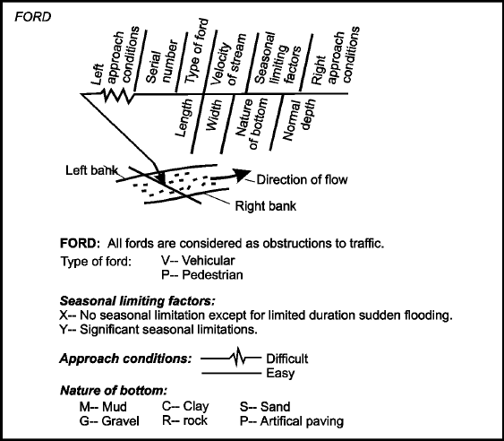
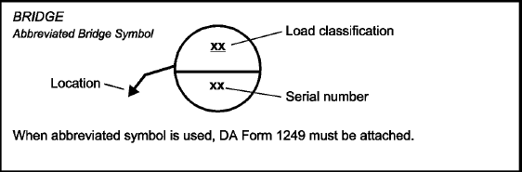
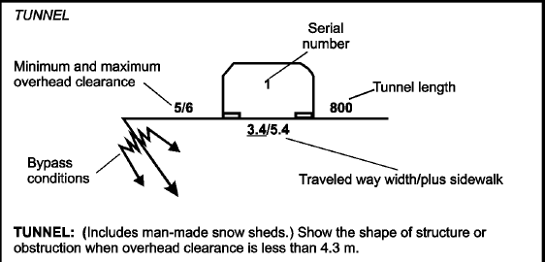
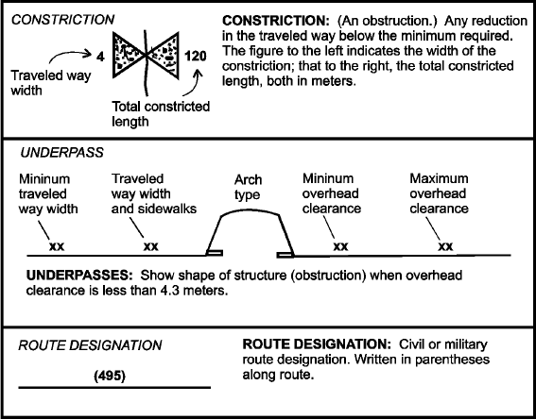
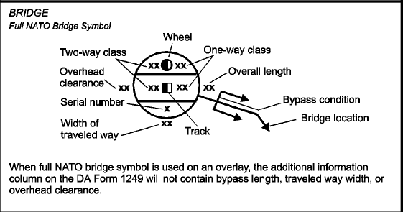
508
Movement and Maneuver
Reconnaissance Overlay Symbols (1 of 2)

Slide 65
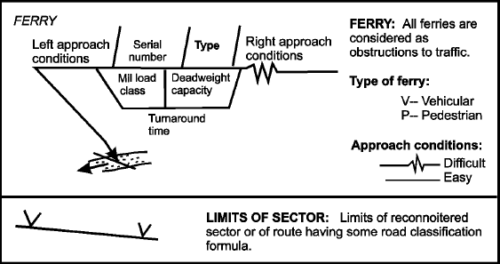
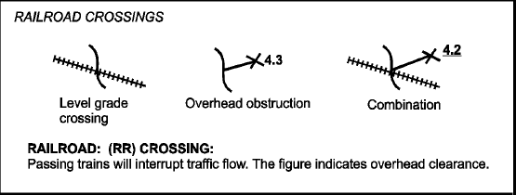
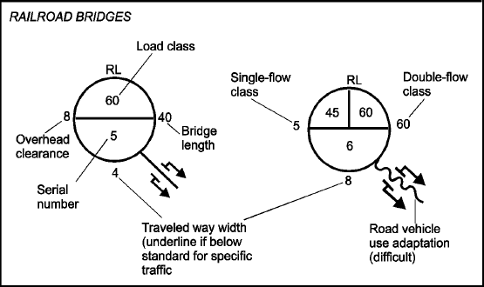
508
Movement and Maneuver
Reconnaissance Overlay Symbols (2 of 2)

Slide 66
509
Movement and Maneuver
Screen & Area Security
A screen provides early warning to the protected force. Although it provides the least amount of protection of any security mission, a screen is appropriate when operations have created extended flanks,
when gaps between forces exist and cannot be secured in force, or when early warning is needed over gaps that are not considered critical enough to require security in greater strength. A commander normally assigns reconnaissance units this mission when he needs time to respond to an unexpected enemy attack and cannot afford to commit additional forces to the task.
The screen mission is defensive in nature. As such, troops screen the front, flanks, and rear of a stationary force, but only to the flanks or rear of a moving force. A screen is established by emplacing a series of OPs, augmented with patrols to ensure continuous surveillance of dead space. Normally, the troop fights only in self-defense. Based on the commander’s intent and unit capabilities, however, it can disrupt, defeat, and destroy enemy elements within its capabilities.
Critical tasks for the screen are—
Maintain continuous surveillance of the AO, including assigned NAIs and avenues of approach that affect the protected force’s mission.
Provide early warning of any enemy approach, including locating and identifying lead elements that indicate the main attack and direction of movement.
Conduct counter reconnaissance to identify enemy elements and to disrupt, defeat, or destroy them in accordance with the prescribed engagement criteria.
Maintain enemy contact, report enemy activity, and conduct proper handover as required.
Disrupt and delay the enemy while displacing to provide the protected force commander with additional time and maneuver space.
Area security is defined as a security operation conducted to protect friendly forces, installations, routes and actions within a specified area. It includes the reconnaissance and security of the area specified for protection, including personnel, airfields (as well as terrain around airfields from which surface-to-air missiles can be launched), unit convoys, facilities, MSRs, lines of communications (LOC), terrain features, towns, equipment, and critical points. Area security is conducted to deny the enemy the ability to influence
friendly actions in a specific area or to deny the enemy use of an area for its own purposes. It may entail occupying and establishing a 360-degree perimeter around the area being secured or taking actions to destroy enemy forces already present. Area security operations may require the execution of a wide variety of supporting operations and tasks; therefore, the troop may require augmentation when it is assigned to perform area security.
TROOP TASKS
The troop can execute the following tasks when conducting area security operations:
Zone, area, and route reconnaissance.
Screen.
Offensive and defensive tasks (within capabilities).
Convoy security.
Route security.
High-value asset security.
Fixed site security.
Checkpoint security.
Downed aircraft recovery team security.

Slide 67
510
Movement and Maneuver
Movement to Contact
Actions on Contact
Deploy and Report
  SALUTE Report
Evaluate and Develop the Situation
  The scouts next concentrate on defining what they are up against.
  If not detected reconnoiter the enemy position, emphasizing stealth and dismounted reconnaissance.
  If detected use a combination of mounted and dismounted reconnaissance, as well as reconnaissance by fire.
  Indirect and direct fires are used to suppress the enemy while scouts maneuver to get information.
  Update SALUTE report
Choose a Course of Action
  Disengage from enemy contact.
  Break contact and bypass
  Maintain contact and bypass.
  Maintain contact to support a hasty attack.
  Conduct a hasty attack.
  Establish a hasty defense.
Execute the Course of Action
The 8 forms of contact (OIDOCANE) will not necessarily happen in sequence.
Observation
Indirect Fire
Direct Fire
Obstacles
Chemical
Air Attack
Non-Hostile
Electronic / Sensor Contact
Scout Platoons
up front
Commander forward to
Observe Plts, C2 the move,
C2 with adjacent units
1-40
Direction of Movement
XO & CP moves as needed
to maintain C2 with Sqn HQ
2km
1SG & Troop Trains o/a 2k
Behind Platoons, bound to/from
cover & concealed positions
Mortar Section & PSG 2km
Behind plts in center of zone

Slide 68
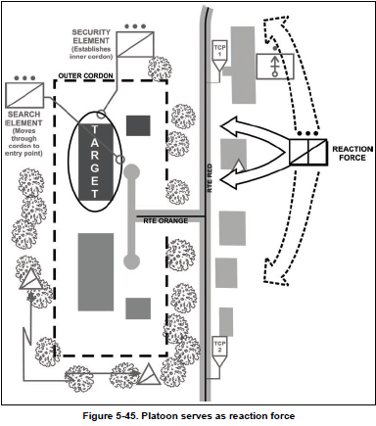
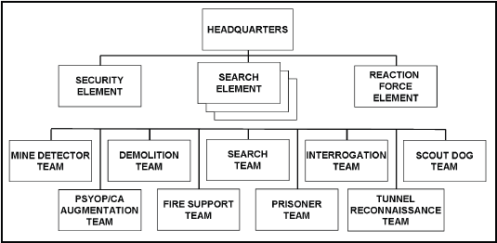
511
Movement and Maneuver
Cordon and Search
Cordon and search, a common tactical operation during stability operations, involves two potentially controversial and inflammatory processes: limiting freedom of movement and searching dwellings. These two actions create a clear potential of negative consequences for U.S. and multinational forces; as a result, organizing cordon and search elements requires extensive mission tailoring. Commanders must always be prepared for civil disturbances when their Soldiers conduct this operation.
TASK ORGANIZATION
The troop commander generally divides the area to be searched in a built-up area into zones and assigns a search party to each. The cordon consists of two parts, an outer and an inner cordon. The outer cordon is usually the responsibility of the troop because it requires a considerable amount of assets for effective control. The outer cordon consists of a security element (to encircle the area, to prevent entrance and exit, and to secure open areas) augmented with the necessary enablers such as linguists and CA specialists (based on METT-TC). The inner cordon is established by the platoon assigned the search mission. The troop must also establish a reaction force element to assist either element, as required.

Slide 69
514
Movement and Maneuver
Air Ground Integration (1 of 2)
1. There are two types of air assets available to the SQDN. The first is unmanned aerial vehicles (UAVs) which typically consist of Predator and Raven aircraft. The second is manned aerial vehicles in the ATK AVN role, typically AH-64s. These two aerial assets can effectively clear routes for a unit and provide the ground forces commander with increased situational awareness and the ability to better track targets attempting to flee from the objective. The thermal capabilities of these two types of aircraft can greatly assist the ground commander in locating individuals who are fleeing or attempting to hide from ground forces. Air assets are recommended for all cordon and search/cordon and knock operations, as well as Squadron level operations. Commanders should integrate air assets into combat operations to assist the ground forces in maintaining situational awareness and reaching the desired end state.
2. Execution
The SQDN S3 coordinates all ATK AVN support, and the SQDN S2 coordinates all UAV support for the ground troop commander. The Troop Commander or XO provides the SQDN staff with the concept of the operation, updated graphics, task and purpose for air assets, and scheme of maneuver for air assets and actions on the objective. The SQDN staff then coordinates this information with the appropriate units IOT support the ground troop commander. The ground troop commander assumes tactical control of the air assets once actions on the objective begin and air assets remain under his control until released by him, S3, or SCO; another higher priority mission develops; or the aircraft can no longer remain on station.
(1) Initial Planning.
a. Planning Timeline:
D-60: Initial ATK AVN Mission Request w/ draft graphics and concept sketch due to S3
D-24: Detailed ATK AVN Worksheet w/ graphics due to S3
D-12: Air/Ground Rehearsal
b. Format for Initial ATK AVN Mission Request
c. Format for Detailed ATK AVN Worksheet (See Card 23)
(2) Ground TRP actions prior to OPN.
a. Receive contact information for AVN assets from S3 or S2.
b. Arrange to speak with actual pilots if possible (most likely via phone)
1) Issue latest FRAGO
2) Ensure pilot understands concept of OPN, task/purpose, and scheme of maneuver
3) Ensure pilot has copy of graphics and updated imagery
4) Ensure pilot has SOI with TRP and PLT frequencies
5) Determine expected arrival time on station
6) Determine expected weapons/ammunition configuration
7) Determine any special capabilities of aircraft that may be useful for the mission.
8) Leave contact information in event of any changes.
9) Coordinate time for Air/Ground rehearsal
c. Ensure S3 or S2 updated with any FRAGOs
d. Conduct Air/Ground rehearsal with key leaders and pilots (via telephone)
(3) Ground TRP actions upon receipt of air assets.
a. Make contact with air asset on SQDN net; if necessary, instruct air asset to drop to TRP net.

Slide 70
514
Movement and Maneuver
Air Ground Integration (2 of 2)
Note: UAV operators will not be able to drop to TRP net and operations must be coordinated through SQDN/BDE NET. Recommend TRP XO or TOC NCOIC be present in the SQDN TOC to observe UAV feed and assist in air/ground integration.
b. Confirm the following information from air assets:
1) Estimated time on station
2) Weapon systems/ammunition breakdown
3) Special capabilities of aircraft
c. Provide SITREP to air asset and brief any recent FRAGOs.
d. Receive SITREP from air asset of situation/activity on the objective.
(4) Actions on Contact. The most likely form of contact will be visual contact with individuals attempting to flee the objective. In this situation, the air asset will maintain contact with the individuals fleeing the objective and guide ground forces to the targets until the ground element establishes contact. Once the ground element is satisfied that they can maintain contact with the target, they release the air asset to acquire additional targets.
If any forces come under direct fire contact from a target, AVN elements are authorized by ROE to return fire. The ground forces commander clears fires and authorizes return fire.
ACM typically have predetermined hiding places that are very difficult to observe from the ground, but are often easily observed from the air. In these situations, the air asset must provide direction and distance from ground forces to the target. The best method to relay direction is the clock method. All vehicles should place a VS-17 panel on the rear of their vehicle to assist air assets in locating the vehicle and determining its direction. When dismounted, it is often difficult for unmanned air assets to determine the direction ground elements are facing. In such situations, the ground element forms a wedge formation with 12 o’clock being the point of the wedge. If two ground elements are operating in the same vicinity and air assets cannot determine which element is which, one element forms a wedge, and the second forms a “T” with the bottom of the “T” being 12 o’clock.
12 o’clock
12 o’clock
12 o’clock

Slide 71
513
Movement and Maneuver
Establishing an HLZ (1 of 2)
1. Select a landing site. These factors should be considered:
A. The size of the landing site.
(1) 50 meter diameter. A helicopter requires a relatively level landing area 50 meters in diameter. This does not mean that a loaded helicopter can land and take off from an area that size. Most helicopters cannot go straight up or down when fully loaded. Therefore, a larger landing site and better approach and departure routes are required.
(2) 10 to 1 Ratio. When obstacles are in the approach or departure routes, a 10 to 1 ratio must be used to lay out the landing site. For example, during the approach and departure, if the helicopter must fly over trees that are 15 meters high, the landing site must be at least 150 meters long (10 x 15 = 150 meters).
B. The ground slope of the landing site. When selecting the landing site, the ground slope must be no more than 15 degrees. Helicopters cannot safely land on a slope of more than 15 degrees.
(1) When the ground slope is under 7 degrees, the helicopter should land upslope. (See figure below)
(2) When the ground slope is 7 to 15 degrees, the helicopter must land side slope. (See figure below)
LZ MARKING STANDARDS
DIRECTION OF WIND
= LIGHTING DEVICE
Note: Area should be clear of obstructions, in an area not likely for an ACM ambush, and positioned on top of hard packed dirt, gravel, or pavement. Keep vehicles and personnel 100m away from landing area if possible.
7 Paces
14 Paces
14 Paces
X
TOUCHDOWN
DIRECTION OF VEHICLE HEADLIGHTS, IF USED
DIRECTION OF LANDING
DIRECTION OF VEHICLE HEADLIGHTS, IF USED

Slide 72
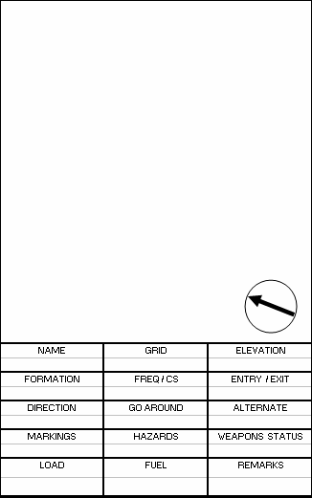
513
Movement and Maneuver
Establishing an HLZ (2 of 2)
C. Surface conditions.
(1) The ground must be firm enough that the helicopter does not bog down during loading or unloading. If firm ground cannot be found, the pilot must be told. He can hover at the landing site during the loading or unloading.
(2) Rotor wash on dusty or sandy surfaces may cause loss of visual contact with the ground. Brownout conditions may occur and should be avoided if possible.
(3) Loose debris that can be kicked up by the rotor wash must be removed from the landing site (engineer tape, commo wire, ponchos, etc). Loose debris can cause damage to the blades or engines. Rotorwash creates high velocity winds that can throw debris injuring personnel or damaging equipment.
D. Obstacles.
(1) Landing sites should be free of tall trees, telephone lines, power lines or poles, and similar obstructions on the approach or departure ends of the landing sites. Any obstacles taller than 30 feet should be pointed out to the helicopter crew.
(2) Obstructions that cannot be removed (such as large rocks, stumps, or holes) must be marked clearly within the landing site.
2. Establish security for the landing site. Landing sites should offer some security from enemy observation and direct fire. Good landing sites will allow the helicopter to land and depart without exposing it to unneeded risks. Security is normally established around the entire landing site. The LZ should also be cleared of IEDs.
3. Mark the landing site and touchdown point.
Determine method of marking LZ. Preferred Marking Methods:
Day: smoke (do not pop until instructed by aircrew) and panel marker (VS-17).
(2) Night: IR or normal strobe, chemlights (blue andgreen chem lights are not visible with Aviation NVGs).
B. Keep vehicles and personnel, except signalman, clear of area (100m) until instructed otherwise by aircrew. A well marked LZ and inexperienced signalman is better than a poorly marked LZ and an experienced signalman.
C. Keep all other light sources away from LZ (they will degrade aviator night vision systems) unless instructed otherwise by aircrew.
D. Once the aircraft is inbound, expect an estimated time of arrival call from the crew. The person on the radio at the site must observe the LZ to confirm signal, if required, or to assist crew in positioning.
E. Once the aircraft has landed, keep personnel away from the aircraft. The medic will come to the patient. The unit must provide four personnel per litter to assist in loading the patient.
F. Weapons and pyrotechnics will not be evacuated.
Generic PZ/LZ Diagram

Slide 73
514
Movement and Maneuver
9 Line MEDEVAC Request w/ MIST

Slide 74
515
Movement and Maneuver
Air Assault Operations (1of 2)
AMCM CHECKLIST
MISSION NAME
SUPPORTED UNIT
SUPPORTING UNIT
GROUND TACTICAL PLAN
MISSION (W/ CONCEPT, COMMANDERS
INTENT)
TIME REQUIRED FOR AVIATION SUPPORT
      AH __________
      OH___________
      UH __________
      CH___________
HOW MANY PAX DO YOU INTEND TO FLY
UH__________
CH__________
H-HOUR :______________
DOES THE GROUND TACTICAL PLAN
DICTATE ANY NO FLY AREAS?
ARE THERE SCOUTS OR COALITION
FORCES ON OBJ?
CONFIRM ANY NFA’S / RFA’S VIC OBJ
CONFIRM NFA’S AFTER FIRST
LIFT INSERTED
VEHICLE INTERDICTION PLAN
(ENEMY BREAKS INNER CORDON)
DETAINEE EXFILL PLAN
GROUND QRF AVAILABLE AND THEIR
FREQUENCY / CALLSIGN
MEDEVAC / CASEVAC PLAN (CALLSIGN
AND LOCATION)
LOCATION OF CASUALTY COLLECTION
POINTS (CCP’S)
LANDING PLAN
LZ PREP FIRES REQUIRED?
WEAPONS STATUS
CHERRY / ICE CALL REQUIRED?
PRIMARY LZ GRIDS AND NAME
(MAP DATUM REQUIRED IF MGRS)
LZ FREQUENCY AND CALLSIGN
  PRIMARY ____________
  ALTERNATE ____________
LZ MARKINGS (IF AVAILABLE)
LANDING HEADING (IF GROUND
TACTICAL PLAN DICTATES)
FORECASTED WINDS__________
SUNRISE / SUNSET____________
SUN / MOON ANGLE / %LUM__________
LANDING FORMATION (IF GROUND
TACTICAL PLAN DICTATES)
DOOR EXIT
ALT LZ GRIDS AND NAME
(MAP DATUM REQUIRED IF MGRS)
LZ HAZARDS
WIRES
IED
ENEMY FORCES
DUST / TRASH / RECENTLY
HARVESTED FIELD
ENEMY CONTACT IN LZ
WHAT IS THE MAX DISTANCE
AATFC WILL ACCEPT AWAY FROM OBJ
Helicopter characteristics.
 | UH-60A | UH-60L | CH-47D
Passenger capacity (seats in) | 11 | 11 | 33
Passenger capacity (seats out) | 18 | 18 | 60
Max cargo weight | 8,500 lbs. | 8,500 lbs. | 26,000 lbs.
Cargo hook capacity | 8,000 lbs. | 9,000 lbs. | 26,000 lbs. (center hook) 17,000 lbs (fore & aft hook) 25,000 lbs (fore & aft hook combined)
NOTE: Actual allowable cargo load (ACL) may be determined by ground and aviation unit commanders.

Slide 75
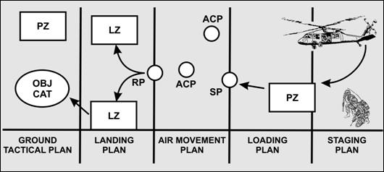
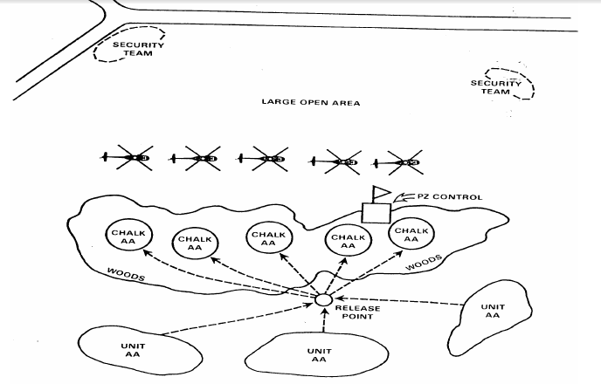
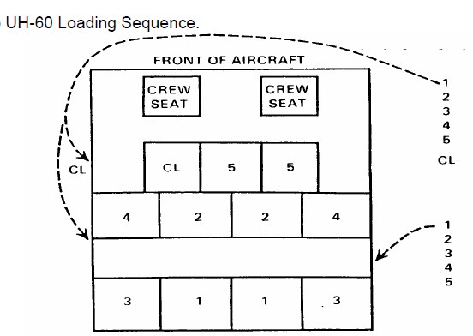
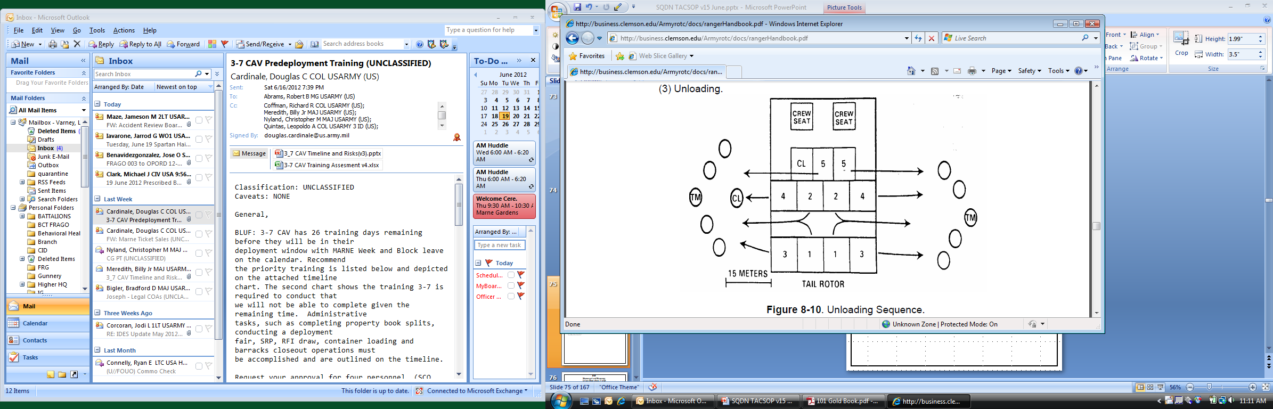
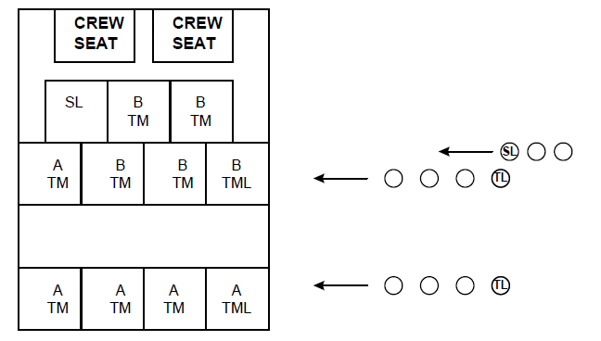
515
Movement and Maneuver
Air Assault Operations (2 of 2)
Large PZ Diagram
UH-60 Loading/Unloading Sequence.

Slide 76
516
Movement and Maneuver
Urban Operations (1 of 2)
FUNDAMENTALS OF URBAN OPERATIONS
When planning and executing urban operations, scouts consider certain fundamentals particular to man-made complex terrain. The eight fundamentals of urban operations include—
Conduct aggressive ISR operations.
Understand the human dimension.
Separate non-combattants from combattants.
Avoid the attrition approach.
Control what is essential.
Maximize effects without unnecessary collateral damage.
Conduct close combat.
Conduct transition control.
PREPARING FOR URBAN OPERATIONS
To operate effectively in an urban environment, platoons must prepare by developing a thorough
understanding of the urban environment through rigorous, realistic training. Platoons cover full spectrum
operations, including appropriate TTP (see FM 3-06.11). In addition, preparations should cover—
Psychological impact of intense, close combat against well-trained, relentless, and adaptive enemies.
The effects of noncombatants—including governmental and nongovernmental organizations and agencies—in close proximity to Army forces.
An in-depth understanding of culture and its effects on perceptions.
An understanding of civil administration and governance.
The ability to mediate and negotiate with civilians, including effective communication through an interpreter.
PREPARING FOR URBAN OPERATIONS (continued)
The development and use of flexible, effective, and understandable ROE.
Employment of a complex intelligence environment requiring lower-echelon units to collect and forward essential information to higher echelons for rapid synthesis into timely and actionable intelligence for all levels of command.
The communications challenges imposed by the environment as well as the need to transmit large volumes of information and data.
The sustainment challenges associated with operations in an urban area, including constant enemy operations against LOCs and sustainment bases.
The platoon conducts reconnaissance in urban environments to gain critical information on the enemy and other aspects of the OE. The reconnaissance or scout platoon must have clear and detailed
reconnaissance guidance from the higher commander to begin planning for reconnaissance in support of urban operations.
A successful reconnaissance effort must be exceptionally comprehensive and synchronized. Success begins with a detailed plan that requires a comprehensive ISR effort. The ISR plan must be flexible, must be responsive to the changing IR of the commander, and must support all phases of urban operations.

Slide 77
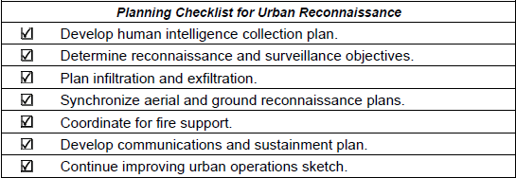
516
Movement and Maneuver
Urban Operations (2 of 2)
The platoon leader is responsible for the following essential aspects of the ISR effort in an urban operations plan:
Understand the reconnaissance objectives.
Conduct urban mapping using these steps:
Identify and pinpoint key locations.
Continuously improve the urban operations sketch.
The platoon leader must consider the following as he develops his urban operations plan:
IPB, including the following:
The enemy situation.
Civil considerations.
Initial map and aerial photograph reconnaissance (if available).
Hazardous areas.
Major terrain features.
Avenues of approach.
Terrain and weather considerations.
Friendly force considerations.
Commander’s intent and concept of the urban operation, including the following:
Key reconnaissance tasks to be accomplished by the platoon.
Purpose of platoon reconnaissance in relation to the higher headquarters reconnaissance objective.
End state for the reconnaissance.
Focus and tempo for the reconnaissance.
HUMINT collection plan.
Reconnaissance of the designated areas to answer the IR.
Synchronization of aerial and ground reconnaissance assets.
Synchronization of target acquisition assignments with reconnaissance tasks.
Integration of other elements or assets into the reconnaissance effort.
Locations and criteria for RHO and target handover.
Fires, including the following:
Determine who controls each fire support asset.
Exchange fire plan and observer plan with adjacent units.
Develop an observer plan.
Identify location of hazardous sites.
Identify the general construction or composition of the buildings and road surfaces.
Determine where buildings, overhead power lines, or towers degrade GPS or compass function.
Determine beneficial and detrimental effects in using obscurants and illumination.
Additional considerations, such as the following:
Bypass and engagement criteria.
Commitment criteria and actions of the reaction force or reserve.
Graphic control measures that support the concept of the operation.
Sustainment considerations.
Communications considerations.
Continuous updating of the urban operations sketch.

Slide 78
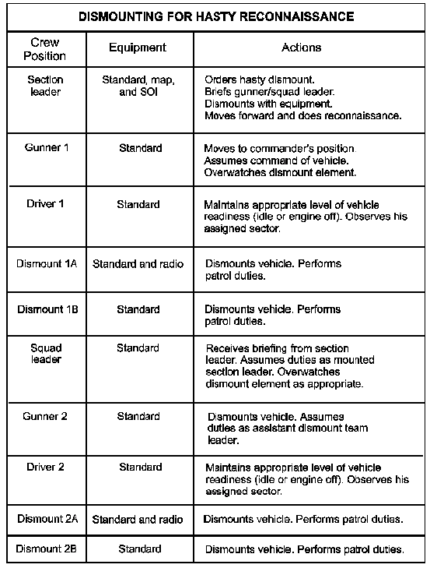
517
Movement and Maneuver
Dismount Drill for Hasty Reconnaissance

Slide 79
518
Movement and Maneuver
Relief in Place
METHODS OF RELIEF IN PLACE
There are three methods for conducting a relief in place:
Sequential. Relieving one unit at a time is the most time-consuming method, but the most secure. Units are relieved in place, with the relieving unit assuming the relieved unit’s positions and missions. Relief normally proceeds by platoon
Simultaneous. Relieving units simultaneously is a variation of the sequential method. It is faster, but less secure, because all platoons are moving at the same time. The decentralized nature of a simultaneous relief requires close coordination.
Staggered. Relieving units by occupying adjacent or in-depth positions is considered staggered relief. The relieved unit withdraws one platoon at a time or simultaneously and conducts a rearward passage of lines through the relieving unit..
Link up and coordination.
A. Link up.
(1) Units contact each other via FM(P) net to work out exact linkup location (FBCB2 is Alternate).
(2) Unit leaders at each relieving point identify link up point (rotate to avoid patterning).
(3) Both units responsible for security during link up.
B. Information Exchange.
(1) Location of weapon systems by type (sniper rifles, crew served, etc.).
(2) Last known enemy contact(s) (SALUTE report and form of contact [i.e. Indirect, Direct, Observation or Obstacle/IED]).
(3) Last known suspicious activity (SALUTE report and form of contact [i.e. Indirect, Direct, Observation or Obstacle/IED]).
(4) All Friendly unit (to include Local Security Forces and MPs if known) dispositions (location, composition, orientation, scheduled patrols and FM frequencies).
(5) Known adjacent unit large scale operations.
(6) UAV and Attack Aviation scheduled windows of support, flight plan, etc.
(7) Raven / Shadow Operator BHO.
(8) Position Range Card exchange (Terrain orientation, TRPs, sectors of fire, RFLs, obstacles, etc.).
(9) Unit Fire Plan (Friendly EAs, Fields of fire, Fratricide prevention measures, etc.).
(10) Unit Obstacle Plan (if any).
(11) MEDEVAC LZ (location and confirmation TOC has location).
(12) Any additional Graphic Control Measures created during that shift.
C. Coordinate.
(1) Sequence of Relief (east to west, north to south, etc.).
(2) Turnover of OPs (mounted and dismounted).
(3) Turnover of C2.
(4) Relieved unit exfil routes.
(5) Transfer of any Classes of supply or equipment that remain at the position.
(6) Transfer of any personnel that remain at the position
D. Exfil and assumption of mission.
(1) RIP preferably done during hours of limited visibility.
(2) Unit begins sequence of relief.
(3) Relieved unit moves along planned exfil routes to release point.
(4) Relief is conducted quickly and quietly maintaining the highest level of security.
(5) Transfer of responsibility for overall security now to relieving unit.
(6) Relieving unit and relieved unit operate on relieved units net until RIP is complete.
(7) Relieving unit subordinate positions inform relieving unit leader that all positions are established.
(8) RIP complete when relieving unit informs SQDN TOC via FM.

Slide 80
519
Movement and Maneuver
Reconnaissance Handover & Adjacent Unit Coordination
RHO is the process of planning, preparing, and executing transfer of responsibility and information from one element to another to facilitate continued observation or surveillance of enemy contact or an assigned area. RHO may cover an area/zone—such as an AO, NAI, or target area of interest (TAI)—and/or enemy elements. It may involve visual, electronic, digital, or analog observation and information sources (or any combination of these). It is usually associated with a designated RHO coordination point or a phase
line designated as a reconnaissance handover line (RHOL).
RHO shares several critical tasks with battle handover (BHO), including relief in place, linkup, and passage of lines. Unlike BHO, however, it does not imply direct fire contact.
Planning steps for the RHO are the following:
Coordinate for redundant surveillance to assist in maintaining enemy contact during RHO.
Coordinate location and criteria for RHO with higher HQs.
Coordinate a communications plan between units.
Coordinate fires, exchange fire support plans, and coordinate fire control measures.
Coordinate target handover.
Coordinate graphic control measures.
Coordinate collocation of CPs.
Coordinate transfer of C2.
Plan for integration of non digital elements.
Adjacent unit coordination must be conducted prior to and during missions to mitigate risk, share information, and ensure mission accomplishment. This coordination is accomplished face-to-face, by FM, or through FBCB2.
Before Mission (NLT 24 hrs. out)
CDR or representative from each unit exchange the following information:
  5W’s for their mission
  Unit Graphics to include Enemy Most Probable and Most Danger COA and contact points
  Frequencies and Call Signs
  Near / Far recognition signals
CDR briefs subordinate leaders on adjacent unit information
CDR assigns Contact Points to subordinate units and relays relevant information for adjacent unit
During Mission
CDR or leader of responsible unit coordinates movement to
and execution of Contact Points
Coordination must also be conducted for the following
situations:
  Movement into adjacent unit’s sector
  Adjacent unit movement into unit’s sector
  Enemy contact in or near adjacent unit’s sector
  Firing into adjacent unit’s sector
  Enemy movement in or into adjacent unit’s sector
  Any other times the CDR or leader deems necessary
Contact Point Checklist
Enemy Situation. (Strength, Type, Location etc.)
Own unit disposition. (Task, Purpose, Front Line Trace etc.)
Unit level Graphics.
Location of obstacles, IEDs, and contaminated areas
Frequencies, and Call Signs
Recognition signals
Tactical support available
Location of next Contact/Coordination Point

Slide 81
520
Movement and Maneuver
Tactical Road Marches (1 of 3)
1. Movement Preparation
A. Determine Mission requirements
(1) Warning order / OPORD, maps, FMs, Load plans
(2) Ensure load plans are updated
(3) Evaluate the environmental impact on the area of operations
(4) Determine Squadron Order of March
B. Conduct Route Reconnaissance
(1) Conduct map recon and select primary and alternate routes.
(2) Follow up with physical recon if time and tactical situation permits.
(3) Consider bridges, underpasses, tunnels, and overhead clearances.
(5) Consider minimum speeds and transport of hazardous cargo and compressed gas when selecting a route.
(6) Identify all halts (rest, meals, refueling, maintenance, and time schedule adjustment) considering limitations of highway regulations, traffic congestion, and availability.
(7) Identify all other route restrictions; temporary road conditions, weather and enemy activity.
C. Prepare Strip Map to contain at a minimum:
(1) Start point.
(2) Release point.
(3) Route numbers.
(4) Town names.
(5) Critical / Choke Point.
(6) Distances between points.
(7) Total distance.
(8) North Orientation.
D. Request convoy clearance: Procedures with host nation, brigade, and movement control team.
E. Plan convoy organization and control.
(1) Appoint a trail party consisting of maintenance, medical, POL vehicle, and claims officer. Direct them in the proper action for accidents, disabled vehicles, and maintenance.
(2) Coordinate support requirements (MP, Class I, Class III, Class V, Fire support, Engineer support).
(3) Plan for special mission requirements (Blackout drive, NVGs, NBC, or vehicle hardening).
(4) Plan troop carrying vehicle placement (away from hazardous material and away from the end of the convoy to minimize injury in event of rear-end collision).
(5) Place heaviest or slowest vehicles at the front of the convoy to set the pace.
(6) Divide convoy into march serials if more than 20 vehicles.
(7) Determine position of march unit and serial commanders.
(8) Obtain assistance of civilian police whenever possible
(9) Prepare movement order.
2. March Column Standards:
Condition | Interval Day/ Night (mph) | Speed(mph) | Catch Up (mph)
Open Road | 50/50 | 20 | 25
Built Up Area | 25/25 | 15 | 25

Slide 82
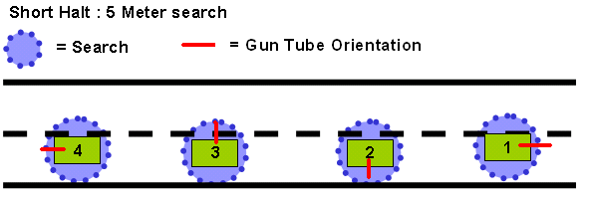
520
Movement and Maneuver
Tactical Road Marches (3 of 3)
A. Maximum range is 200 kilometers per day.
B. March unit interval is 2-5 minutes.
C. The day travel interval will vary depending on weather conditions.
D. (1) Day – No lights in tactical situations, service drive if civilian vehicles present.
(2) Night – Black out markers or black out drive depending on weather conditions, service drive if civilian vehicles present.
E. 360 Security at all times
3. Actions at a halt:
A. Primary weapon and radio manned in each vehicle.
B. Local Security established (5 and 25 meter sweeps).
C. Maintenance halts scheduled every 3 to 4 hour for 10 minutes.
4. Vehicle Breakdown:
A. Move off route to allow convoy to pass; place safety warning devices behind vehicle.
B. Vehicle signals following vehicles to continue; notify higher CDR/TOC.
C. Post local security and attempt repair.
D. Prepare vehicle for recovery if unable to repair.
E. Ground guide for bypass.
5. Actions during Artillery Attack:
A. Continue to move.
B. Button up and report, “Observing Artillery at Grid:________________.”
6. Communications – Report the following:
A. Vehicle break down or unscheduled halt.
B. Enemy contact.
C. Any suspicious activity.
D. Movement delays of more than 10 minutes.
E. TAC controls move over Squadron CMD net until TOC is set at new location; once TOC reports closure on new site, TAC hands over control to TOC.
F. All checkpoints along route.
G. Any changes to route trafficability that may affect follow-on units.
Actions at Halts.
5 and 25: A movement technique where patrols will conduct area searches around their vehicle and around the area depending on how long the halt is. These searches will enable the patrol to gain immediate situational awareness of their surroundings.
Short Halt: When a convoy or patrol of any size or composition stops for a short halt and remain mounted, every member of the element scans a 5 meter area around their vehicles for IEDs before focusing their attention farther out.

Slide 83
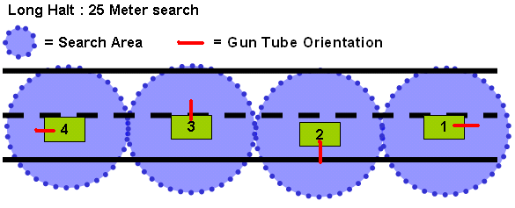
520
Movement and Maneuver
Tactical Road Marches (3 of 3)
Long Halt: When a convoy or patrol of any size or composition stops for a long halt, designated members of the element will dismount and search a 25 meter area around their vehicle(s) for IEDs as appropriate, based on METT-TC. If your convoys were traveling with a 50m interval, the immediate area should be clear. Remember mines!
Maneuver Techniques:
1. Clear and secure flanks (at least 100 meters in forested areas).
2. Clear and secure the far side of suspected and known obstacles before marking and clearing of obstacle or route.
3. Identify and clear potential sniper positions before clearing obstacles.
4. Provide overwatching fire for clear team element.
5. Coordinate for AWT, UAS, or other aerial support.
Command and Control Techniques:
1. Route clearance may be performed either be centralized (up to brigade level) or decentralized (squadron or below)
2. Task-organize appropriately for the mission and to ensure unity of effort.
3. Determine routes with definable start and end points.
4. Establish clearly identifiable checkpoints along routes to control traffic and monitor route clearance progress.
5. Coordinate with adjacent units.
6. Coordinate additional support forces with unit(s) occupying the surrounding terrain if the operation is conducted from the brigade level.
7. Track progress and then revise/adjust maneuver/CSS plan accordingly.
8. Ensure ground commanders have communication with indirect fire systems, aviation, higher headquarters ,and adjacent units.
9. The maneuver platoon leader or troop commander should be the controlling element on the ground.

Slide 84
521
Mounted Maneuver
Quick Reaction Force
ACT AS QRF
-You will receive a mission to act as a QRF to provide a response force to the Commander for missions he is given
- Typical missions might include:
Assisting FOB Guard Force
Adding Combat Power to Units on patrol
Assisting in Crowd Control, Convoy Security Missions or safeguarding officials.
PLAN, PREPARE, AND REHERSE
-Resource requirements
-REDCON status and force protection status
-ANSF Participation
-Rehearse Routes and Actions on the Objective
-Building clearing Techniques
-ROE/RUF—Tactical Directives applicable
-Link up point and Recall plan
-Commo plan
- Weapon Control status
- PCC/PCI’s
- Contingency Plans
- Other assets available/coordinate methods of reinforcement
- QRF near and far recognition signals
-QRF interpreter(and availability)
- Brief higher
- Conduct at least one mounted and one dismounted alert daily. Time and set to standard.
STANDARDS
-The QRF should be ready to move according to REDCON status as designated by the commander.
- Before departure the current situation is briefed to all personnel
- QRF takes appropriate action at the scene to protect soldiers lives and to ensure mission accomplishment IAW ROE.
- QRF departs the scene with all personnel and equipment accounted for.
- QRF recovers upon return to base and is ready to employ again in 3 hours.

Slide 85
522
Mounted Maneuver
Traffic Control Point
A traffic control point (TCP) is a designated spot on the ground or road network to control traffic flow into or out of a given area. Most TCP’s that will be conducted are hasty and may be partnered with ANSF or other NATO Forces. The missions associated with a hasty TCP are:
- Act as an OP.
- Check and inspect traffic for possible ACM and contraband.
- On order, block or impeded traffic.
TO ESTABLISH CHECKPOINT:
- After receiving the mission review requirements to complete the mission (Personnel, interpreter, vehicles, weapons, special ammo, communication equipment, etc)
- Build Checkpoint(Establish Over watch and Security, emplace obstacles, vehicle/personnel search locations and teams, employ signs, prepare defense procedures).
- Report all information and intelligence requirements regularly.
RUNNING THE CHECKPOINT :
-Establish control by insuring each individual soldier understands his piece of the mission(QRF,
Vehicle search etc.)
-Give special consideration to
a. Searching females
b. Cars with only one driver
c. Intoxicated individuals.
-Be suspicious of
a. Nervous behavior
b. Clean shaven hands/faces
c. wear bulging or excessive clothing.
-Additional considerations
a. Specific search requirements
b. Confiscation requirements
c. Detainment requirements
TCP Kit.
A. Alert signs (2x).
B. Warning sign (1x).
C. Stop sign (1x).
D. Stop paddle (1x).
E. Sawhorses (5x) or traffic cones (10x) or warning triangles (7x).
F. Bean-bag lights or similar flashing / warning lights (5x).
G. Spike strips, roles of C-wire, or similar vehicle disabling device (3x).
H. Portable speed bump or field expedient substitute (sandbags, track, etc) (1x).
I. Flashlights (2 per screening team and search team).
J. Pre-printed instructions in local language or translator with each screening team.
K. Body bags (5x).
L. Rubber gloves (10 pair).
M. Detainee forms (20x).
N. Zip ties (20x).
O. Laminated search instructions, curfew violation warnings, contraband list, weapon’s policy guidelines, and female search instructions.
P. Search mirrors.

Slide 86
523
Movement and Maneuver
Vehicle Load Plans (1 of 6)
Interior and Trunk Loads
Log Book and
Vehicle TM
(Under Driver Seat)
Communication Equipment
(vehicle dependent)
9-line Medevac Card (taped on left and right upright windshield posts)
Fire
Extinguisher
Extra Pyrotechnics
(Strapped to TC seat)
Detainee
Kit
CLS Bag
Crew Serve
Weapon Ammo
(6 boxes strapped,
2 loose and ready)
LZ Kit
Wire Handler’s
Gloves
Assault Packs x 3
MREs
5 Traffic Cones
Water
Winch
Controller Cable
Slave Cable
Jack
Max Tool Kit
D-handle
Shovel
1st Aid
Kit
Warning
Triangles
Tool Bags
Bolt
Cutters

Slide 87
523
Movement and Maneuver
Vehicle Load Plans (2 of 6)
Exterior
550 Cord tied to front grill
Concertina Wire
Secured with 550 cord
550 Cord secured to hood latch
IR Strobe light (Velcro to gunner’s shield)
Crew Serve Weapon
M-2 / M-240B/MK19
M-16/M-4 rifle
Binoculars
Laser Pointer
(with lanyard)
M-136 AT-4
(If issued)
VS-17 Panel
(Orange side up)
FM 572
Unit Frequency
Litter
(Behind Antenna Mounts)
Spare Tire

Slide 88
523
Movement and Maneuver
Vehicle Load Plans (3 of 6)
Vehicle Front
IR Strobe Light Velcro to front of gunner’s shield
Reflective Tape; Coalition vehicle marking
Reflective Tape; Coalition vehicle marking
Tow strap routed to driver’s mirror
3-7 CAV
A 14
SLING AND
TIE DOWN
Two rolls of concertina wire secured to hood of vehicle
Tow Strap Girth-hitched to front sling point
Tow strap secured with single loop of break-cord (single strand of 550-cord gut)

Slide 89
523
Movement and Maneuver
Vehicle Load Plans (4 of 6)
Vehicle Rear
Reflective Tape
Horizontal; Coalition vehicle marking
Looped-end of tow strap secured to right rear antenna mount with single strand of break cord
Reflective Tape
Horizontal; Coalition vehicle marking
3-7 CAV
A 14
Looped end must protrude past side of vehicle
SLING AND
TIE DOWN
Vehicle
Tow Bar
Litter
(Behind Antenna Mounts)
Excess strap S-folded and secured with single loop of break-cord (single strand of 550-cord gut)
Tow Strap Girth-hitched to rear sling point
Not shown in Diagram:
Warning sign – “Warning, stay back 50 meters” – attach to spare tire with 550-cord

Slide 90
523
Movement and Maneuver
Vehicle Load Plans (5 of 6)
Close-up, Left Front
Concertina secured to hood with single-strand of 550-cord
End-of-Line-Bowline knot on end of 550-cord looped over hood latch secures concertina wire to hood of vehicle
Small Clevis attached to end of Tow strap
Tow strap routed to front of vehicle
Small Clevis secured to driver’s mirror with single loop of break-cord (single strand of 550-cord gut)
To remove concertina wire, unlatch hood latch and slip off 550-cord loop; do not untie knot

Slide 91
523
Movement and Maneuver
Vehicle Load Plans (6 of 6)
Antennae Rigging, Vehicle Rear
Aerials tied together with a single strand of 550-cord
Single strand of 550-cord tied to horizontal line, secured to back deck of vehicle; cord must not prohibit turret from rotating
Gunner pulls the lowering cord to negotiate low hanging wires
3-7 CAV
A 14
SLING AND
TIE DOWN

Slide 92
524
Movement and Maneuver
Patrol Checklist (AKA Trip Ticket)
COMMO PLAN
TYPE FREQ
P
A
C
E

Slide 93
525
Movement and Maneuver
Fundamentals of Security (1of 2)

Slide 94
525
Movement and Maneuver
Fundamentals of Security (2 of 2)

Slide 95
FORCE PROTECTION
600 | FOB/ Combat Outposts
601 | Sector Sketch Example
602 | CBRNE
603 | NBC Warnings and Alarms
604 | Risk Management

Slide 96
600
Force Protection
FOB / Combat Outposts (1 of 3)
A reconnaissance or scout platoon may conduct operations from a combat outpost equipped with automatic and crew-served weapons, communications equipment, and sensors supported by indirect fires.
Platoons assigned to combat outposts may be augmented with additional combat elements such as UAS teams, infantry, armor, and engineers to provide assistance in reconnaissance and offensive actions to counter enemy activities. This is a very labor-intensive mission and is used only in response to clearly defined squadron requirements.
Combat outposts are also used to protect critical lengths or locations along the route. Due to the length of some convoy routes, a squadron or troop will establish mutually supporting platoon-size combat outposts and provide security between them. Combat outposts are established at critical choke points to prevent sabotage and to defend against or respond to attacks to interdict the route between outposts. Reconnaissance or scout platoons may be augmented to supply reaction forces, engineer route clearance assets, and insurgent intervention elements as well as continuous surveillance along key points of the route. Patrols are organized with sufficient combat power to destroy near ambushes and to survive initial enemy contact from far ambushes. Platoons conduct patrols at irregular intervals between the outposts based on enemy trends and recent activities.
Each combat outpost maintains a reaction force to respond to enemy activity or reinforce patrols. Based on METT-TC, a troop can establish one or two platoon combat outposts, and a squadron can typically establish up to six platoon-size combat outposts.
FOBCON Levels
Green – Situation Normal
Uniform is duty uniform/PTs with weapon.
Magazine is available but not loaded.
Amber – Attack on FOB is probable/imminent
Uniform is ACUs with weapon.
Magazine is available but not loaded.
IOTV and ACH are available within 5 minutes but not worn
Red – Limited attack on FOB is underway
Uniform is ACUs, IOTV, ACH, weapon
Weapon status is amber
On-duty personnel report to assigned fighting positions
Black – Attack on FOB is underway, security breach exists or imminent
Uniform is ACUs, IOTV, ACH, weapon
Weapon status is amber
100% of personnel are woken/alerted and assume defensive positions
2x guards posted on all building entryways
Pro-Words
Phoenix-Bldg ## - Fire in specified building
Fallen Angel – UAS or A/C crash or accident
Red Rain – Indirect Fire Attack on FOB
Hailstorm – Direct Fire Attack on FOB
DUSTWUN – US/Allied Soldier Missing

Slide 97
600
Force Protection
FOB / Combat Outposts (2 of 3)
1. Establish Security Zone.
A. Minimum distance of 150m from outer perimeter.
B. Clear foliage (minimum of 200m out to 300m if possible).
C. Deny use of adjacent buildings.
D. Develop a reconnaissance and surveillance plan (R&S Plan).
E. Conduct random recon patrols outside the FOB perimeter IAW R&S plan.
F. Establish elevated surveillance with direct fire overwatch.
G. Employ remote surveillance on areas not directly observed.
H. Utilize generator light sets/spotlights to deny dismount approaches in limited visibility.
I. Designate/enforce a civilian traffic dismount point and parking lot to keep vehicles out of the FOB.
J. Deny vehicle acceleration by establishing TCPs using barrier materials/spotlights on major avenues of approach to main gate.
K. Designate adjacent subordinate units or patrolling elements to maintain/rehearse QRF function to defeat threats, conduct counter reconnaissance, or reinforce friendly forces in security zone.
2. Control Access to Main Gate.
A. Establish security screening points in-depth on access road ensuring overwatch.
B. 100% ID check for all civilians.
C. Establish serpentine barrier with CL IV/Hesco Bastions.
D. Construct machine gun emplacement in overwatch.
E. Build security positions in-depth (2-3 man fighting positions) outside and inside main entrance.
F. Establish alternate entry/exit gate that can only be opened from inside the perimeter and used only for specific requirements.
3. Prepare to Defend within the Perimeter.
A. Distribute key functions between separate buildings or within buildings (i.e., keep living area away from TOC, if possible).
B. Create blast barriers/serpentine on the route between main gate and key buildings.
C. Maintain/rehearse internal reaction force to reinforce main gate defense or react to contact within the perimeter to block access to key nodes.
D. Develop/rehearse general defense plan for all personnel occupying the FOB.
E. Establish/rehearse casualty collection points, medevac landing zone, ammunition resupply, and rally points.
FORCE PROTECTION STANDARD FOR ALL FOBS/Outposts: Must be able to defeat an attack of an enemy infantry squad seeking to penetrate defenses and emplace VBIED

Slide 98
600
Force Protection
FOB / Combat Outposts (3 of 3)
FORCE PROTECTION STANDARD FOR ALL FOBS/Outposts: Must be able to defeat an attack of an enemy infantry squad seeking to penetrate defenses and emplace VBIED

Slide 99
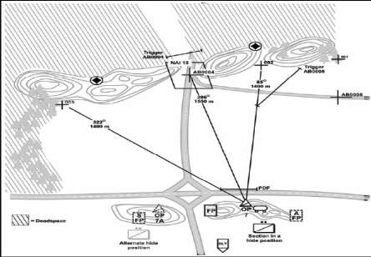
601
Force Protection
Sector Sketch Example
The Section Leader OP Sketch is similar to a fighting position sketch but with some important differences. At a minimum, the sketch will include the following:
A sketch of key and significant terrain, including NAIs and avenues of approach.
Location of the OPs.
Location of the hide position (s).
Locations of vehicle fighting and observation positions.
Alternate positions (hide, fighting, and observation).
Routes to and from the OP and fighting positions.
Sectors of observation, with dead space identified.
Preplanned artillery targets.
TRPs for direct fire.
Prepared SPOTREPs and calls for fire, based on trigger lines and projected locations where the enemy will first be seen.
Locations of protective obstacles, such as claymore mines and trip flares.

Slide 100
602
Force Protection
CBRNE MOPP Levels (1of2)
MOPP Equipment | MOPP LEVELS |  |  |  |  |  | Command
 | MOPP Ready | MOPP Zero | MOPP 1 | MOPP 2 | MOPP 3 | MOPP 4 | Mask Only
Mask | Carried | Carried | Carried | Carried | Worn¹ | Worn | Worn
Overgarment | Ready³ | Available⁴ | Worn¹ | Worn¹ | Worn¹ | Worn
Vinyl Overboot | Ready³ | Available⁴ | Available⁴ | Worn | Worn | Worn
Gloves | Ready³ | Available⁴ | Available⁴ | Available⁴ | Available⁴ | Worn
Helmet Protective Cover | Ready³ | Available⁴ | Available⁴ | Worn | Worn | Worn
Chemical Protective Undergarment² | Ready³ | Available⁴ | Worn² | Worn² | Worn² | Worn²
¹ In hot weather coat or hood can be left open for ventilation. ² The CPU is worn under the BDU (primarily applies to SOF and armor vehicle crewmen. ³ Must be available to the soldier within two hours. Second set available in 6 hours. ⁴ Within arms reach of soldier.

Slide 101

602
Force Protection
CBRNE MOPP Levels (2of 2)
MOPP LEVELS AND M9 PAPER EMPLACEMENT
1. This card establishes the standards for mission oriented protective posture (MOPP). The threat to the SQDN may range from WMD and NBC systems employed by hostile forces to the careless storage, operation, or damage of industrial sites or transportation means. Commanders will direct MOPP to permit continued execution of operations while protecting personnel. Commanders may modify MOPP, when no immediate hazard is present, to reduce heat stress on soldiers. Commanders may always increase the directed MOPP level based on METT-TC and local conditions.
2. NBC protective equipment will be worn, carried or stored in the manner indicated based on the directed MOPP posture.

Slide 102
603
Force Protection
NBC Warnings and Alarms
THREAT CONDITION | ATTACK PROBABILITY | ENEMY INDICATORS | CIVIL INDICATORS | MINIMUM PROTECTIVE ACTIONS
WHITE | Negligible | Has no NBC offensive capability in the AI | No known industrial hazards or nuclear reactors in the AI | - Verify Chemical Defense Equipment (CDE) - Routine Maintenance
GREEN | Possible | - Has offensive NBC capability - No indicators of potential employment in next 24 hours | Confirmed presence of hazardous industrial materials or nuclear reactors in the AI | Above, plus - NBC Training & Rehearsals - PMCS NBC Equipment, to include vehicle and shelter filters - Shelter/Overhead cover plan - MOPP 0
AMBER | Probable | - Moving, dispersing, or prepositioning NBC munitions forward or near delivery systems - Wearing protective gear or movement/ dispersal of decon systems - Increased OPSEC of delivery means | - Hazardous industrial practices reported - Hazardous conditions in storage facilities detected - Combat operations being conducted near sites with confirmed hazards | Above, plus Emplace Alarms - MOPP 2 decision - Cover equipment/ supplies - Verify alarms/ warnings - Brief NBC Teams - Verify mask seals/MOPP - Decon Site Prep - Collective Shelters - Issue - FOXs on stand-by or conducting directed surveillance
RED | Imminent | - Ready/certain to employ NBC munitions - Used in AI; no local contamination hazard present | - Localized spill or accident confirmed - HN authorities direct limited precautionary evacuation or declare hazard area | Above, plus - MOPP 2/3/4 decision based on METT-TC - Continuous Monitoring - Use Vehicle Overpressure - FOX NAI overwatch
BLACK | Attack Occurred | - NBC contamination is present in AO - Germs/Toxins detected in AO | Major industrial accident/ incident | Above, plus - FOX Recon/Unit Survey - Mark Contaminated Areas - Find Clear Routes - CDE Resupply

Slide 103

604
Force Protection
Risk Management (1 of 2)

Slide 104


604
Force Protection
Risk Management (2 of 2)
Risk Management is conducted for all operations regardless of task or environmental condition

Slide 105
FIRES AND EFFECTS
700 | Risk Assessment Distance
701 | Crater Analysis
702 | Artillery and Mortar Ranges
703 | Fire Missions
704 | Air to Ground Integration

Slide 106
700
Fires and Effects
Risk Assessment Distances

Slide 107


701
Fires and Effects
Crater Analysis (1 of 3)
Fuse Furrow and Center of Crater Method
Place a stake in the center of the crater.
Place two stakes, one at the end of each line of side spray, equal distance from the center stake.
Hold a length of communications wire (or another appropriate field expedient means) to each side spray stake, and strike an arc forward of the fuse furrow.
Place a stake where these arcs intersect.
Set up a compass in line with the center stake and the stake at the intersection of the arcs.
Orient the instrument.
Measure the direction to the firing weapon.
Side Spray Method
Place a stake in the center of the crater.
Place a second stake in the fuse furrow.
Set up a compass in line with the stakes and away from fragments.
Orient the instrument.
Measure the direction to the hostile weapon.
Side Spray Method

Slide 108


701
Fires and Effects
Crater Analysis (2 of 3)
There are two types of low-angle fuse delay craters - ricochet and mine action.
Ricochet Furrow Method
Clean out the furrow.
Place a stake at each end of a usable straight section of the furrow.
Set up a direction-measuring instrument in line with the stakes and away from fragments.
Orient the instrument.
Measure the direction to the weapon.
Mine action occurs when a shell bursts beneath the ground. Occasionally, such a burst will leave a furrow that can be analyzed in the same manner as the ricochet furrow. A mine action crater that does not have a furrow cannot be used to determine the direction to the weapon.
Splinter Groove Method
Lay a stake along the ends of the splinter grooves that extend from the crater.
Lay a second stake perpendicular to the first stake through the axis of the fuse tunnel.
Set up a direction-measuring instrument in line with the second stake and away from fragments.
Orient the instrument.
Measure the direction to the weapon.

Slide 109


701
Fires and Effects
Crater Analysis (3 of 3)
Main Axis Method
Lay a stake along the main axis of the crater, dividing the crater into symmetrical halves. The stake points in the direction of the mortar.
Set up a direction-measuring instrument in line with the stake and away from fragments.
Orient the instrument.
Measure the direction to the weapon.
Fuse Tunnel Method
Place a stake in the fuse tunnel.
Set up a direction-measuring instrument in line with the stake and away from fragments.
Orient the instrument.
Measure the direction to the weapon.
Note: If the angle of fall is too great (a 90 degree angle), the fuse tunnel method cannot be used.

Slide 110
1002
Fires and Effects
Artillery and Mortar Ranges

Slide 111

703
Fires and Effects
Fire Missions (1 of 2)

Slide 112
703
Fires and Effects
Fire Missions (2 of 2)
CAS 9-Line
CCA 5-Line
IP Grid _______________
Heading-(Deg)_________
Distance (NM)_________
TGT Elev (ft)___________
TGT Desc_____________
TGT Loc_______________
Type of Mark__________
LOC of Friendly/Method of Marking
Egress Dir_____________
*Ensure Lines 4/6 are read back*
____this is_____ Fire Mission, Over.
My Location is Grid________, marked by__________ Over.
(TGT DESC), marked by__________ Over.
Remarks___________________________________________
*Remarks should include a TGT Talk on; Always start big to small*
GRID MISSION
IMM SUPPRESSION/SMOKE
____this is___ ADJ Fire/FFE Over.
Grid___________ Alt____ Over.
(TGT DESC) Over.
Direction _______ Over.
*TGT DESC Should include 1. What the TGT is 2. What the TGT is doing 3. Size & Shape 4. Degree of protection & 5. # of elements in the target*
_____this is_____-Immediate Suppression, Grid__________ alt_____ Over.
_____this is_____-Immediate Smoke, Grid__________ alt_____ Over.
*Normal Standard for these missions is 2 rdns HE & 2 rdns WP unless otherwise specified*

Slide 113
704
Fires and Effects
Air to Ground Integration (1 of 3)
When the aircraft is within communications range it transmits a check-in briefing (fighter lineup) to the terminal controller. C
AS CHECK-IN BRIEFING
Aircraft Transmits to controller
Aircraft: “, __________________ this is” _______________”
(Controller call sign) (Aircraft Call Sign)
Identification/Mission number:____________________
NOTE: Authentication and appropriate response suggested here. The brief may be abbreviated for brevity or security (“as fragged” or “with exception”).
Number and Type of Aircraft: “____________________”
Position and Altitude: “__________________________”
Ordnance: “___________________________________”
Play Time: “___________________________________”
Abort Code: “______________________” (if applicable)
*Remarks: “____________________ (NVG, LST,
Special Mission Items) __________________________”
*Optional Entry
Note: Ensure that you update the pilot as to any change of conditions on the objective/tasking upon check in.

Slide 114
704
Fires and Effects
Air to Ground Integration (2 of 3)
J-FIRE CAS BRIEF (9-LINE BRIEF)
The CAS 9-line brief provides the aircrew with essential information for execution of the mission. The brief follows a numbered format sequence; therefore, reference to line numbers or elements is not required. The brief should be passed to the aircrew as early as possible. As a last resort, the aircrew can receive the brief at the contact point. The ALO provides IP location and fighter run-in time from IP to target. The ALO determines who will have final control of the CAS mission.
CAS BRIEFING (9-LINE) Omit data not required. Do not transmit line numbers or their titles. Units of measure are standard unless otherwise specified. *Denotes minimum essential in limited communications environment. BOLD denotes readback items when requested.
Terminal controller:”________________, this is_________________” (Aircraft Call Sign) (Terminal Controller) 1. *IP: “____________________________________” 2. *Heading: “___________________________________” (Deg Magnetic) (IP/BP to Target) Offset: “______________________________________” (Left/Right) 3. *Distance: “____________________________________” (IP to Target in nautical miles/ BP to Target in meters) 4. *Target Elevation: “______________________________” (in feet/MSL) 5. *Target Description: “_______________________________________” 6. *Target Location: “________________________________________” (Lat/Long, grid cords to include map datum [i.e., WGS-84], offsets or visual description) 7. *Type Mark: “______________” Code: “__________________________” (WP, Laser, IR, Beacon) (Actual Code) Laser to Target Line: “_______________________ Degrees” 8. *Location of Friendlies: “___________________________________” (from target, cardinal directions and distance in meters) Position marked by: “____________________________________” 9. Egress: “_____________________________________________” Remarks (as appropriate): : “__________________________________________” (Ordnance Delivery, Threats, FAH, Hazards, ACAs, Weather Restrictions, Addtn l Tgt Info, SEAD, Laser, Illumination, Night Vision Capability, Danger Close[with commander’s initials]) Time on Target (TOT): “__________________________________” OR Time to Target (TTT): “Stand by _________________________ plus _______________________________. Hack.” (minutes) (seconds)
NOTE: When identifying position coordinates for joint operations, include map data. Grid coordinates must include the 100,000-meter grid identification.

Slide 115
1004
Fires and Effects
Air to Ground Integration (3 of 3)
Kilometer to Nautical mile Conversion Chart *
Km | Nm | Km | Nm | Km | Nm | Km | Nm
1 | .54 | 7 | 3.78 | 13 | 7.02 | 19 | 10.26
2 | 1.08 | 8 | 4.32 | 14 | 7.56 | 20 | 10.80
3 | 1.62 | 9 | 4.86 | 15 | 8.10 | 21 | 11.34
4 | 2.16 | 10 | 5.40 | 16 | 8.64 | 22 | 11.88
5 | 2.70 | 11 | 5.94 | 17 | 9.18 | 23 | 12.42
6 | 3.24 | 12 | 6.48 | 18 | 9.72 | 24 | 12.96
*1 kilometer equals .54 nautical miles
The following table can be used to figure the number of minutes/seconds that it will take an aircraft to go from the IP to the target based on the aircraft speed:
Nautical Mile to Minute Conversion Chart
A/S (Knots) | NM/ MIN | 8 NM | 9 NM | 10 NM | 11 NM | 12 NM | 13 NM | 14 NM | 15 NM
300 | 5 | 1:36 | 1:48 | 2:00 | 2:12 | 2:24 | 2:36 | 2:48 | 3:00
360 | 6 | 1:20 | 1:30 | 1:40 | 1:50 | 2:00 | 2:10 | 2:20 | 2:30
420 | 7 | 1:09 | 1:17 | 1:26 | 1:34 | 1:43 | 1:51 | 2:00 | 2:09
450 | 7.5 | 1:04 | 1:12 | 1:20 | 1:28 | 1:36 | 1:44 | 1:52 | 2:00
480 | 8 | 1:00 | 1:08 | 1:15 | 1:23 | 1:30 | 1:38 | 1:45 | 1:53
510 | 8.5 | :57 | 1:04 | 1:11 | 1:18 | 1:25 | 1:32 | 1:39 | 1:46
540 | 9 | :53 | 1:00 | 1:07 | 1:13 | 1:20 | 1:27 | 1:33 | 1:40
CAS Aircraft Run-In Speeds
Aircraft |  |  |  |  | Airspeed (knots)
AC-130 H/U |  |  |  |  | 210-250
A-10 |  |  |  |  | 300-350
AV-8B |  |  |  |  | 420-480
F-16 |  |  |  |  | 480-540
F/A-18 |  |  |  |  | 480-520

Slide 116
INTELLIGENCE
800 | Processing EPWs / Refugees
801 | Detainee Packet
802 | Tactical Sensitive Site Exploitation
803 | Tactical Questioning
804 | Patrol Debrief Report
805 | Key Leader Engagement (KLE) Report
806 | TrIST SOP

Slide 117
800
Intelligence
Processing EPWs & Refugees (1 of 2)
  Treatment of EPWs and Detainees
  EPWs/detainees are a good source of information. They must be handled without breaking international law and without losing a chance to gain intelligence. Treat EPWs humanely. Do not harm them, either physically or mentally. The senior Soldier present is responsible for their care. If EPWs cannot be evacuated in a reasonable time, give them food, water, and first aid. Do not give them cigarettes, candy, or other comfort items. EPWs who receive favors or are mistreated are poor interrogation subjects. In handling EPWs/detainees, follow the procedure of search, segregate, silence, speed, safeguard, and tag (the 5 Ss and T). It implies the legal obligation that each Soldier has to treat an individual in custody of, or under the protection of, US Soldiers humanely. The 5 Ss and T are conducted as follows:
  Search‑‑This indicates a thorough search of the person for weapons and documents. You must search and record the EPWs/detainees equipment and documents separately. Record the description of weapons, special equipment, documents, identification cards, and personal affects on the capture tag.
  Silence‑‑Do not allow the EPWs/detainees to communicate with one another, either verbally or with gestures. Keep an eye open for potential troublemakers, both talkers or quiet types, and be prepared to separate them.
  Segregate‑‑Keep civilians and military separate, and then further divide them by rank, gender, nationality, ethnicity, and religion. This technique helps keep them quiet
  Treatment of EPWs and Detainees
  Safeguard‑‑Provide security for and protect the EPWs/detainees. Get them out of immediate danger and allow them to keep their personal chemical protective gear, if they have any, and their identification cards.
  Speed‑‑Information is time sensitive. It is very important to move personnel to the rear as quickly as possible. The other thing to consider is that an EPW/detainee's resistance to questioning grows as time goes on. The initial shock of being captured or detained wears off and they begin to think of escape.
Rights of an EPW
Receive sanitary living conditions
Food
Medical care
Facilities for proper hygiene
Opportunity to practice religion
Receive humane treatment

Slide 118
800
Intelligence
Processing EPWs & Refugees (2 of 2)
DA 4137
Property Custody
Medical
Screening
DA 1594
Tracking
Log
DD2745
Capture Tag
DD 2708
Detainee
Receipt
OEF
Custody
UECTR
Constructed
Sworn Statements
Detainee
Moved to BTIF
Transfer
of Custody
Memo
ISAF
Custody
Detainee
Captured
DA 4137
Property Custody
Medical
Screening
DA 1594
Tracking Log
DD 2745
Capture Tag
DETENTION PLAN:
ISAF PERSONNEL WILL INITIALLY DETAIN AND MAINTAIN CONTROL PENDING HVI DETERMINATION. HVIs WILL REMAIN IN ISAF CUSTODY AND ALL OTHER DETAINEES WILL BE TRANSFERRED TO ANSF ON SCENCE.
ALL DETAINEES WILL BE TRANSFERRED TO THE FDS FOR INTERROGATION BY US PERSONNEL.
AFTER INITIAL INTERROGATION, A DETERMINATION WHETHER TO REQUEST AN EXTENSION THROUGH DIVISION OR TRANSFER TO/REMAIN IN ANSF CUSTODY.
IF DETAINEE MERITS DETENTION IN THE DFIP, WILL SUBMIT HVD STATUS AND TRANSFER PACKET THROUGH DIVISION TO JTF 435 BY DAY 8.
INTERROGATION PLAN:
ISAF- AFTER TACTICAL QUESTIONING ON OBJECTIVE AND INITIAL QUESTIONING AT FDS, UNIT WILL DETERMINE IF EXTENDED ISAF DETENTION IS NECESSARY FOR FURTHER INTERROGATION AND REQUEST EXTENSION BY DAY 2.
ANSF- ANSF DETAINEE WILL BE INTERROGATED UPON DIVISION APPROVAL.
SSE PLAN:
THOROUGH SSE BOTH INSIDE AND AROUND ALL SITES. ALL DOCUMENTATION AND INTELLIGENCE (EX. WEAPONS, ORDNANCE, DOCUMENTS, MEDIA, IED MATERIALS AND COMPONENTS) WILL BE PHOTOGRAPHED, COLLECTED, AND REMOVED FROM THE OBJ, ENSURING ALL EVIDENCE IS PRESERVED.
ONLY AFTER ORDNANCE BEEN PROPERLY DOCUMENTED AND PHOTOGRAPHED, ORDANANCE WILL BE BLOWN IN PLACE.
SSE WILL BE CONDUCTED BY TF LEP/MFT.
ALL MATERIALS COLLECTED DURING THE SSE WILL BE PROPERLY DOCUMENTED ON A DA FORM 4137, PHOTOGRAPHED, AND TRANSFERRED TO THE PROPER TF ELEMENTS AT FOB FOR FURTHER EXPLOITATION.
CLEARLY PHOTOGRAPH THE FULL FRONT OF THE DETAINEE, FROM FACE TO SHOULDER.
ANY DETAINEES CAPTURED WITH WEAPONS, IED COMPONENTS OR OTHER ITEMS WILL BE PHOTOGRAPHED WITH THE ITEMS THAT ANSF/ISAF MEMBER(S) CAPTURED WITH. MEMBER(S) OF THE ANSF/ISAF UNIT WHO CAPTURED THE DETAINEE WILL ALSO APPEAR IN THIS PHOTO.
A MINIMUM OF THREE CAPTURING ANSF/ISAF MEMBER(S) ALSO COMPLETE A SWORN STATEMENT(DA 2823) ATTESTING TO THE FACT THAT HE WAS PRESENT ON THE OBJ AND/OR APPEARED IN THE PHOTOGRAPH. A COPY OF THE DA FORM 4137 AND PHOTOGRAPHS OF EVIDENCE FOUND ON THE OBJECTIVE WILL BE PROVIDED TO TF PMO UPON IN-PROCESSING AT THE FDS.
PROPER CHAIN OF CUSTODY WILL BE MAINTAINED FOR ALL EVIDENCE COLLECTED AT THE POINT OF CAPTURE.
IF TRANSFERRED TO ANSF CONTROL, EVIDENCE WILL BE CLOSELY MONITORED BY CF COUNTER PARTS THROUGHOUT THE DENTENTION PERIOD.
CLAIMS CARDS AND PROPERTY RECEIPTS WILL BE ISSUED TO VILLAGE ELDERS PRIOR TO DEPARTING THE OBJ AND WITH BSHO ELEMENT PERSONNEL.
ANP/NDS
Custody
ANP/NDS
Packet
Constructed
Sworn Statements
ANSF
Custody

Slide 119
801
Intelligence
Detainee Packet
What Squadron Needs:
  2 x DA Form 2823
  Pictures of Detainee w/ evidence
  BATS enrolled
  Detainee/evidence kept together (tagged & bagged)
CPA Apprehension Form:
  All yellow blocks are filled in
  Full unit designation thru division
  1st Plt/C Trp/ 3-7 Cav/2nd BCT/3rd ID
  Use grids as address or district of city/village
  Be clear, concise when writing statements
DA Form 2662-R not our level
DA Form 4137:
  Receiving Activity- 1st Plt/HHT / 3-7 Cav/2nd BCT/3rd ID
  Location- grid
  Address- grids as address or district of city/village
  Description of Articles- what is in bag to accompany detainee, specific and descriptive
  Chain of Custody- fill out just like a key control log
DA Form 2823:
  Records what the witness (CF or LN) saw, heard, felt, and smelled
  Answer the 6 W’s ( who, what, where, why, when and witness)
  “Did the detainee commit the crime?”
  Individual writing statement, witness and officer signs form
Pictures:
  Detainee with name, DTG, grid of capture/incident
  Detainee w/ evidence (weapons, electronics, cache, etc)
  Vehicle (front, back, oblique, license plate)
  IED holes, wires, weapons, posters, buildings, street, key terrain, electronics, paperwork, ID, pocket litter, etc
Detainee & Evidence Bagged and Tagged
Detainee tagged IAW Tag A DD Form 2745 (local or actual form)
Tag B stays with unit (Team Detain or to S-2)
Evidence bag IAW Tag C DD Form 2745 (local or actual form); minimum
blocks 1, 8, 9, 10

Slide 120

802
Intelligence
Tactical Sensitive Site Exploitation (1 of 2)
Site exploitation (SE) operations are a series of related activities that involve gathering personnel, information, and/or material and using them to support tactical, operational, and strategic objectives. Effective SE ensures that personnel, documents, electronic data, and other material at a site are identified, evaluated, collected, and
protected to facilitate follow-on actions. The essential goal of SE operations is to allow all materials and information of immediate tactical value to be forwarded higher as quickly and securely as possible. The importance of SE is based on the concept that every Soldier is a sensor and must understand the significance of the
objective area and the potential availability of information for collection and analysis. At the tactical level, the troop must integrate SE objectives into its assigned missions in a timely manner.
SE covers the spectrum of exploitation activities, including the following:
DOMEX.
Equipment exploitation.
Hasty analysis of pocket trash.
Mirror imaging of media and expediting various forms of media to the rear for further exploitation.
EOD site exploitation, which includes weapons inspection teams (WIT) conducting blast analysis.
Criminal site exploitation, which may incorporate support from HN, Central Intelligence Agency (CIA), Federal Bureau of Investigation (FBI), and other governmental agencies.
Regardless of the composition of the exploitation element, SE fundamentally serves three purposes:
Answer IR.
Facilitate subsequent operations (through intelligence analysis and targeting).
Facilitate criminal prosecution by HN authorities.
Below is a recommended supply and equipment list for SE operations.

Slide 121
802
Intelligence
Tactical Sensitive Site Exploitation (2 of 2)
Tactical Site Exploitation (TSE) Checklist:
____ Site is secure and if necessary cleared by EOD or military working dogs.
____ Team leader conducts an initial debrief of the assault force.
____ Team leader conducts site walk-through.
____ TSE team briefed on any remaining safety or enemy threats.
____ Team leader gives final update to the TSE team and the acting commander on the ground.
____ Team leader sketches a diagram of the site.
____ Team leader designates consolidation points for intelligence and evidence.
____ Team leader marks the door of buildings (if multiple), rooms, and vehicles.
____ Once the search of a room or vehicle is complete, a slash is put through the number in order to keep track of rooms and vehicles searched.
____ Tactical questioning (TQ) team begins segregating the personnel located on the objective according to unit standing operating procedure (SOP).
____ Team leader identifies those personnel needed for TQ.
____ Search teams begin by taking an initial picture of the room or vehicle (look for the obvious, before evidence is disturbed).
____ Search teams start the search in the center of room, placing evidence into bags at the consolidation point.
____ Assistant team leader inspects each bag and tag of evidence to ensure it is labeled correctly.
____ Search and TQ is complete. All evidence, detainees, and other search equipment and materials are consolidated for movement back to the base.
____ Begin withdrawal from the objective. Consideration must be given to enemy activity along ingress and egress routes (e.g., IEDs, ambushes, and snipers), crowd control, and other factors.
____ Release all others not required for detention, and use civil affairs or psychological operations assets (if available) to defuse any potentially negative situation.
____ Detainees are immediately prepped for in-processing into the brigade combat team detention facility according to unit SOP.

Slide 122
803
Intelligence
Tactical Questioning
TQ is expedient initial questioning conducted to gain information of immediate value. When the term applies to interaction with the local populace, it does not usually take the form of formal questioning; rather, it refers to personal contact that is more conversational in nature.
Key Points for small unit leaders: TQ is asking DIRECT questions, can be conducted by any DoD personnel, conducted at or near the point of capture (local security concerns dictate), and only conducted detained or captured personnel (DoDD 3115.09)
Soldiers should train themselves to become constantly aware of conditions such as⎯
Armed elements. Location of factional forces, minefields, and potential threats.
Homes, buildings, and other personal property. Condition of roofs, doors, windows, and lights; presence of vehicles, outbuildings, crops, and livestock.
Infrastructure. Presence of functioning stores, service stations, and open air markets; condition of public areas and resources, such as roads, bridges, and power lines; availability of public utilities (water, electricity, sanitation) through regular delivery means.
People. Numbers, sex, and age; visible health; clothing; daily activities; leaders; residences or status of dislocated civilians or evacuees.
Contrast. Has anything changed? For example, are there new locks on buildings? Are windows boarded up or are previously boarded-up windows now open, indicating a change of use of a building? Have buildings been defaced with graffiti?
The following basic list of example questions can be tailored to fit requirements as needed. Keep in mind that they are only examples.
What is your name? (Require verification with identification papers, and check any applicable lists or rosters, such as “detain,” “of interest,” or “protect.”)
What is your home address? (Ask for a former residence from dislocated civilians.)
What is your occupation?
Where were you going? (Get specifics.)
Why are you going there? (Get specifics.)
What route did you travel to arrive here?
What obstacles (or hardships) did you encounter on your way here?
What unusual activity did you notice on your way here?
What route will you take to get to your final destination?
Whom do you (personally) know who actively opposes U.S. (or multinational) forces? Follow this up with, “Who else?” If the person knows of anyone in this category, ask the nature of any hostile activities (against U.S. or multinational forces), including when and where such activities have occurred.
Why do you believe we (U.S. or multinational forces) are here?
What do you think of our presence (of U.S. or multinational force) here?
EPWs and Detainees
When conducting TQ of EPWs or detainees, it is imperative that the provisions of the Geneva Conventions be followed at all times.
In questioning EPWs or detainees, DO NOT⎯
Attempt to force or scare information out of them.
Mention that they may be interrogated later or try any other “scare tactic.”
Give them comfort items. They are not your guests.
Pay money or make other compensation for information.
Inform them of their rights; someone else will handle that task..

Slide 123
804
Intelligence
Patrol Debrief Report (1 of 2)

Slide 124
804
Intelligence
Patrol Debrief Report (2 of 2)

Slide 125
805
Intelligence
Key Leader Engagement Report
Unit: ___________________________ Date: ____________________
Meeting Leader Contact Info: _____________________________________
U.S. Attendees: ________________________________________
______________________________________________________
ANSF Attendees: _______________________________________ ______________________________________________________
Afghan Key Leader Attendees:____________________________
______________________________________________________
Objective: ____________________________________________
Items of Discussion: ____________________________________
____________________________________________________________________________________________________________
Commitments (U.S. and Afghan): _________________________ ______________________________________________________
____________________________________________________________________________________________________________
Overall Assessment: ____________________________________
Future KLE Recommendation: ____________________________
______________________________________________________
Info of Potential Intelligence Value: ________________________
______________________________________________________
Additional Observations:_________________________________
__________________________________________________________________________________________________________________________________________________________________
Open Action Items: _____________________________________
______________________________________________________________________________________________________________________________________________________________________________________________________________________________________________________________________________

Slide 126
806
Intelligence
TrIST SOP (1 of 3)
Troop Intelligence Support Team
The mission of the TrIST is to provide a clear, concise, and accurate picture of the battlefield to the Troop Commander and
SQDN S2 by utilizing the bottom-up approach to Intelligence gathering through Every Soldier a Sensor (ES2), Patrol Debriefs, and
Site Exploitation (SE).
Personnel
(1) LT/SSG - OIC, Day OPS
(1) SSG/SGT- NCOIC Night OPS
(2) SGT/SPC - Lead Analysts [D/N]
(2) SPC/PFC - Analysts [D/N]
The TrIST OIC has the following responsibilities:
  Integrates TrIST into all aspects of Troop-level operations:
      Military decision-making process
      Targeting
      Patrol briefing and debriefing
  Listens and acts on the analyses and recommendations of the TrIST.
  Allocates space for execution of TrIST responsibilities and functions.
  Provides guidance and direction on information presentation, and approves PIRs.
The TrIST NCOIC has the following responsibilities:
  Supervises intelligence operations within the Troop.
  Responsible for all TrIST actions and operations.
  Gives updated enemy threat briefs to patrols prior to start point time.
  Ensures TrIST members are tasked appropriately and identifies priorities of work.
  Ensures priorities are completed and analysts have time and appropriate area to work.
  Acts as liaison between the TrIST and SQDN S-2 section.
  Requests SQDN intelligence and collection assets for Troop and platoon operations, and synchronizes collection efforts and priorities with the SQDN S-2.
  Assists in the preparation of indicators to satisfy PIRs.
  Manages all current and emerging targets, and ensures target packets are created to facilitate servicing of targets.
  Recommends to the commander when a target is actionable and what assets are available.
  Responsible for and recommends options to the commander on nonlethal fight operations.
The TrIST analyst
  Responsible for reading, interpreting, researching, and analyzing intelligence
  Most knowledgeable and informed member of the TrIST (debriefs and prebriefs, communicating with the SQDN S-2 analyst).
  Makes recommendations and gives the commander his predictions based on information he obtains.
  Updates PIRs, SIR, and SOR from the commander.
The TrIST Soldiers’ responsibilities include the following:
  Prepare intelligence products to support the Troop commander .
  Assist in establishing and maintaining systematic, cross-referenced intelligence records and files.
  Receive and process incoming reports and messages.
  Assist in determining significance and reliability of incoming information.
  Assist in integrating incoming information with current intelligence holdings.
  Prepare and maintain the situation map.
  Assist in the analysis and evaluation of intelligence holdings to determine changes in enemy capabilities, vulnerabilities, and probable courses of action.
  Assist in the preparation of order of battle records using information from all sources and the preparation of estimates of enemy unit and organization strengths and capabilities.
  Assemble and proofread reports and assist in consolidating them into military intelligence.
  Prepare IPB products.
  Assist in the preparation of reports on captured enemy material.
  Draft periodic and special intelligence reports, plans, and briefings.
  Brief and debrief patrols.

Slide 127
806
Intelligence
TrIST SOP (2 of 3)
The S-2/TrIST conducting the Intelligence prebrief must:
  Describe the effects of terrain and weather.
  Define the operational environment.
  Describe operational effects.
  Evaluate the threat.
  Determine the threat courses of action.
Key intelligence items to discuss during the intelligence prebrief include the following:
  Last 24–48 hours significant activities in the area of responsibility (storyboards or graphic intelligence summary).
  Forecasting for the next 24, 48 and 72 hours.
  Route status.
  ISR collection assets and priorities.
  Current assessments and future expectations.
  High-payoff target list (HPTL).
  Updates on key personalities (spheres of influence [SOI]), groups, events, and threats).
  Collection priorities (ISR matrix and intelligence synchronization matrix) in support of the commander’s PIRs.
  Updated ISR matrix (intelligence requirements, SIR, ISR Tasks, named areas of interest [NAIs]) in support of the commander’s PIRs.
  Updated biometric files for the BAT and HIIDE systems at patrol level.
  Updated graphics (routes, imagery, objectives, NAIs, and targeted areas of interest [TAIs]).
  Updated assessments of the operational environment in regard to PMESII, ASCOPE and SWEAT-MS assessments.
Intelligence debrief tactical ground reporting
  At the conclusion of a mounted or dismounted patrol, leaders and Soldiers must debrief their respective unit and intelligence counterparts to ensure information and intelligence are not lost. Routine information often provides indicators of the operational environment and is decisive in the targeting process (lethal/nonlethal). When a successful debrief is conducted, the TrIST can analyze the information, develop it into an intelligence product, and distribute the product to the SQDN S-2.
Key intelligence items to discuss during the debrief:
  Answers to PIRs, SIR, ISR Tasks, and observed actions and inactions in NAIs.
  Route taken/route tasked and status of routes.
  Observations of populace:
      Key engagements
      Items discussed
      Attitudes observed
      Photographs taken
      Unusual sounds or odors
      New graffiti/enemy propaganda
      Changes to terrain or physical environment
  Changes to operational graphics or observations from route/main supply route.
  Signal Operating Instructions assessments, observations, and notes from KLE.
  Updates to ISR matrix and PIRs.
  Updates to patrol-level PMESSII-PT, ASCOPE, and other related assessments.
  Updates to town/village assessments.
  Host nation security force assessments.
  HIIDE device upload to BAT database.
  Updates to intelligence databases (Command Post of the Future and TiGR).
  Theater Conflict Assessment Form (TCAF):
      What is wrong in the area?
      Who is in charge in the area?
      What is the number one thing the area needs fixed?
      Who can help fix it?
Lethal Targeting Operations
  The TrIST will develop Troop-level targets based on the commander’s PIRs/IRs. All lethal target operations must be coordinated through SQDN operations and the SQDN S-2 and assigned a target tracking number before operations.

Slide 128
806
Intelligence
TrIST SOP (3 of 3)
Lethal targeting packets will at a minimum include:
  Cover with target number, date, and name of individual who assembled/updated the packet.
  Target overview.
  Personal description with known associates.
  Link diagram.
  Imagery of the object/target.
  Reporting information.
  Site exploitation plan.
Nonlethal Targeting Operations
  Nonlethal operations encompass all civil affairs, engineering, medical, political, and social structures. Nonlethal operations are not only an effort to win hearts and minds but may be used to shift local power from anti-coalition forces to a local population that supports anti-insurgency activity. All nonlethal targeting operations must be approved through SQDN operations and assigned a target tracking number before execution.
Nonlethal targeting packets should include at a minimum:
  Imagery with physical description, biographical information, background, and engagement goal.
  Known relationships and associations.
  Notes from previous engagements.
  Intelligence updates.
  Related civil-military operations projects.
  Engagement worksheet.
  Historical notes.
TrIST Products – Updated after every debrief and any time additional intelligence is pushed by the S2
  Maps and Overlays
  Unit Boundaries
  Tribal, Religious, Sectarian Boundaries
  Spheres of Influence
  Association and Activities Matrix
  Link Diagram
  Time Wheel
  PSYOPS
  Civil Affairs Projects
  Holiday Calendar
  Weather
  PIR Breakdown
  Intelligence, Surveillance and Reconnaissance
  White, Grey and Black List
  Route Status
  Friendly Force Information Requirements
  Essential Elements of Friendly Information

Slide 129
SUSTAINMENT
900 | Organization
901 | Classes of Supply
902 | FLIPLs, Battle Loss & Absentee Baggage
903 | Recovery Procedures
904 | Medical Operations

Slide 130
900
Sustainment
Organization
TROOP TRAINS
The trains provide sustainment during operations. They can be collocated with the CP or may operate separately under the control of the 1SG. Generally, troop trains are located at least 2,000 meters
away from the troop’s combat operations. By placing at least one terrain feature between it and the enemy, the troop trains will be out of the enemy’s direct fire range. The troop trains can consolidate with the squadron trains if locations and distances allow for collocation. This method alleviates stress on the troop’s limited sustainment assets.
The supply sergeant and armorer are located in the squadron field trains. Generally, the troop trains in the IBCT include a maintenance support team from the forward support company (FSC) with capabilities for maintenance, recovery, and limited combat spares.
SQUADRON TRAINS
Two types of squadron trains, combat trains and field trains, provide administrative and sustainment support. The squadron commander can designate either the combat trains CP (CTCP) or the field trains CP (FTCP) as an alternate squadron main CP. Refer to the discussion of trains operations in FM 3-20.96.
COMBAT TRAINS
In the IBCT, the combat trains normally consist of the UMCP, emergency resupply trucks (for example, carrying Class III and V), and the SAS. Generally, the primary intent for location of
the combat trains is to ensure they are outside of the enemy’s mortar range. A UMCP may also be positioned where recovery vehicles have access or where major or difficult maintenance is performed. A
suitable helicopter landing site for MEDEVAC should be established nearby.
COMBAT TRAINS COMMAND POST
The CTCP plans and coordinates sustainment for tactical operations and is prepared to serve as an alternate for the squadron main CP. When established, the CTCP consists of elements from the squadron S-1 and S-4 sections. The S-4 is the OIC of the CTCP and is assisted by the S-1.
FIELD TRAINS
The field trains in the IBCT reconnaissance troops usually consist of the FSC, and troop supply section. For all troops, the field trains also may include elements of the squadron headquarters and headquarters troop (HHT), S-1, and S-4. Field trains personnel facilitate sustainment from the squadron to the troop by ensuring that LOGPACs are organized, configured, and dispatched. Generally, the primary intent for location of the field trains is to ensure they are outside of the enemy’s artillery range.
FIELD TRAINS COMMAND POST
The FTCP is the primary direct coordination element between the squadron and the BSA/RSA. Generally, the HHT commander is the OIC of the FTCP.

Slide 131

901
Sustainment
Classes of Supply

Slide 132

902
Sustainment
FLIPLs, Battle Loss, Absentee Baggage
FLIPLS
Initial drafts will be submitted to the SQDN S4 within three days (72hrs) of the LLD incident; the S4 will QAQC (IAW AR 735-5 and local SOPs) and return to unit for corrections and or troop signatures within two (48hrs). The unit will then have 24 hours to return to the SQDN S4. S4 will then process the FLIPL through BDE S4, the Accountable Officer and the Unit Commander within the next eight days. FLIPLs submitted to the SQDN S4 will be in a plain manila folder, the packet will be free of staples in order to for them to be scanned for digital records. DA 7531 FLIPL Checklist will be filled out and present with each DD 200 submitted to the SQDN S4. Each exhibit will be labeled IAW AR 735-5. NOTE: Additional exhibits can be submitted during the investigation process.
Mandatory initiation of a FLIPL will be IAW AR 735-5 Chapter 13-3 a. All FLIPL’s involving a sensitive or controlled item will require an AR 15-6 investigation. The AR 15-6 investigation can be used for supporting documentation for the FLIPL investigating Officer, 15-6 must state in detail by UIC, NSN, Nomenclature and serial number all items destroyed or lost. A single Officer should be used to complete both the AR 15-6 and FLIPL investigation.
Separate FLIPLs will be initiated for Theater provided Equipment (TPE), Organizational Equipment, Organizational Sensitive items and each individual(s) OCIE even if there was only one incident involving equipment from each of the categories listed. In addition all FLIPLs will be organic to the equipments assigned UIC.
BATTLE LOSS
With in six hours of incident the unit must submit to the SQDN S4, the serial and registration number, bumper number and type of vehicle. SQDN S4 will relay this information to the BDE SPO, S4 and Property Book Office. A FLIPL will be initiated for all items lost (destroyed/no residue) during the incident however the vehicle will not be included in the FLIPL it will be turn in and or lateral transfer to supporting agencies. Original fielded equipment and BII must be turned in with each vehicle, units will need to confirm these items and serial numbers from the original issue documents. The SQDN S4 is over all responsible to track the battle loss packet arrange for the battle losses movement to the supporting agencies and assist the unit, it is the losing units responsibility to conduct the property transactions and maintain copies of all documentation. The SQDN ALOC will be a key element in processing the battle loss packet and turn in off the equipment.
Battle Loss Checklist:
ABSENTEE BAGGAGE
Soldiers that are hospitalized detained or other wised removed from the theater of operation for reasons other the WIA/KIA their personal effects and equipment will be inventoried IAW AR 700-84 and stored until the units redeployment. Personal items are not authorized to be shipped home at government expense for reasons other than KIA/WIA. Soldiers returning to home station prior to the unit may draw supplemental issues from the local CIF in order to maintain cold weather or mission critical functions. i.e. Advanced Combat Helmet, Goreex Jacket.

Slide 133
903
Sustainment
Recovery Procedures (1 of 7)
VEHICLE RECOVERY
The preferred method of recovery for all operations is self-recovery by the same type of vehicle. If that is not possible, follow the steps below.
All Recovery QRF personnel must maintain contact with the FTCP at all times. Upon notification of a recovery mission, the FTCP notifies the recovery NCOIC.
The recovery NCOIC reports to Saber TOC for the following information:
A. Type of vehicle.
B. Status of vehicle (i.e., mechanical failure, battle damage, rollover, etc.).
C. The terrain where the vehicle is presently located.
The recovery NCOIC then brings the appropriate recovery vehicle to REDCON 1 and links up with the security escort from the line Troop requesting assistance. The security element must consist of at least two M1114s or tracked vehicles. The recovery team then conducts radio checks with the security element and receives their patrol brief from the leader of the security element.
After arriving at the site, the recovery team leader must assess the situation and determine the best possible solution to recover the vehicle.
When a course of action is chosen, the vehicle will then be hooked up to the recovery vehicle. The vehicle commander of the recovery vehicle must recheck the hook-up to ensure it is secure before towing it back to the FOB.
The security element must ensure that they travel at a safe rate of march to ensure that the recovery vehicle does not fall behind.
Command and control (C2) of the recovery convoy is conducted by the escorting element’s leader until link-up is complete at the recovery site. At that time, and if the situation requires it, the ranking leader from the maneuver element on the ground assumes C2 and is responsible for the security of the recovery asset and the utilization of the escort in his own security plan. If all elements return to base, then the ground commander maintains C2; however, if the maneuver unit remains in zone, then the security element leader reassumes C2 and leads the recovery
convoy back to base.

Slide 134
903
Sustainment
Recovery Procedures (2 of 7)
EQUIPMENT RECOVERY
Implementation.
  In order to maintain the squadron’s high degree of readiness, it must conduct a thorough post-operations recovery stand-down period.
  During this recovery period, leaders will ensure that all soldiers and equipment have been returned to proper war fighting readiness standards.
  Prior to the execution of training events, the Squadron S3 will declare a Day Zero for each troop and will allocate time for either a Deliberate or a Hasty Recovery.
  The Squadron S4 will coordinate for the Washrack (if available) so that each troop has completed washrack operations prior to the end of Day One.
Day Zero. Day Zero is defined as the day that soldiers redeploy their equipment from the training event to the motorpool. Regardless of whether or not the training event is complete, troops will comply with the reports in subparagraph b below.
DELIBERATE RECOVERY
DAY 0 (COM – Release @ Troop Area)
PRIOR TO LEAVING TACTICAL ASSEMBLY AREAS:
Weapons & NVGs wiped down
No brass / No ammo check complete; results forwarded to the Squadron TOC
Washrack times disseminated (based on train load plans)
Training areas policed
Sensitive items accountability complete; report forwarded to the Squadron TOC
Any classified operational / intel data consolidated at the Squadron TOC
Vehicles prepped for washrack @ ROM site
  All trash removed
  All TA-50 inside vehicle
  Vehicles cleaned of major debris, mud, and wire
Inventory property (TA-50) belonging to soldiers who were removed from the field
Updated 5988s printed for each vehicle and piece of troop property
ROM Completed
AT WASHRACK (Fort Stewart):
Drain plugs open
Suspension and roadwheels free of dirt and wire
Hull areas cleaned
Turret areas sponged out
Vehicle exteriors pressure washed to remove all dirt and POL residue
All personal gear removed from vehicles
All BII rinsed off
PL / PSG inspects vehicles prior to departure from washrack

Slide 135
903
Sustainment
Recovery Procedures (3 of 7)
AT MOTOR POOL:
B/D/A operations PMCS complete
Troop maintenance notified of any deadlining faults (corrected prior to departure, if parts are available)
PL / PSG inspects logbooks, to include fuel, POL, and mileage; turned in to PLL
All weapons field stripped and cleaned
All other sensitive items cleaned, batteries removed, and turned in
All radios Z’d out
100% sensitive items inventory and results reported to Squadron Staff Duty
First formation of the day is at 0900 in the Squadron motor pool. The SXO will conduct maintenance showdowns / recovery updates at 1300 daily in the Squadron motor pool. Required attendees are Troop XOs and the SMO. Troop commanders will update the SCO (SXO or CSM in the SCO’s absence) at 1700 daily.
DAY 1
Hull, turret, and commo equipment PMCS (Before, After, and Weekly) complete
PL receives 5988s; review and return to Troop Maintenance Sergeant by 1200
Troop Maintenance Sergeant reviews 5988s; prioritizes work and assigns mechanics
BII Inventoried
Troubleshooting for possible vehicle deadlining deficiencies complete
Troop Maintenance Sergeant verifies vehicle faults, troubleshoots as necessary and supervises organizational level deficiency work
Vehicles complete lubrication IAW appropriate lube orders
POL basic load inventoried and replenishment ordered
Bolt tapping requirements submitted to Troop maintenance sergeant
Recommendations for awards submitted to Squadron S-1
DAY 2
All weapons and sensitive items cleaned and PMCS’d, deficiencies ordered and Job Orders processed
DAY 3
Vehicle operators continue to work off operator level deficiencies and hang parts
PL receives verified 5988s and prepares deferred maintenance paperwork
Vehicle batteries cleaned and serviced
Troops conduct TA-50 inventories and update clothing records
Commo inventories batteries and replenishes as necessary
PLs inventory equipment and update shortage annexes
Final weapons cleaning complete
Troop armorers begin organizational repairs, coordinate job orders, and order parts
All damage statements completed

Slide 136
903
Sustainment
Recovery Procedures (4 of 7)
DAY 4 Squadron RFI Day
Vehicle operators continue to work off operator level deficiencies and hang parts
M3 feeders and receivers serviced
EAPUs and generators serviced
Troop supply sergeants initiate procedures to replenish supplies
DAY 5
Vehicle operators continue to work off operator level deficiencies and hang parts
PLs supervise 100% layout and inventory of organizational equipment
Unserviceable BII consolidated at Troop supply rooms and tagged for turn-in
Organic NBC equipment drawn and PMCS’d; 5988s complete
Protective masks triple washed, PMCS’d; 5988s complete
DAY 6
V-packs / precleaners / air filters cleaned and serviced
Tool trucks / tool boxes cleaned and inventoried – PLL inventoried by Troop XO
Vehicle interiors cleaned and repacked IAW load plans
All maintenance records updated
All hand receipts updated
DAY 7
Ancillary reports complete; submitted to Squadron maintenance
Troop supply adjustment documents prepared
Troops submit list of field losses to the Squadron S-4
Reports of survey initiated as appropriate
DAY 8
Repaint necessary bumper numbers and / or vehicle ID numbers
Unserviceable TA-50 DX’d
All personnel SRC records updated
Troop leader books updated
Counseling completed
Troop containers cleaned out, inventoried; excess turned in to Troop supply
DAY 9
Inventory and AOM Make-up
DAY 10
Line Troop complete with 100% property book inventories
Squadron Recovery Inspection (see Appendix 3)
Squadron impact awards presented

Slide 137
903
Sustainment
Recovery Procedures (5 of 7)
HASTY RECOVERY
DAY 0
PRIOR TO LEAVING TACTICAL ASSEMBLY AREAS:
Weapons wiped down
No brass / No ammo check complete; results forwarded to the Squadron TOC
Washrack times disseminated
Training areas policed
All sensitive items accounted for
Any classified operational / intel data consolidated at the Squadron TOC
Final Green 3 report forwarded to Squadron TOC
Vehicles prepped for washrack @ ROM site
  All trash removed
  All TA-50 inside vehicle
  Vehicles cleaned of major debris, mud, and wire
Inventory property (TA-50) belonging to soldiers who were removed from the field
AT WASHRACK (Fort Stewart):
Drain plugs open
Suspension and roadwheels free of dirt and wire
Hull areas cleaned
Turret areas sponged out
Vehicle exteriors pressure washed to remove all dirt and POL residue
All personal gear removed from vehicles
PL / PSG inspects vehicles prior to departure from washrack
AT MOTOR POOL:
After operations PMCS complete
Troop maintenance notified of any deadlining faults (corrected prior to departure, if parts are available)
PL / PSG inspects logbooks, to include fuel, POL, and mileage; turned in to PLL
All weapons field stripped and cleaned
All other sensitive items cleaned, batteries removed, and turned in
All radios Z’d out
Sensitive items accounted for and reported to Troop CDR / XO
During the Hasty Recovery, the Squadron will not conduct PT. First formation of the day is at 0800 at the Squadron motor pool. The SXO will conduct maintenance showdowns / recovery updates at 0900 and 1600 daily in the Squadron motor pool. Required attendees are Troop XOs and the SMO. Troop commanders will update the SCO (SXO or CSM in the SCO’s absence) at 1700 daily. Platoon, Troop and Squadron level recovery inspections will be scheduled at the earliest opportunity following the three day recovery period.

Slide 138
903
Sustainment
Recovery Procedures (6 of 7)
DAY 1
All weapons and sensitive items cleaned and PMCS’d
Hull, turret, and commo equipment PMCS (Before, After, and Weekly) complete
PL receives 5988s; review and return to Troop Maintenance Sergeant by 1200
Troop Maintenance Sergeant reviews 5988s; prioritizes work and assigns mechanics
Troubleshooting for possible vehicle deadlining deficiencies complete
Troop Maintenance Sergeant verifies vehicle faults, troubleshoots as necessary and supervises organizational level deficiency work
Troop Maintenance Sergeant completes 5988s; QCs parts requests
DAY 2
Vehicles complete lubrication IAW appropriate lube orders
Vehicle gun tubes punched
POL basic load inventoried and replenishment ordered
Troop armorers begin organizational repairs, coordinate job orders, and order parts
Weapons maintenance complete
Vehicle operators work off operator level deficiencies and hang parts
PL receives verified 5988s and prepares deferred maintenance paperwork
Vehicle batteries cleaned and serviced
BII layout / inventory completed
Bolt tapping requirements submitted to Troop maintenance sergeant
Troops conduct TA-50 inventories and update clothing records
DAY 3
Troop supply sergeants initiate procedures to replenish supplies
Commo inventories batteries and replenishes as necessary
Vehicle operators continue to work off operator level deficiencies and hang parts
M3 feeders and receivers serviced
EAPUs and generators serviced
Unserviceable BII consolidated at Troop supply rooms
Troops submit list of field losses to Squadron S-4
Troop supply adjustment documents prepared
All damage statements completed
Reports of survey initiated as appropriate
Recommendations for awards submitted to S-1
V-packs / precleaners / air filters cleaned and serviced
Tool trucks / tool boxes cleaned and inventoried
Vehicle interiors cleaned and repacked IAW load plans
Organic NBC equipment drawn and PMCS’d; 5988s complete
Protective masks washed, PMCS’d; 5988s complete
Ancillary reports complete and submitted to Squadron maintenance

Slide 139
903
Sustainment
Recovery Procedures (7 of 7)
(RECOVERY INSPECTION SHEET)
This inspection checklist is designed for use by leaders to evaluate recovery. It is intended for us on days 9 & 10 of the deliberate recovery mission, and as soon after recovery as possible after the hasty recovery mission.
PLATOON LEADERS / PLATOON SERGEANTS
Leaders Books present and updated
Personnel SRC status updated
Maintenance status updated
Hand receipts / shortage annexes updated
ALL PERSONNEL
Marne Standard uniform clean and serviceable
Assigned crews present and standing by vehicles with crew equipment accessible
ALL VEHICLES
Packed IAW load plan, minus equipment laid out for inspection; load plan available and updated
Vehicle logbook updated and 5988s complete
Engine access doors open and POL basic load laid out
CVCs laid out and serviceable
Crew-served weapons, NVGs, and NBC equipment laid out; 5988s complete
M3s
Ramp down, propped up
25mm feeder receiver, bolt / track and barrel on back deck
Battery boxes open
Floor access plates open, hot boxes open
MORTARS
Battery boxes open
Guns in place
NBC equipment laid out
WHEELED VEHICLES
BII laid out
Hoods up; batteries accessible

Slide 140
904
Sustainment
Medical Support Operations (1of 2)
1. Organization:
A. HHT Treatment
SQDN Aid Station (SAS) M577 | Forward Aid Station (FAS) M577
Doctor | Physician Assistant
NCO Medic | NCO Medic (PSG)
2 x Medics | 2 x Medic
Medical Platoon Leader
B. HHT Evacuation
Evac Team 1 (M113) | Evac Team 2 (M113) | Evac Team 3 (M113)
NCO Medic | NCO Medic | NCO Medic
2 x Medic | 2 x Medic | 2 x Medic
C. Line Troop Medic Sections will consist of one M113, one NCO medic, and 3 medics.
D. HHT Medical Support Section will consist of one FMTV with two medics and one HMMWV with two medics.
2. Maneuver Support.
A. Squadron Aid Station (SAS): The SAS will deploy with the combat trains. It will operate at the combat trains. If the squadron is performing a screen, the MAS may be required to move forward and act as a FAS in order to provide adequate coverage to the Troops. The SAS will operate on the Squadron A/L net. Upon receiving casualties and treating, the MAS can RTD the patient or EVAC him further to the rear. EVAC will be by Air MEDEVAC or pre-positioned ambulances from the supporting Medical Company. The CAV Support Team (CST), will be augmented by the Brigade Forward Support Battalion (FSB) that will include a Medical Company, C CO/Charlie Med. They will provide EVAC assets to a Level II Medical Treatment Facility (MTF). The positioning of Ambulance Exchange Points (AXPs) will be determined by the location of the CST and coordination with the Medical Company.
B. Forward Aid Station (FAS): The FAS moves out with the combat trains. Upon being deployed forward, the FAS will remain within 5 km behind the elements being supported, closer if EVAC time and terrain dictates. The FAS will operate on the Squadron A/L net. The FAS will also monitor Troop frequencies when necessary. HHT Evac tracks will deploy with the FAS IOT exchange casualties from the line troops and evacuate them to the FAS for further treatment. Evac tracks will then evacuate casualties to the MAS for continued treatment. The Medical Company will Evac from the MAS to a Level II MTF.
C. Troop Evacuation: A, B, and C Troops will deploy with their organic Medical Tracks and position their remaining medical assets in order to provide adequate coverage. The Evac teams will assist and provide greater medical treatment as necessary.
(1) Air MEDEVAC: Medics will determine the medical status of a casualty. He will then direct the commander on ground, if needed, to call a 9 Line MEDEVAC. The Medic will continue to treat the casualty until the MEDEVAC has picked up the casualty. Medic will have 4 Soldiers to assist in moving and loading the casualty aboard the helicopter. The Medic will advise the Flight Medic of the status and provide any documentation as necessary.
(2) Casualty feeder Report (DA Form 1156) and Witness Statement on Individual (DA Form 1155): Cards will be filled out with all pertinent information to the extent possible prior to any operation. Squadron Aid Station (SAS) will consolidate all cards and turn into the CTCP.
(3) Sensitive Items: All sensitive items will not be transported with litter patients to the medical treatment areas. PSG/PL/1SG must secure all sensitive items prior to evacuation. Ambulatory patients may carry weapons if injuries allow. These personnel will be utilized to pull security and/or perform duties as necessary to the fullest extant that their injuries will allow.

Slide 141
904
Sustainment
Medical Support Operations (2of 2)
3. Casualty Identification and Vehicle Marking: There are four categories of
casualties which identify the degree of the soldier’s wounds. Since most soldiers in a stressful situation are not able to differentiate between these categories, all CAV soldiers will mark casualties as either serious (red) or not-as-serious (green) to help the medical team quickly help the more seriously wounded. When evacuating casualties by vehicle, use 4-way hazards to identify which vehicle is carrying casualties. Use lights as mission dictates.
4. 3-7 CAV Graves Registration Operations.
A. KIAs/DOWs (Died of Wounds) will be reported and tracked to the CTCP using the same procedures as the standard casualty reports.
B. The CCP will designate a Squadron level GREGG site. There may be several sites selected during a battle with a consolidated GREGG site established once imminent fighting has ceased. The GREGG sites will be located at Casualty Collection Points (CCP). At the CCPs, the GREGG will be designated by the medical personnel, ensuring it is out of sight of the living casualties.
C. All living casualties must be evacuated separately from the KIAs and DOWs. DOWs and KIAs may be evacuated by any vehicle. As a last resort, using a Medical Vehicle to move the DOWs and KIAs is authorized.
D. After the battle and all DOWs and KIAs are consolidated at the Squadron GREGG site, nonstandard evac vehicles will be used to move remains back to the field trains
E. Reporting is the most important element. The sooner all KIAs and DOWs are reported via the Squadron A&L net, the quicker a replacement report can be sent.
F. A DD Form 1155 and 1156 will be completed for each KIA and DOW and accompany the remains to the field trains for collection and processing
5. Mass Casualty Situation:
A. A Mass Casualty Situation exists when the number of casualties exceeds the number patients a Medic and/or a Doctor/Physician Assistant can effectively treat.
B. The Medic and or Doctor/Physician will be the identifying individual that will call a MASCAL.
C. When a MASCAL is called, all available personnel will report to the area. They will provide litter and aid teams to assist the Medics with treatment. All available vehicles will be used to transport the casualties to the next level of care.
D. Notification of a MASCAL will be made to the CTCP as soon as possible to start the coordination of a MASCAL with the FSB Medical Company.
E. Medical Assets not being used will be directed to assist in the treatment of casualties.
6. Ambulance Transfer Points (AXP):
A. The AXP will be set up between FAS and the MAS if evacuation times are greater than 30 mins.
B. Locations will be determined by terrain and access routes.
C. CTCP will notify the TOC of the locations of AXPs.
7. Tail Gate Medicine:
A. Tail gate medicine will be utilized when the unit is not expected to be in place for extended periods of time; or the need to move out of area is more important.
B. Tail gate medicine requires minimal equipment to be used. Medical Equipment Sets (MESs) sick call and trauma sets will be open and ready to use with 2 litters set up.
8. Nonstandard Evacuation: Any vehicle may be used to evacuate a casualty. Minimizing further injury to the casualty must be emphasized due to the inability to properly support and stabilize the patient.
9. Field Sanitation Teams (FSTs): FSTs are used to minimize the risk of disease non-battle injuries (DNBIs). HHT and each Line Troop will provide Soldiers to attend a field sanitation class in order to teach their Troop on field hygiene. They are resupplied mainly through the S-4, with some CL VIII from the medical section.

Slide 142
REPORTS
Red 1 Personnel Daily Summary Report
Red 2 Personnel Battle Loss Report
Red 3 Personnel Requirements Report
Red 4 Casualty Feeder Card
Blue 1 SPOT Report/SPOTREP; SALUTE
Blue 2 Commander’s Report
Blue 3 Critical Information Report
Blue 4 Bridge, Overpass, Underpass, Culvert or Tunnel
Blue 5 Crossing Report/CROSSREP
Blue 7 Route Report/ROUTEREP
Blue 8 Closing Report
Blue 9 Obstacle Report
Blue 10 Bypass Report
Blue 12 UXO Report w/Instructions
Green 2 Sensitive Items Report
Green 3 Request for Information
Green 9 Detainee Report
Yellow 1 Equipment Status Report/ESTAT
Orange 1 Supply Status Report/Request
Orange 3 LOGSITREP
Orange 5 Battle Loss Report
NBC1 Report

Slide 143
1000
Reports
Red 1 (Personnel Daily Summary Report) (1 of 2)
1. PURPOSE. To prescribe Personnel Daily Summary (PDS) procedures within the 3-7 CAV.

Slide 144
1000
Reports
Red 1 (Personnel Daily Summary Report) (2 of 2)

Slide 145
1001
Reports
Red 2 (Personnel Battle Loss Report)
Additional Remarks as needed:

Slide 146
1002
Reports
Red 3 (Personnel Requirement Report)
PURPOSE. To prescribe Personnel Requirement Report (PRR) procedures within the 3-7 CAV.

Slide 147


1003
Reports
Red 4 (Casualty Feeder Report)

Slide 148
1004
Reports
Blue 1 (Spot Report / SPOTREP)
A SPOTREP, widely known as a SALUTE report, is used when scouts observe any known or suspected enemy activity, when they observe any characteristic of the AO likely to affect accomplishment of the mission, or when required by the OPORD. A SPOTREP/SALUTE report takes priority over all other routine radio traffic. The initial SPOTREP/SALUTE report should follow no more than 1 minute after the initial contact report, depending on METT-TC factors and survivability drills.
SIZE:.
ACTIVITY:
LOCATION (GRID):.
UNIT: .
TIME:.
EQUIPMENT:

Slide 149
1005
Reports
Blue 2 (Commander’s Report)

Slide 150
1006
Reports
Blue 3 (Critical Information Report)
Additional details upon follow-up: _____________________________________________________________________________________________________________________________________________________________________________________________________________________________________________________________________________________________________________________________________________________________________________________________________________________________________________________________________________________________________________________________________________________________________________________________________________________________________________________________________________________________________________________________________________________________________________________________________________________________________________________________________________________________________

Slide 151
1007
Reports
Blue 4
(Report for Bridge, Overpass, Culvert, Underpass, or Tunnel)

Slide 152
1008
Reports
Blue 5 (Crossing Report / CROSSREP)

Slide 153
1009
Reports
Blue 7 (Route Report / ROUTEREP)
When Used. To report the results of a route reconnaissance, scouts should send an initial report at the SP. As a minimum, the initial report should be followed by updates at any obstructions, at each phase line, and whenever a route change becomes necessary. These update reports should include only the line(s) that have changed from the initial ROUTEREP.
Format. To send this report, state “ROUTEREP,” followed by pertinent information on these lines:
Line ALPHA: “From” location, reported using a control measure or TIRS point.
Line BRAVO: “To” location, reported using a control measure or TIRS point.
Line CHARLIE: Type of route, reported using the following designations: 1- Highway 2- Road 3- Trail 4- Cross-country
Line DELTA: Classification of route. Check for height, width, and weight restrictions to determine the appropriate class, and report what vehicles the route is capable of handling using the following designations:
· 1- All Squadron Vehicles (70 Class minimum) 2- Tracked Vehicles only 3- CFVs only
Line ECHO: Seasonal limitations of route based on weather-support capability, reported as follows:
X-All Weather (usable year round) Y-Limited All Weather (limited use during bad weather) Z-Fair weather (may be impassable during Bad weather)
Line FOXTROT: Rate of movement the route will support, reported as follows:
1- Fast
2- Slow
Line GOLF: Location of any Critical points (send the applicable report) Report the following obstructions in all cases:
Curves with a radius of 45 M or less
Uphill slopes with grades of 5% or greater
Width restrictions of 6 M or less for one way traffic or 10 M for two way traffic
Overhead Clearance of 4.3 M or less

Slide 154
1010
Reports
Blue 8 (Closing Report)
Reports unit movement status and capability of units to conduct future operations.
Submit closure (Blue 8) by best means; BFT, FM, Land-Line.
Submit initial report, including Unit and CP location upon closure. Submit final report upon completion of movement of main body, or at a designated time, to the SQDN TOC. The closure report is a status report and Units need not be 100% to submit. A final report, however, is required once the unit is 100% complete (NLT arrival + 2 hours). For complex or prolonged movements (combination of transport modes), submit report every 2 hours or as directed.

Slide 155
1011
Reports
Blue 9 (Obstacle Report)

Slide 156
1012
Reports
Blue 10 (Bypass Report)

Slide 157
1013
Reports
Blue 12 (UXO Report & Instructions)
Line 1. DTG____________________________________
Line 2. LOCATION______________________________
Line 3. UNIT AND CONTACT MEANS______________
Line 4. TYPE MUNITION/DELIVERY________________
Line 5. NBC CONTAMINATION___________________
Line 6. RESOURCES, THREATENED______________
Line 7. IMPACTON MISSION______________________
Line 8. PROTECTIVE MEASURES TAKEN__________
Line 9. RECOMMENED PRIORITY_________________
Upon identification or suspicion of a UXO or IED
A. The maneuver unit commander submits his UXO/IED report to Squadron TOC requesting EOD. The Squadron TOC then notifies EOD and their security element of the incident at which time they have 15 minutes to be at the gate and prepared to move.
B. EOD will conduct movement to the incident location with dedicated security and link up with the on scene commander.
-On scene commanders (OSC) will include their location and a safe direction of approach. EOD or their security will call for updated SITREPs prior to arrival so that they can adjust as necessary.
-On scene units will maintain a secure perimeter as far away from suspect device as possible WITHOUT losing site of the item.
-If tactically possible OSC will achieve a 360 degree perimeter without exposing their troops to any further undo risks. If available, OSC utilize local national security forces on the outside of their forces to liaise with the local population.
C. Once on site, EOD and their security will establish there own inner security cordon. The OSC is responsible for the outer cordon for the entire operation.
C. EOD will advise the OSC of any security concerns.
Using EOD
A. On Site Commander Responsibilities
-Establish initial staging area for EOD team (EOD will modify as required upon arrival). Site should be at least 300m from IED if possible and have never been used in a prior incident.
-Relay to EOD the near and far recognition signals
-Day Near: VS-17 Panel posted on Patrol Leader’s Vehicle
-Day Far: FM
-Night Near: 5 Chemlights set online in road 100 m from Link Up Point (Color established over FM prior to Link Up)
-Night Far: FM
-OSC will retain responsibility for site security
-Establish roving security.
-Patrol at a safe distance from the IED
-Monitor the area, stay alert for changes
-Inspect vehicles, people, and buildings as needed.
-Consider people with cell phones, radios, cameras of any type, and key fobs for car alarms in the area suspect.
-Detain and question as necessary. When in doubt, detain personnel.
-Upon arrival of EOD at the sight, the OSC must brief the EOD team on the following:
+Where the IED is exactly (have the individual, who saw the item nearby).
Ways to assist EOD
+Help with guiding the robot in to IED.
+Shield EOD from onlookers.
-Stay in communication with EOD, relay information to the rest of the patrol as needed.
Keep all security elements facing out scanning the area for suspect personnel.
EOD determines all safe distances and is the commander for all operations dealing with IEDs, conventional munitions, and emplacement/employment of CREW systems on the incident site.
C. EOD will request air clearance from the Squadron TOC before conducting all controlled detonation.
D. EOD will inform the OSC to have all personnel “button up” and utilize all frontal and overhead cover prior to all controlled detonations.

Slide 158
1014
Reports
Green 2 (Sensitive Items Report)
All subordinate units send this report at 0600 as of 0600 to confirm that they have accountability of sensitive items. Render report IAW current TASK ORG.
Example FM report:
“SABER X-Ray this is APACHE X-Ray, Green 2 Green. My last name is ____and my rank is ________” -E5 OR ABOVE MUST SEND.
If items are missing send a Green 2 Red report (shown below) detailing the circumstances and efforts to recover missing item. Submit at 0800 and 1700 daily.
Definition of sensitive items. The following items will be considered as sensitive. Note: Items h.-n. below have been declared sensitive for the purpose of sensitive item reporting by the UA Commander.
a. ALL WEAPONS and components essential to firing of the weapon (receiver group, barrels,etc)
b. All COMSEC equipment (KY57, KYK13, etc) SOIs, OPCODES, keylists and authentication tables.
c. All laser rangefinders and designators.
d. Classified documents.
e. Controlled drugs and Atropine injectors (when issued).
f. All ammunition.
g. All Night Vision Devices.
h. Unclassified SOIs.
i. Bayonets.
j. Chemical protective masks and equipment (i.e. alarms and decon kits).
k. GPS navigation systems.
l. All radios and EPLRS.
m. Computers.
n. Complete vehicle MILES systems.
Format.
If all sensitive items are accounted for:
“LINE 1 – Green 2 green”
“LINE 2 – My last name is _______ and my rank is (Name of the person approving the report).”
If sensitive items are not accounted for:
“LINE 1 – Green 2 red”
“LINE 2 – Description of missing item(s).”
“LINE 3 – Subordinate unit discovering the loss.”
“LINE 4 – DTG and location of discovery of the loss.”
“LINE 5 – DTG and location of the last known location of the missing item(s).”
“LINE 6 – Summary of actions taken thus far.”
See TACSOP Vol. 1, Card D011 for detailed description of actions for unit with lost sensitive item.
Unit will follow up with a Blue 2, Commander’s Incident Report (see TACSOP VOL. II, CARD J305). This must be submitted within two hours of the notice of loss. Brigade must send a verbal Blue 2, Commander’s Incident Report via landline, MSE or FM to Division EOC within one hour of incident, with as much information as possible concerning the lost item. BDE S2 should also submit a written Commander’s Incident Report to the Division EOC within two hours of original incident or notice of loss. Subordinate units submit reports to the BDE S2 at the TOC, Spartan X-ray, via MSE / Landline or the BDE O&I net. If the TOC is unavailable, send the report to the BDE TAC, Spartan Oscar. Submit via command net only if the MSE and O&I nets are unavailable.

Slide 159
1015
Reports
Green 3 (Request for Information)
REQUEST FOR INFORMATION (RFI)
TASKING AND TRACKING FORM
RFI SUBJECT:___________________________ POC: _____________________________
RFI ORIGINATOR:_______________________ PHONE#:__________________________
DATE ASSIGNED:_______________________ LTIOV:___________________________
DATE DESIRED:_________________________ FORMAT:_________________________
*THE FOLLOWING WILL BE COMPLETED OR THE RFI FORM WILL BE RETURNED*
*DESCRIBE THE INFORMATION THAT YOU NEED IN AS MUCH DETAIL AS POSSIBLE (THIS WILL ENSURE THE RESPONSE MEETS YOUR NEEDS):__________________________________ _________________________________________________________________________________________________________________________________________________________________________________________________________________________________________________________________________________________________________________________________________________________________________________________________________________________________________________________________________________________________________________________________________________________________________________________________________________________________
-----------------------DO NOT WRITE BELOW THIS LINE: FOR CM&D USE ONLY---------------------
RFI NUMBER:____________________________
ACCEPTED BY:___________________________
VALIDATED BY:__________________________
SENT TO:_________________________________ DTG:_____________________________
FORWARD TO:____________________________ DTG:_____________________________
REMARKS/ANSWER:_____________________________________________________________________________________________________________________________________________________________________________________________________________________________________________________________________________________________________________________________________________________________________________________________________________________________________________________________________________________________________________________________________________________________________________________________________________________________________________________________________________________________________________________________________________________________________________________________________________________________________________________________________________________________________________________________________________________________________________________________________________________________________________________________________________________________________________________________________________________________________________________________________________________________________________________________________________________________________________________________________________________________________________________________________________________________________________________________________________________________________________________

Slide 160
1016
Reports
Green 9 (Detainee Report)

Slide 161
1017
Reports
Yellow 1 (Equipment Status Report / ESTAT) (1 of 2)
Equipment status is recorded using one of these terms: operational, inoperative, or combat loss. Provide all pertinent information using the following categories and lines:

Slide 162
1017
Reports
Yellow 1 (Equipment Status Report / ESTAT) (2 of 2)
Equipment status is recorded using one of these terms: operational, inoperative, or combat loss. Provide all pertinent information using the following categories and lines:

Slide 163
1018
Reports
Orange 1 (Supply Status Report/Request) (1 of 3)
GENERAL INSTRUCTIONS: This report is used to provide a snapshot and projection of a troop's supply status,
This is a forecasting document, and is NOT considered a requisition. Maintenace posture and key
each Battalion and separate Troop will submit the entire report to the Brigade S4.
The data is as of 1200 and submitted to the BDE S4 NLT1700. BDE S4 will forward reports to the SPO
Line Alpha: Reporting Unit Identification:
1 |  | UNIT SUBMITTING REPORT:
2 |  | DTG OF REPORT:
3 |  | REPORT POC (NAME/#):
4 |  | REPORT RECEIVED AT HHQ:
Line Bravo: Class I:
 |  |  |  | A. | B. | C. | D.
 |  |  |  | Officer | WARRANT Officer | E7-E9 | E1-E4
1 |  | Headcount
 |  | A. |  | B. | C. | D. | E. | F.
 |  |  |  | UNITOF | REQUIRED | CURRENTLY O/H | PROJECTED | NXT 48 HRS
 |  | ITEM |  | ISSUE |  |  | NXT 24 HRS | CUMULATIVE
1 |  | "A" RATION |  | EA
2 |  | UGR/H&S |  | CASE
3 |  | MRE |  | CASE
4 |  | ICE |  | POUND
5 |  | WATER |  | GAL
Line Charlie: Class II:
 |  | A. |  | B. | C. | D. | E. | F.
 |  |  |  | UNITOF | REQUIRED | CURRENTLY | PROJECTED | NXT 48 HRS
 |  | ITEM |  | ISSUE |  | O/H | NXT 24 HRS | CUMULATIVE
1 |  | Critical items
Line Delta: Unit Maintenance Status:
 | A. |  |  | B. | C. | D. | E. | F.
 |  |  | LIN | UNIT OF ISSUE | REQUIRED | CURRENTLY | PROJECTED | PROJECTED
 | ITEM |  |  |  |  | O/H | NXT 24 HRS | NXT 48 HRS
1 | Trailer, Palletized Loading (M1076) |  | T93761
2 | Truck, Palletized (M1120) |  | T96496
3 | Trick, Palletized (M1075) |  | T40999
4 | Truck, Cargo (M1085) |  | T61704
5 | Truck, Utility (M1165) |  | T61494
6 | Truck, Utility (M1083) |  | T41135
7 | Truck lift, Fork (6k) |  | T49255
8 | Cointainerized Kitchen w/Trailer |  | C27633
9 | Truck, Tank (M978) |  | T58318
10 | Truck, Cargo (M1078) |  | T60149
11 | Truck, wrecker (M1089) |  | T94709
12 | Truck, Utility (M1025) |  | T92242
13 | Trailer, Tank (M149A2) |  | W98825
14 | Truck, Utility (M097) |  | T07679
15 | Truck, Van (M1079) |  | T93484
16 | Trailer, Flat Bed (M1082) |  | T95564
17 | Truck, Cargo (M1026) |  | T60081
18 | Truck, Cargo (M998) |  | T60185

Slide 164
1018
Reports
Orange 1 (Supply Status Report/Request) (2 of 3)
Line Foxtrot: Class III(B):
 | A. |  | B. | C. | D. | E. | F. | G.
 | ITEM |  | UNIT OF | CAPACITY | CURRENTLY | PROJECTED | CUMULATIVE NXT 48 HRS | CUMULATIVE NXT 72 HRS
 |  |  | ISSUE |  | O/H | NXT 24 HRS
1 | JP8 |  | GAL
2 | MOGAS |  | GAL
3 | DIESEL |  | GAL
Line Gulf: Class III Package:
 |  | A. | B. | C. | D. | E. | F. | G.
 |  |  | UNIT OF | UBL | CURRENTLY | PROJECTED | CUMULATIVE NXT 48 HRS | CUMULATIVE NXT 72 HRS
 |  | ITEM | ISSUE |  | O/H | NXT 24 HRS
1 |  | LUBE OIL 10WT | CARTON
2 |  | LUBE OIL 30WT | CARTON
3 |  | LUBE OIL 15W40 | QUART
4 |  | LUBE OIL 80/90 | CARTON
6 |  | LUBE OIL 8OZ | TUBE
7 |  | ANTI-FREEZE | 5 GAL
8 |  | DEXTRON | CARTON
9 |  | DENATURED ALCHOL | CARTON
10 |  | BRAKE FLUID | GAL
Line Hotel: Class IV:
 |  | A. | B. | C. | D. | E. | F.
 |  |  | UNIT OF | CURRENTLY | PROJECTED | CUMULATIVE NXT 48 HRS | CUMULATIVE NXT 72 HRS
 |  | ITEM | ISSUE | O/H | NXT 24 HRS
1 |  | G-TRIPLE STND CONCERTINA | PACKAGE
2 |  | SAND BAGS | BUNDLE
3 |  | BARB WIRE | ROLL
4 |  | CONERTINA | ROLL
5 |  | LONG PICKETS | EA
6 |  | SHORT PICKETS | EA
7 |  | PLY WOOD | SHEET
Line India: Class V:
 |  | A. | B. | C. | D. | E. | F. | G. | H.
 |  | ITEM |  | UNIT OF | UBL | CURRENTLY | PROJECTED | CUMULATIVENXT 48 HRS | CUMULATIVENXT 72 HRS
 |  |  | DODIC | ISSUE |  | O/H | NXT 24 HRS
1 |  | 5.56 BALL | A059 | EA
2 |  | 5.56 TRACER | A063 | EA
3 |  | 5.56 LINKED | A064 | EA
4 |  | 7.62 LINKED | A131 | EA
5 |  | CTG 9mm | A363 | EA
6 |  | .50 CAL | A576 | EA
7 |  | 25mm ADPS-T | A974 | EA
8 |  | 25mm HE-T M792 | A975 | EA
9 |  | 40mm Green Star Para | B504 | EA
10 |  | 40mm Red Star Para M | B505 | EA
11 |  | 40mm Red Smoke M713 | B506 | EA
12 |  | 40mm Green Smoke M71 | B508 | EA
13 |  | 40mm Yellow Smoke M7 | B509 | EA
14 |  | 40mm White Star Para | B535 | EA
15 |  | 40mm White Star Cluster | B536 | EA
16 |  | 40 mm Linked MK19 | B542 | EA
17 |  | 40mm HEDP M443 | B546 | EA
18 |  | 40mm CS M651 | B567 | EA
19 |  | 120mm HE | C623 | EA
20 |  | 120mm SM | C624 | EA
21 |  | 120mm ILL | C625 | EA
22 |  | 120mm Sabot | C786 | EA
23 |  | 120mm HEAT | C787 | EA
24 |  | 120mm APF | C792 | EA
25 |  | AT-4 | C995 | EA
26 |  | Grenade, SMK SCRN | G815 | EA

Slide 165
1018
Reports
Orange 1 (Supply Status Report/Request) (3 of 3)
 | A. | B. | C. | D. | E. | F. | G. | H.
 | ITEM | DODIC | UNIT OF ISSUE | UBL | CURRENTLY O/H | PROJECTED NXT24HRS | CUMULATIVENXT 48 HRS | CUMULATIVE NXT 72 HRS
 | Grenade, SMK IR | G826 | EA
 | Grenade, HD FRAG M67 | G881 | EA
27 | Grenade, HD INCEN | G900 | EA
28 | Grenade, HD SMK HC | G930 | EA
29 | Grenade, HD SMK Green | G940 | EA
30 | Grenade. HD SMK Yellow | G945 | EA
31 | Grenade, HD SMK Red | G950 | EA
32 | Grenade, HD SMK Violet | G955 | EA
34 | Green Star Para | L305 | EA
35 | Red Star Cluster | L306 | EA
36 | White Star Cluster | L307 | EA
37 | Red Star Para | L311 | EA
38 | White Star Para | L312 | EA
39 | Green Star Cluster | L314 | EA
40 | Flare Surface Trip | L495 | EA
44 | Cap, Blast Elec | M130 | EA
45 | Cap Blast Non-Elec | M131 | EA
46 | Destructor Explosive | M241 | EA
47 | Cord Det Petn | M456 | EA
48 | Fuse Blast Time | M670 | EA
49 | Igniter Time Blast | M766 | EA
50 | Charge, Demolition | M913 | EA
53 | Fuze, MT | N285 | EA
54 | Fuze, MTSQ M582 | N286 | EA
55 | Fuze, MTSQ M577 | N335 | EA
56 | Fuze, PD, Sel Del M739 | N340 | EA
57 | Fuze Prox M732 | N464 | EA
58 | Primer Perc M82 | N523 | EA
59 | TOW | PE05 | EA
60 | STINGER | PL90 | EA
61 | DRAGON | PM80 | EA
66 | M-26 MLRS ROCKET | H104 | EA
67 | M577 MTSQ FUZE | N285 | EA
68 | M582 MTSQ FUZE | N286 | EA
69 | M739 PD FUZE | N340 | EA
70 | GREEN BAG CHARGE | D540 | EA
71 | WHITE BAG CHARGE | D541 | EA
72 | M82 PRIMER | N523 | EA
73 | 155mm SADARM |  | EA
74 | 155mm HC SMK | D506 | EA
75 | 155mm M825 SMK | D528 | EA
76 | 155mm HE | D544 | EA
77 | 155mm DPCIM | D563 | EA
REMARKS

Slide 166
1019
Reports
Orange 3 (LOGSITREP)

Slide 167
1020
Reports
Orange 5 (Battle Loss Report)
Additional information after initial report: ______________________________________________________________________________________________________________________________________________________________________________________________________________________________________________________________________________________________________________________________________________________________________________________________________________________________________________________________________________________________________________________________________________________________________________________________________________________________________________________________________________________________________________________________________________________________________________________________________________________________________________________________________________________________________________________________________________________________________________________________________________________________________________________________________________________________________________________________________________________________________________________________________________________________________________________________________________________________________________________________________________________________________________________________________________________________________________________________________________

Slide 168
1021
Reports
NBC 1 Report
WHAT: NBC 1 (Observer's Initial NBC Report)
WHO: ANYONE IDENTIFYING AN NBC ATTACK
WHEN: IMMEDIATELY AFTER AN NBC ATTACK
NET: SQUADRON COMMAND
Line | Nuclear | Chemical / Biological | Example
BRAVO* | Position of Observer |  | NB062634
CHARLIE* | Direction of attack, from observer include unit of measure |  | 90DGG
DELTA* | Date/time of Detonation | Date-time of start of attack | 201405Z
ECHO | Illumination Time in seconds | Date-time of end of attack | 201412Z
FOXTROT* | Location of area attacked |  | LB206300 Estimated/Actual
GOLF | Means of delivery | Kind of attack | Aircraft, artillery, mortars, rockets, missiles, bombs, or spray
HOTEL* | Type of Burst Air, surface or unknown | Type of agent – Persistent / Non Persistent Air, ground or spray attack
 | NA | Number of munitions or aircraft
JULIET | Flash to bang time | NA | Use Seconds
KILO | Presence or absence of crater/diameter | Description of terrain and vegetation | Nuc: In Meters Chem: Used in NBC 6
 | Cloud Width at H+5 min | NA | Degrees or mils
SIERRA | Date-time of reading | Date-time contamination detected | For initial sample reading
*NOTE: Lines B, D, H and either C or F always reported. Use other lines if information known

Slide 169
TACSOP
Draft Version: 15 June 2012

