Slide 1
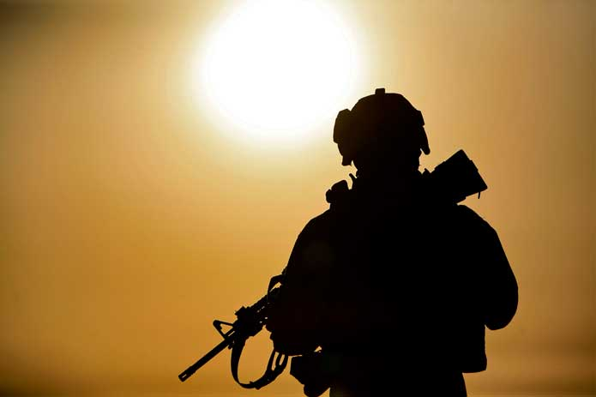
SAFETY ALERT SAFETY ALERT
SAFETY
ALERT
SAFETY
ALERT
AFGHAN heat can take you out of the fight
TOO HOT TO HANDLE?
SAFETY
ALERT
SAFETY
ALERT
Heat cramps, heat exhaustion, and heat stroke are all conditions that require medical attention.
Heat cramps – Knotting up and seizing of muscles in the arms, legs, and abdomen, caused by loss of salt in the body
Heat exhaustion – Feelings of exhaustion, nausea, dizziness, pale and clammy skin, quick pulse, and low blood pressure
Heat stroke – Perspiration stops, the body temperature rises, the heart pounds, and the skin becomes flushed and hot
Leaders at all levels are required
to implement work/rest cycles
Heat
Injuries are REPORTABLE accidents
We are beginning to see the seasonal heat injuries again. Heat Injuries are completely preventable by engaged leaders who take the time to perform proper planning and risk management.
JOCHQ THEATER SAFETY OFFICE/ DSN: 318-449-4831
SAFETY ALERT SAFETY ALERT 13-026

