Slide 1
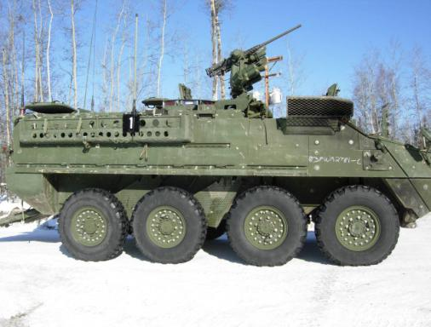
Install Instructions
IPU/ICV

Slide 2
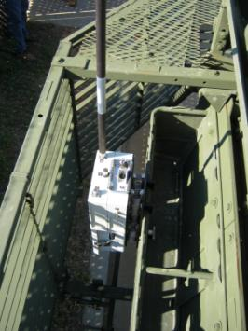
BMU
Install the BMU on the external stowage rack on the right side of the vehicle and secure the locking slide and Nut. (Ensure that the internal and external battery cables are connected). Check that the BMU is secure.

Slide 3
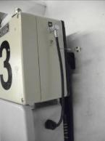
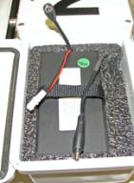
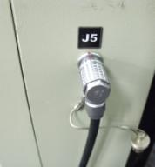
BMU Battery Cable
Battery Power Cable
BMU Power Cable and J5 Connector
BMU Power Cable
Twist the locking latch on the BMU battery box cover and open the cover. Connect the Battery Power Cable to the BMU Power cable, close and lock the cover. Connect the BMU Power Cable connector to the J5 connector on the BMU; ensure that the red dots on the BMU Power Cable connector and the J5 connector are aligned.

Slide 4
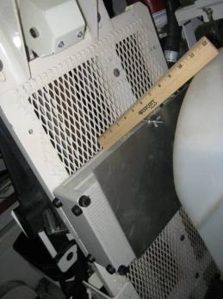
CMU
Install the CMU in the gunners position as shown above using the mount and screws provided. Place the CMU in the mount as shown and secure with the screw and wing nut that is provided. The CMU should be oriented so that the back of the unit is facing the mount and the top of the unit is towards the communications rack.

Slide 5
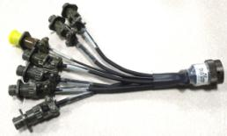
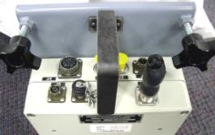
A/V Input Cable
A/V Input Cable
CMU J6
Connect the A/V Input Cable to the CMU J6 connector

Slide 6
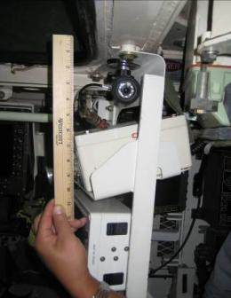
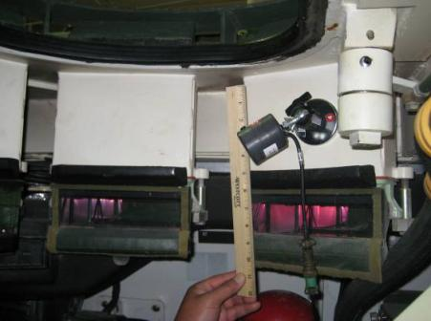
Crew Camera
Using the Magnetic Camera Mounts and two crew camera, secure the camera and mount and install the mount in the Commander’s and Gunner’s Station as shown above (camera is focused on dismount area). Attach camera cables to each of the crew cameras and route the cables to the CMU and attach it to one of the video inputs on the CMU A/V Input cable.

Slide 7
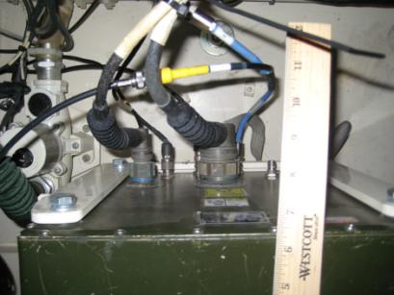
STRYKER Video Cable
Install the STRYKER Video Cable to the EVDT/VDT J-6 and route the other end of the cable to the CMU and attach it to one of the video inputs on the CMU A/V Input cable.

Slide 8
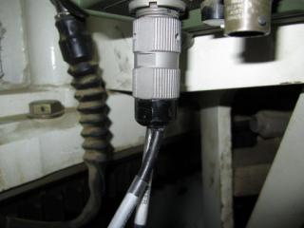
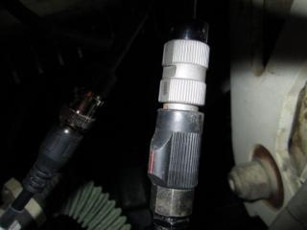
External Audio Adapter
The External Audio Adapter (EAA) attaches to the Full Function Crew Station in the Commander’s Station. Attach the CVC to the External Audio Adapter connector labeled “CVC” and the External Audio Adapter Cable connects to the BNC connector on the external audio adapter. Route the cable to the CMU and connect it to the A/V Input Cable connector labeled (A).

Slide 9
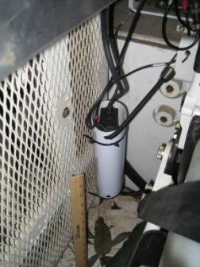
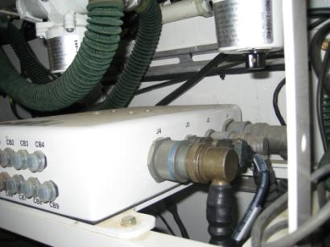
PowerVerter
Install the PowerVerter Cable to the J3 connector on the Electronic Distribution Terminal (EDT) as shown above. Connect the PowerVerter Cable labeled “CMU J1” to the CMU J1. Secure the PowerVerter to the wall using zip ties.

Slide 10
Power-UP
Turn on vehicle power
Turn on the BMU Power
Turn on CMU Power

Slide 11
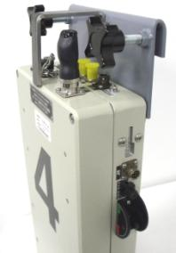
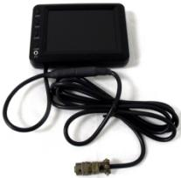
Hand Held Monitor
Handheld Monitor
CMU J8 Connector
Connect the Handheld Monitor connector to J8 connector on CMU. Turn on the Handheld Monitor power. Turn the Monitor Selector Switch on the CMU to the desired video input. Ensure that the cameras are aligned properly. When the cameras are properly aligned, remove the Hand Held Monitor and store it a safe location, so it will not be damaged.
Note: The Handheld Monitor will shut off automatically if it does not detect a video source.

Slide 12
Secure Cables
Once installation is complete ensure that all cables are routed under the communications rack are secured and clear of the turret, main gun, and/or any place where they inhibit the crew’s operation of the vehicle.

