Slide 2
OUTLINE
-Introduction
-MEDPROS
-Eprofile
-MEB/PEB
-WTU
-Appointments
-BCT Providers
-Unique Profiles
-Future Changes

Slide 3
Introduction
-Pens down
-Handouts
-Distribution List

Slide 4
MEDPROS
-MRC Categories
-MND
-USR
-Commander’s Drill Down

Slide 5
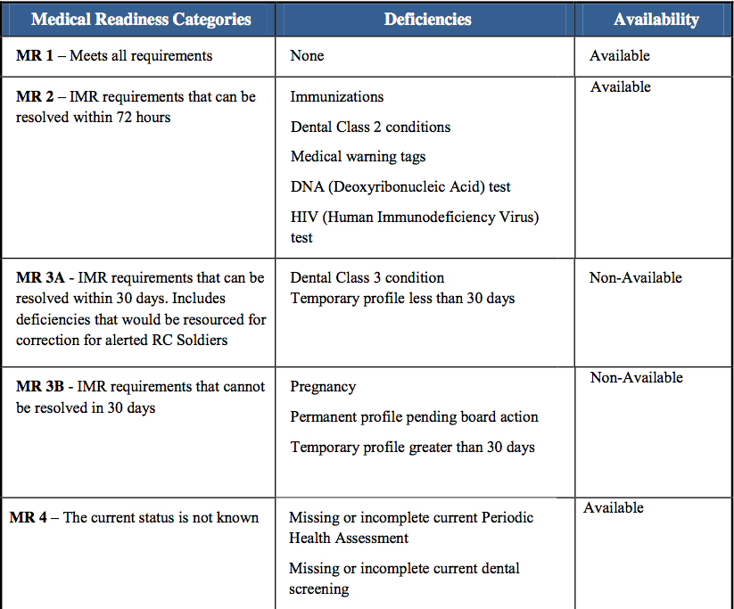

Slide 6
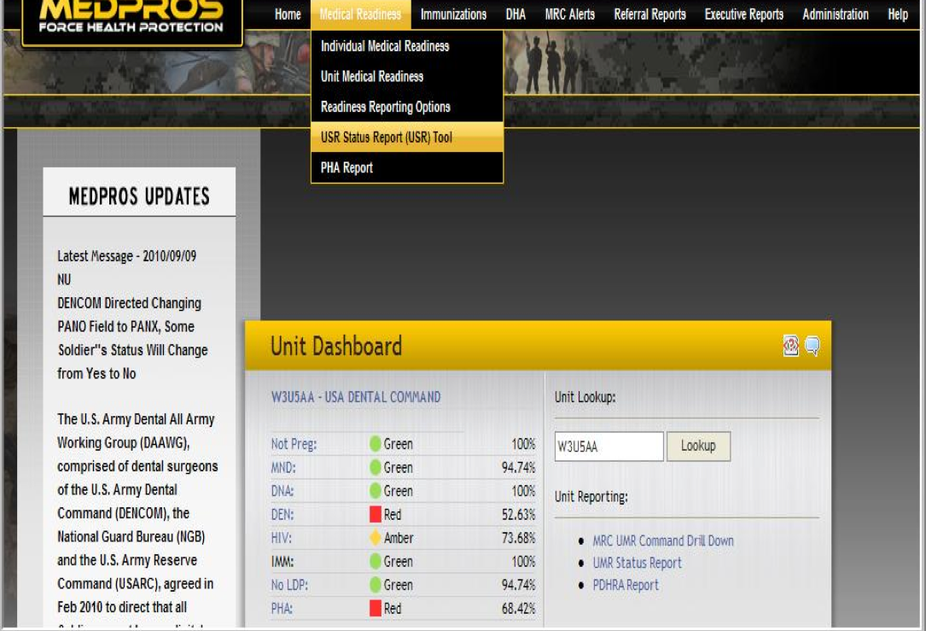
OUTLINE
-Introduction
-MEDPROS
-Eprofile
-MEB
-Appointments
-BCT Providers
-Future Changes

Slide 7
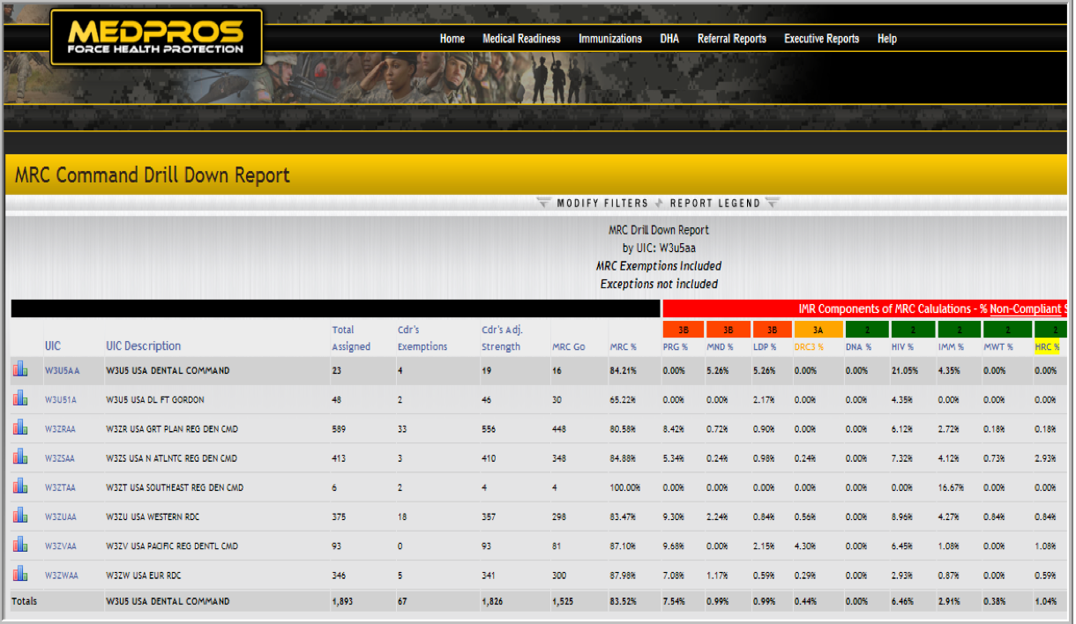
OUTLINE
-Introduction
-MEDPROS
-Eprofile
-MEB
-Appointments
-BCT Providers
-Future Changes

Slide 8
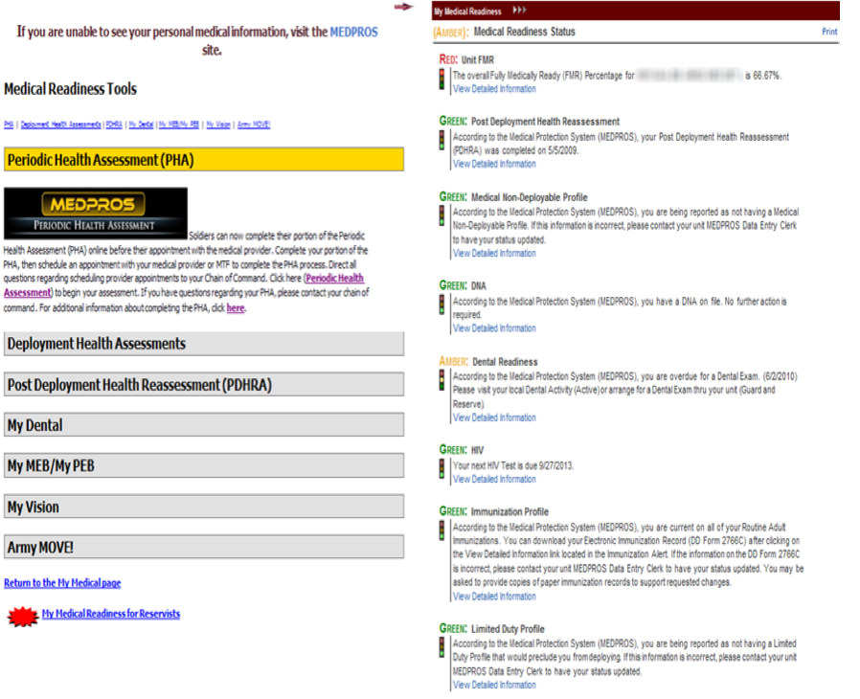
OUTLINE
-Introduction
-MEDPROS
-Eprofile
-MEB
-Appointments
-BCT Providers
-Future Changes

Slide 9
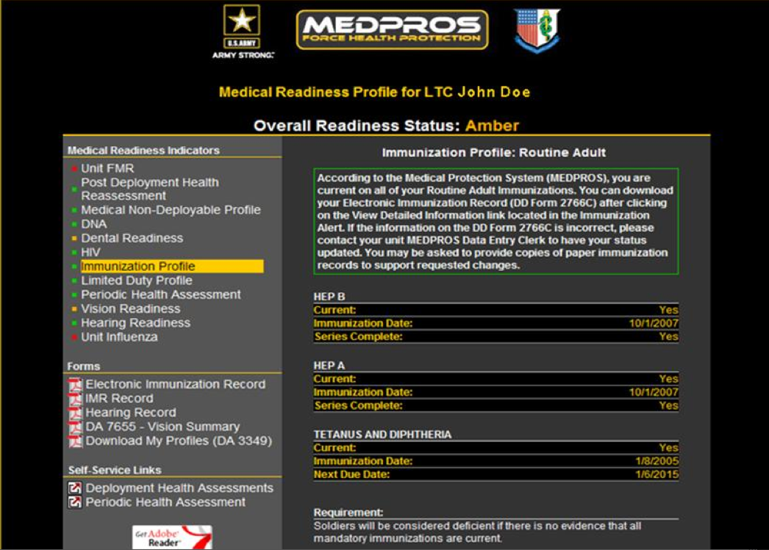
OUTLINE
-Introduction
-MEDPROS
-Eprofile
-MEB
-Appointments
-BCT Providers
-Future Changes

Slide 10
PULHES
-Physical Capacity
-Upper Extremity
-Lower Extremity
-Hearing
-Vision (Eyes)
-Physciatric

Slide 11
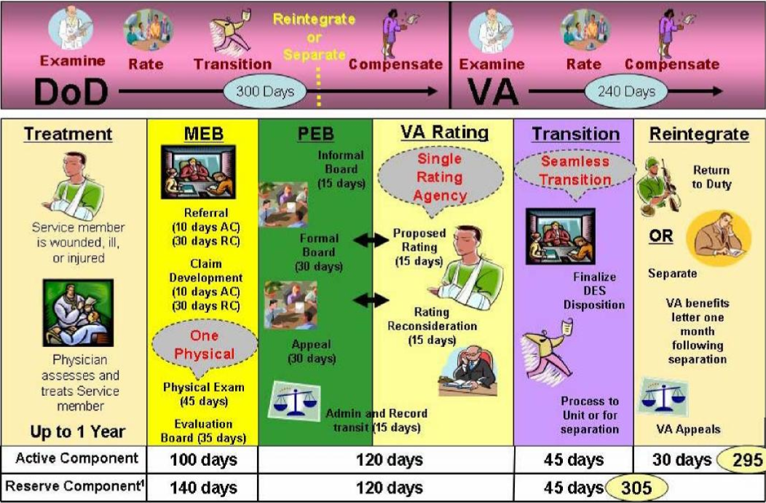
WTU
-6 months
-Intense Rehab
-Appointment
-Case Manager
Notes:
d) MEB Referral Part 1: This starts with an initial physical, interview and questionnaire. During this time it is determined what additional appointments and testing the Soldier needs in order to ensure that their service disqualifying medical condition(s) are indentified, treated and they are stable or have a predictable recovery course. Standard time to complete is < 30 days.
(l) MEB Forwarded to PEB: This entire MEB packet is forwarded by PEBLO to Washington DC for PEB action. The PEB in conjunction with the VA determines: Whether the Soldier is fit or unfit for continued service; Determines level and type of disability compensation; Eligibility for disability severance pay or disability retirement based upon the VA determined level and type of disability compensation. The Standard time to complete is < 60 days.
(m) MEB Returns from PEB with the results and the VA ratings determination (not the NARSUM packet) and the decision is reviewed by the Soldier to confirm or appeal. At this point the Soldier should consult with their lawyer (MEB counsel). If the Soldier Concurs, the Soldiers signs board results which make the MEB portion complete. Standard time to complete is < 10 days; If the Soldier non-concurs, the Soldier has decided to appeal the PEB decision. Regardless of the decision, the conclusion of the appeal process the MEB portion is complete. During this step, Soldiers are not authorized to take ordinary leave during this step since the 10 days to review their board begins once their MEB packet returns. Standard time to complete is < 30 days.
(n) Board completed: This is when the appeal process is complete, the Soldier has received their ratings, all documents are signed, and the Physical Disability Agency has reviewed the packet and loaded the Soldier into TRANSPOC in order to receive orders. Standard time to complete is < 10 days
(o) Awaiting orders: The Soldier awaiting orders for actual separation date. This needs to be calculated based on the number of days authorized for out-processing, ordinary leave and Permissive TDY. Standard time to complete is < 7 days
(p) Transition Date: The last date the Soldier is present for duty. This occurs after out-processing and generally before the Soldier starts any authorized concurrent permissive TDY and transition leave. Standard time to complete is < 30 days.
(q) Separation date: The final day the Soldier is assigned to the WTB and in the service. This occurs after out-processing and taking all authorized leave and PTDY. This date will not exceed 90 days from the transition date unless approved by the Battalion Commander. Standard time to complete is < 90 days.
(e) MEB Referral Part 2: All physicals, testing and consultations are complete. Per OTSG/MEDCOM policy 09-037 each of the Soldiers service disqualifying medical condition(s) are now fully worked-up, cured, medically stable or with a predictable recovery state. Additionally, all other appropriate conditions have met the same criteria. The MEB physician determines that MRDP has been met on at least one diagnosis and will initiate or forward the appropriate permanent profile to the DCCS. Standard time to complete is < 30 days.
(f) P3 Signed by DCCS & MEB Starts: The patient’s medical packet is reviewed and a permanent “3” or “4” level profile is signed by the DCCS. This acknowledges that MRDP is met for at least one medical condition that is service disqualifying. This also begins the MEB as outlined under OTSG/MEDCOM Policy Memo 09-037. Standard time to complete is < 7 days.
(g) Schedule VA Exam(s): Soldier is scheduled for initial appointment for disability assessment within the Veterans Affairs (VA) system. The first appointment which must occur within 10 days consists of an interview, physical, and review of the diagnosis listed in the prepared MEB packet. From that information additional VA appointments are scheduled and diagnoses are evaluated. Until the VA exams are complete the Soldier cannot take ordinary leave since that will interfere with the evaluation process. Once the evaluations are complete the VA packet is processed through their channels to be evaluated for a disability rating. Additionally, a copy of the VA assessment is sent back to the Womack Army Medical Center Physical Evaluation Board Liaison Officer (PEBLO). Disability ratings are not included in the standard time to complete since it runs concurrent to our PEB processing time. Standard time to complete is < 40 days.
(h) Packet Complete; Narrative Summary (NARSUM) signed by MEB Physician & DCCS: Once all evaluation appointments are completed within the VA system both physicals
are reviewed and NARSUM is completed and signed by the MEB Physician. It is then sent to the DCCS who reviews and signs the NARSUM. Standard time to complete is < 21 days.
(i) (Optional) Soldier reviews completed packet with MEB Physician: The Soldier has the option to review the completed MEB packet. Standard time to complete is < 3 days.
(j) PEBLO assembles packet: Prepares the packet and ensures that it is complete for processing by the PEB. Standard time to complete is < 7 days.
(k) Soldier Reviews and signs DA 3947: If the Soldier concurs, the Soldier reviews their entire MEB complete paying particular attention to the Medical Evaluation and Board Proceedings and Signatories (DA 3947). The DA 3947 will list all of their service disqualifying conditions and take into account all medical conditions, whether individually or collectively, that render the service member unfit to perform the duties IAW 10 USC 121a(b) may also list conditions that are present but are NOT service disqualifying. The Soldier may consult with their lawyer (MEB counsel) during this time. Once complete they sign the DA3947 and the packet is now complete and ready to proceed to the PEB. Standard time to complete is < 10 days. (l) MEB Forwarded to PEB: This entire MEB packet is forwarded by PEBLO to Washington DC for PEB action. The PEB in conjunction with the VA determines: Whether the Soldier is fit or unfit for continued service; Determines level and type of disability compensation; Eligibility for disability severance pay or disability retirement based upon the VA determined level and type of disability compensation. The Standard time to complete is < 60 days.
(m) MEB Returns from PEB with the results and the VA ratings determination (not the NARSUM packet) and the decision is reviewed by the Soldier to confirm or appeal. At this point the Soldier should consult with their lawyer (MEB counsel). If the Soldier Concurs, the Soldiers signs board results which make the MEB portion complete. Standard time to complete is < 10 days; If the Soldier non-concurs, the Soldier has decided to appeal the PEB decision. Regardless of the decision, the conclusion of the appeal process the MEB portion is complete. During this step, Soldiers are not authorized to take ordinary leave during this step since the 10 days to review their board begins once their MEB packet returns. Standard time to complete is < 30 days.
(n) Board completed: This is when the appeal process is complete, the Soldier has received their ratings, all documents are signed, and the Physical Disability Agency has reviewed the packet and loaded the Soldier into TRANSPOC in order to receive orders. Standard time to complete is < 10 days
(o) Awaiting orders: The Soldier awaiting orders for actual separation date. This needs to be calculated based on the number of days authorized for out-processing, ordinary leave and Permissive TDY. Standard time to complete is < 7 days
(p) Transition Date: The last date the Soldier is present for duty. This occurs after out-processing and generally before the Soldier starts any authorized concurrent permissive TDY and transition leave. Standard time to complete is < 30 days.
(q) Separation date: The final day the Soldier is assigned to the WTB and in the service. This occurs after out-processing and taking all authorized leave and PTDY. This date will not exceed 90 days from the transition date unless approved by the Battalion Commander. Standard time to complete is < 90 days.

Slide 12
MEB Changes

Slide 13
MEB Timeline
TYPE | Process in days
 | 30 | 60 | 90 | 120 | 150 | 180 | 210 | 240 | 270 | 300 | 365 | 450
MND Tracking
Initial injury/illness and profile
Day 30-90; by name report due by BN PA; Identify dispositions that would meet FRAGO 3 criteria (WTB)
Day 90-180; by name report due to BDE Surgeon and CDR with disposition and plan
Day 180-365+; by name report due to Div Surgeon and AA5 with disposition and plan
MRDP Process (up to 1 year)
TYPE | Standard Process in days
 | 30 | 60 | 90 | 120 | 150 | 180 | 210 | 240 | 270 | 300 | 365 | 450
MEB
Phase I/II at WAMC MEB Clinic (< 1 month)
VA C&P Exams
(6 weeks)
Beneficial to Trooper
PEBLO/PEB adjudication and
(3 weeks)
DRAS
(3 weeks)
Transition period
(3 months)
TYPE | Actual Process in days
 | 30 | 60 | 90 | 120 | 150 | 180 | 210 | 240 | 270 | 300 | 365 | 450
MEB
Phase I/II at WAMC MEB Clinic (1-3 months)
VA C&P Exams
(2-3 months)
Beneficial to Trooper
PEBLO/PEB adjudication
(2 months)
DRAS
(6-9 months)
Transition period
(3 months)
Unit level management
MTF managed (local and off-post)
VA (local)
VA/DRAS (off-post)
Choke points
Notes:
Limitations
MEB provider access limited due to volume (WTB personnel have priority) 1-3 months to complete Phase I&II
VA provider access limited due to volume 2-3 months to complete C&P exam
DRAS bureaucracy, VA rating timeline is six months and above
Currently completing the MEB is a 130 step process
Mitigating Factors
82d policy ensures all medical conditions are screened/evaluated prior to submission for MEB processing
Sec Def Tiger Team currently at WAMC for 6 weeks to implement PDES Pilot Program with the goal of decreasing local processing time by 50%

Slide 14
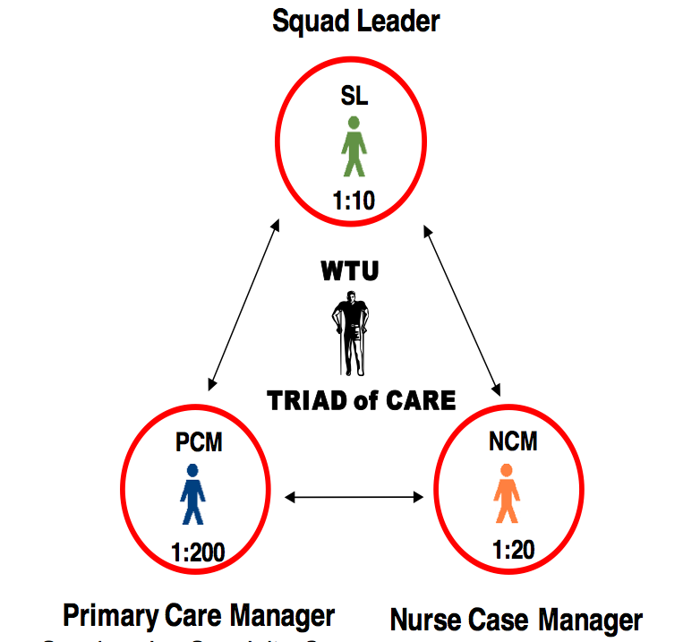
OUTLINE
-Introduction
-MEDPROS
-Eprofile
-MEB
-Appointments
-BCT Providers
-Future Changes

Slide 15
Appointments
-Rational
-MEB/PEB
-Distribution List

Slide 16
MEDICAL OFFICERS
-MED OPS
-Providers

Slide 17
BN PA
-PCM
-Prior Service
-Bachelor's degree
-Master’s Degree
-18 month Fellowship

Slide 18
BDE PT
-Ranger Regiment
-Bachelor's degree
-Doctorate
-Various additional qualification

Slide 19
BSO
-Mental Health of Comand
-1/2 here now
-Bachelor's degree
-Masters/Doctorate
-Various additional qualification

Slide 20
BDE SURGEON
-Health of the Command
-Bachelor's degree
-Doctorate
-Residency (3-6 years)
-Fellowship(1-3 years)

Slide 21
Special Profile
-TBI
-Heat Casualty
-Hand Surgery

Slide 22
Deployment Limiting Categories
-DL1:P3 and not in board
-DL2:MAR2
-DL3:MEB/PEB
-DL4:Profile > 30 days
-DL5:Pregnancy
-DL6:Profile < 30 days

Slide 23
Temporary Profile Management Process
Mandates use of DA Form 7652 (COMMANDER'S PERFORMANCE AND FUNCTIONAL STATEMENT)
7 day requirement from first to second signature on permanent profile
Required use of eProfile
MRC 3bSoldiers will not PCS to deploying formations
Proceed to MEB
MRDP P3/4 Profile 2nd signature & submit VA Form 21-0819
Soldier does not meet medical retention standards & requires P3/4 Profile issued 1st Signature
Soldier can meet MRDP at any point
>240 Days by Senior Mission Commander, Medical Authority/Case Manager *Documented on DA Form 7652 (Update)
>180 Days Review by BDE CO, Medical Authority/ Care Coordinator *Documented on DA Form 7652 (Update)
>120 Days Review by BN CO, Medical Authority/Care Coordinator
*Documented on DA Form 7652 (Update)
>60 Days Review by CO/1SG, Medical Authority /Care Coordinator *Documented on DA Form 7652
Soldier issued aT3/T4 Profile. Begin Temp Profile Review
Items in RED are new/enhanced standards
UNCLASSIFIED

Slide 24
Phase 1- Conduct MEB Process
MEBSubmitted to PEB
Second signature authority submits for VA Form 21-0819
Enhanced Access to Care for disqualifying condition
VA Appointment tracking mandatory, no show rate <1%
Multidisciplinary Team intake (MEB physician, BH, PEBLO, PEBLO Assistant, SFAC, VA and command) within 14 days of initiation
NARSUM completion within 5 days of receipt of C+P exam
Required use of IDES Narrative (abbreviated) Summary
Co-location/collaboration with MTF and VA assets
Use of BMM for PEBLO/assistants
Day 65-100 AC/105 -140 RC
MEB Stage
- NARSUM completion within 5 days
-PEBLO Counseling
-Presentation of MEB Findings to Soldier
-- Soldier has 5 days to make election
- Independent Medical Review
-Appeal Decision
-Completion of IDES Case file
- Submission of case file to PEB
Day 20-65 AC/60-105 RC
Medical Evaluation Stage
-VA C & P Examinations
- D-RAS Review and Approve
- Submission of Completed C & P reports to PEBLO
Day 10-20 AC/ 30-60 RC
Claim Development Stage
- VA MSC Counseling
- Review of STR
- Full completion of VA – Form 21-0819
- Schedule of VA Appointments (C&P Exam)
- PEBLO Notification of C&P Exam Appointment
Day 1-10 AC / 1-30 RC
Referral Stage
- PEBLO initiates Case Preparation
- VA/DoD Referral Forms
- Notification of IDES Initiation (Soldier/Unit
-- Unit Cdr has 5 days to complete DA 7652 (Commander’s
Performance and Functional Statement)
- Comprehensive Multi-Disciplinary Team Meeting
- PEBLO Counseling
- Provide complete copy of STR to MSC
100 days Active Duty
140 days RC not on AD
P3/4 Profile Second signature (MRDP) Completion of Section 1 of VA Form 21-0819 -24 hours to transmit to PEBLO
UNCLASSIFIED

Slide 25
Phase 2 – Conduct PEB/PDA Process
.
Case is approved and PEBLO is notified.
Day 95-120 Formal Appeal and
final processing
-PEB response to appeal
-PDA response to appeal
- Secretarial Approval and
notification of PEBLO
Directed use of virtual PEB for 90% of all formal PEB
Notification of PEBLO after Secretarial Approval date
Electronic File Transfer required
Day 85-95 Soldier Election of Options (10 Days)
- concur or submit written appeal
Day 55-85 Conduct of Formal PEB (30 Days)
Day 55-70 DRAS reconsideration
- runs concurrently with formal PEB if applicable
Day 55-65 Final Processing (if concurrence) (10 Days)
- Case forwarded to PDA
- PDA reviews if required
- Secretarial Approval and notification of PEBLO.
Day 45-55 Soldier Election of Options (10 Days)
- concur
- request formal PEB
- submit written appeal
- request reconsideration of VA ratings for referred conditions
Day 30-45 PEB issues findings and sends to PEBLO (15 Days)
- includes three day period for PEBLO to counsel Soldier
Day 15-30 Disability Rating Activity Site issues Rating to PEB (15 days)
Day 1-15 Informal PEB
- Submit request for rating to DRAS if unfit
Issue IPEB findings if fit.
Return to MTF if insufficient information for adjudication
120 days All COMPO
UNCLASSIFIED

Slide 26
Phase 3- Transition or Reintegration
Service Member
transitions from military
service
Day 21-81 Leave (over 60 days of
leave requires first COL in chain of
command’s approval)
Decreases outprocessing days to 14
Mandates review of leave/pTDY in excess of 60 days
Day 7-21 Out Processing and Transition Counseling to include VA benefits briefing
Day 1-7 Separation Orders
Army Secretarial Approval
Soldiers Found Fit this concludes IDES for these Soldiers
AD Soldiers Found Unfit---TRANSPROC Input
81 Days All COMPO
UNCLASSIFIED

