Slide 1
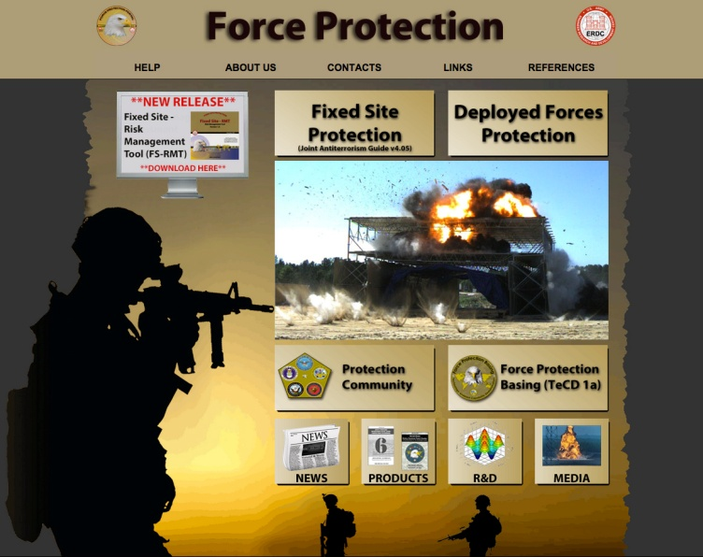
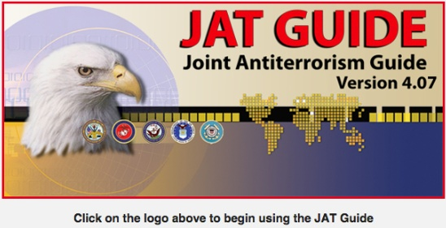
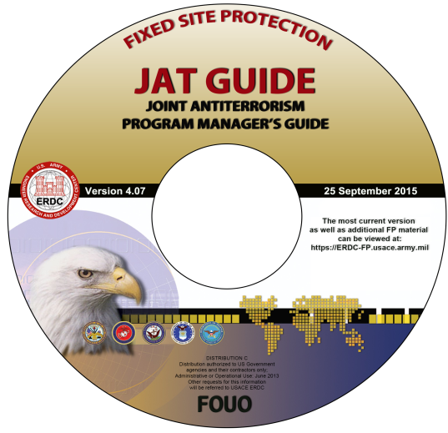
Announcing Updates to the ERDC Force Protection Portal
AND
Joint Antiterrorism Guide (JAT Guide) v4.07, 25SEP2015
Force Protection Portal Updates:
Over 80 new and updated references
New JAT Guide v4.07
New downloadable Deployed Force-Risk Management Tool (both the interactive version and the Manual Version worksheets)
New Features of the Updated JAT v4.07:
Includes the 2015 DoD Mission Assurance Assessment Benchmarks just released in SEP 2015. (Click on References for Fixed Site Protection module)
JAT v4.07 provides new and updated references including all references from Deployed Forces Protection module:
Survivability Engineering References
GTA’s
Camouflage, Concealment, and Deception References
The JAT Guide provides AT Program “HOW TO” guidance with all the necessary processes, templates and decision-aid tools for implementing the DoDI 2000.16 AT Standards.
Get the Updated JAT Guide Here:
The interactive version of the updated JAT Guide can be found in the Fixed Site Protection module of the Force Protection Portal at:
https://erdc-fp.usace.army.mil
A one-time registration is required and a CAC card is needed to access the FP Portal.
To launch the JAT Guide from the FP Portal: Click on Fixed Site Protection - - - then - - - Click on the JAT Guide Logo
For the free CD, email your CD request (and mailing address) to:
ERDC-JAT@usace.army.mil OR Order the JAT CD online using the PRODUCTS Tab on the Force Protection Portal Home Page.

