Slide 1
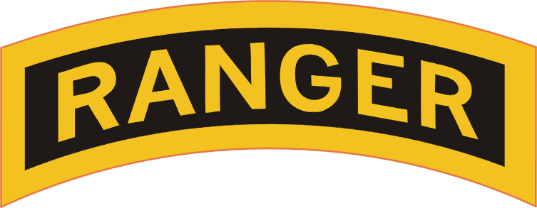
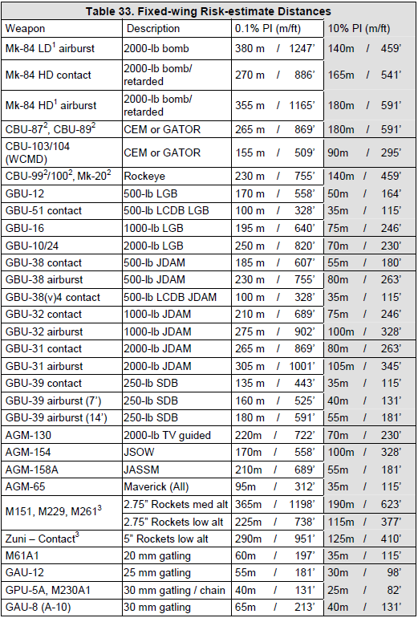
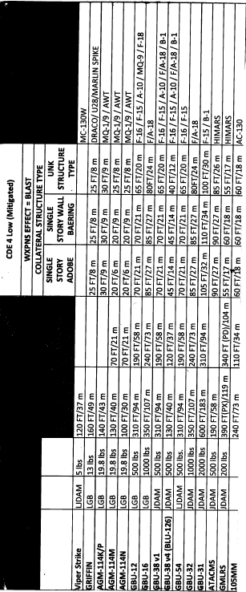
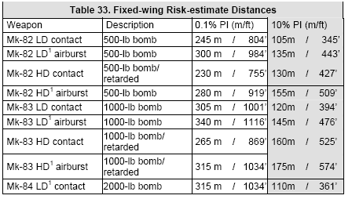
FIRE SUPPORT COORDINATION MEASURES (FSCM)
Permissive (Measures facilitate target attacks)
1. Coordinated Fire Line (CFL): A line beyond which conventional indirect surface fire support means may fire at any time within the boundaries of the establishing HQ without additional coordination.
2. Fire Support Coordination Line (FSCL): Coordination of attacks beyond the FSCL is especially critical to commanders of air, land, and special operations forces. In exceptional circumstances, the inability to conduct this coordination will not preclude the attack of targets beyond the FSCL.
3. Free-Fire Area: An area into which any weapon system may fire without additional coordination with the establishing headquarters. Normally established on identifiable terrain by division or higher HQ.
Restrictive Measures (Measures safeguard friendly forces)
4. Restrictive Fire Line (RFL): A line between converging friendly forces ( one or both may be moving) that prohibits fires, or their effects, across that line without coordination with the affected forces. It is established on identifiable terrain by the common commander of the converging forces.
5. Restrictive Fire Area (RFA): An area with specific restrictions and in which fires that exceed those restrictions will not be delivered without coordination with the establishing headquarters.
6. No Fire Area (NFA): An area into which no fires or their effects are allowed. Two exceptions:
a. When the establishing HQ allows fires on a mission by mission basis.
b. When a friendly force is engaged by an enemy located in a NFA and the commander returns fire to defend his forces.
7. Airspace Coordination Area (ACA): A three dimensional block of airspace in the battle area in which friendly aircraft are reasonably safe from surface fires. Aircraft and indirect fires are separated by time, space and altitude. Informal ACAs are most often used and are the preferred method. Established at TF or higher level. ACAs allow the simultaneous attack of targets near each other by multiple fire support teams, one of which is normally air.
CAS Brevity Codes
FOR COMBAT USE ONLY
BLIND – No visual contact of friendly aircraft/ground position. Opposite of VISUAL.
BURN – EO / IR illuminator is being used to provide illumination of surface points of interest.
BINGO – Fuel state needed for recovery.
CONTACT – 1) Sensor contact at the stated position. 2) Acknowledges sighting of a specified reference point (either visually or via sensor).
NO JOY – Aircrew does not have visual contact with the target / bandit /landmark. Opposite of TALLY.
PLAYTIME – Amount of time aircraft can remain on station, given in hours plus minutes (e.g., ONE PLUS THIRTY equals one hour and thirty minutes).
PULSE – Illuminate / illuminating an enemy position with flashing IR energy.
RIFLE – Friendly A/S missile launch.
ROPE – Circling an IR pointer around an aircraft to help the aircraft identify the friendly ground position.
SNAKE – Oscillate an IR pointer about a target.
SPARKLE – 1) Mark/marking target by IR pointer. 2) Platform is IR point capable.
SPLASH – 1) (A/S) Weapons impact. 2) (surface-to-surface) Informative call to observer or spotter five seconds prior to estimated time of impact. 3) (air to-air ) Target destroyed.
STEADY – Stop oscillation of IR pointer.
STOP – Stop IR illumination of a target.
TALLY – Sighting of a target, non-friendly aircraft, landmark, or enemy position. Opposite of NO JOY.
THUNDER – One minute until A/S weapons impact.
VISUAL – Sighting of a friendly aircraft/ground position. Opposite of BLIND
WINCHESTER – No ordnance remaining.
Risk Estimate Distances
Reference: FM 3-09.32 (J-FIRE)
3RD Infantry Bridge Combat Team
1st Infantry Division
Joint Fire Card
OCT 2012 v1.0
FOR COMBAT USE ONLY
Close Air Support 9-Line Briefing
Emergency CAS 5 Line
Lines 4, 6, and restrictions are mandatory readback from the aircraft (*). You may request additional readback.
“__________________, this is ______________________”
(Aircraft Call Sign) (Controller Call Sign)
“I AM NOT JTAC QUALIFIED”
“LINES 1-3: NA”
4*. Target Elevation: “___________________________________”
(In feet MSL)
5. Target Description: “__________________________________”
6*. Target Location: “___________________________________”
(MGRS with grid zone identifier)
7. Type Mark: “_____________” Code: “____________________”
(WP, Laser, IR sparkle, Beacon, smoke) (Actual Laser Code)
8. Location of Friendlies: “________________________________”
(From target, cardinal direction and distance in meters)
Position marked by: “__________________________________”
9. “Egress: ___________________________________________”
Remarks (as appropriate): “_______________________________”
(Restrictions*, final attack heading, hazards, ACAs, target information, LTL/GTL [degrees magnetic], danger close [with commander’s initials])
Note: When identifying position coordinates for joint operations, include map data. Grid coordinates must include 100,000 meter grid identification.
DELIVERY
PLATFORM
CDE Estimation/Distances
CDE 3 LOW
WPN EFFECT = FRAG
MISC FW WPNs | RED 0.1% PI
GRIFFIN MISSILE (AGM-175) | 140m
VIPER STRIKE (GBU-44) | 61m
GBU-54 (LJDAM) | 130m (HIGH <) 175 (LOW <)
INST / DELAY
TYPE / WEIGHT
WEAPON

Slide 2
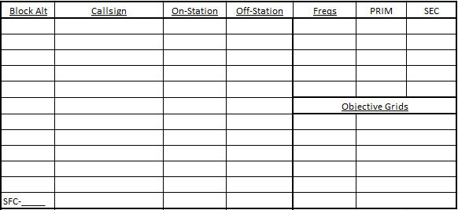
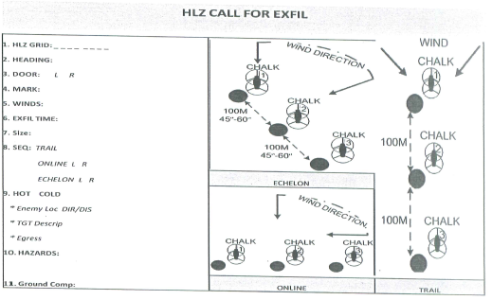
NOTES
Unexploded Ordnance (UXO) and
Improvised Explosive Devices (IEDs)
UXO and IEDs are currently the greatest threats to coalition forces. UXO are munitions that have been fired, thrown, or failed to detonate and should be treated with care. UXO is still live and very volatile. Call EOD using the IED/UXO Report.
Untrained Soldiers should not attempt to demine, defuse, or neutralize UXO, unless absolutely necessary.
Remember the 5 C’s
Clear, Cordon, Control, Call EOD, and Check
UXO/IED Battle Drill
Step 1. Clear: Leave the immediate area; detonation may be imminent; secondary devices
may be present.
Step 2. Cordon: Establish a perimeter (300 m small device/1000 m up to van-size/2000 m water truck or semi)
Step 3. Control: Maintain visual (binoculars or scopes) observation to ensure no one tampers with the device; maintain security.
Step 4. Call EOD: Immediately contact your
supporting EOD to respond (9-line IED/UXO Spot
Report)
Step 5. Check: All personnel stationed on the
cordon should check their immediate area for
secondary devices. Report any suspicious items
to the situation commander; if necessary, mark the
position and re-establish the cordon to a safe place.
Standard 9-line IED/UXO Report
Line 1: Date time group discovered: (Command policy will dictate Local or Zulu time).
Line 2: Reporting Activity (UIC / Unit designation). Location: mandatory 8 digit grid: (include: landmarks, reference points, or street addresses).
Line 3: Contact Method: Radio Freq / Call Sign or Telephone Number. (If using phone number, provide name).
Line 4: Type of Munition: (Dropped, Projected, Placed, or Thrown).
Line 5: NBC Contamination: Yes or No, known or suspected NBC Contamination. If yes, report type of agent if known / identified.
Line 6: Resources Threatened: (What resource is threatened - is it a critical asset?).
Line 7: Impact on Mission: (How the UXO is affecting the mission).
Line 8: Protective Measures Taken: (Unit emplaced protective measures).
Line 9: Recommended Priority: (Immediate, Indirect, Minor, or No Threat).
9 LINE MEDEVAC
1: LOCATION OF PICKUP SITE (__________________)
2: FREQUENCY AND CALL SIGN (________________)
3: # OF PATIENTS BY TYPE (____) A – URGENT
(____) B – SURGICAL
(____) C - PRIORITY
(____) D - ROUTINE
4: SPECIAL EQUIPMENT A – NONE
B – HOIST
C – EXTRACTION EQUIP
D – VENTILATOR
5: # OF PATIENTS BY TYPE (____) L – LITTER
(____) A – AMBULATORY
6: SECURITY OF PICKUP SITE N – NO ENEMY
P – POSSIBLE ENY
E – ENY IN AREA
X – ARMED ESCORT
7: METHOD OF MARKING SITE A – PANEL
B – PYRO
C – SMOKE
D – NONE
E – OTHER
8: PATIENT NATIONALITY AND STATUS
A – US MILITARY
B – US CIV
C – NON US MIL
D – NON US CIV
9: NBC CONTAMINATION N – NUCLEAR
B – BIOLOGICAL
C - CHEMICAL

Slide 3
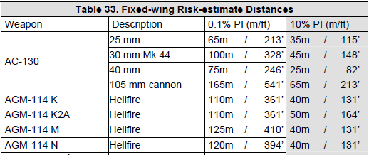
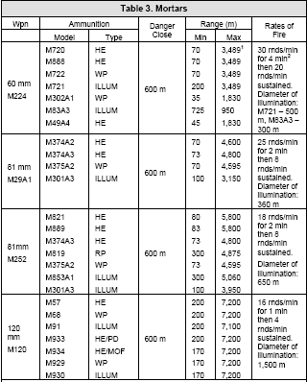
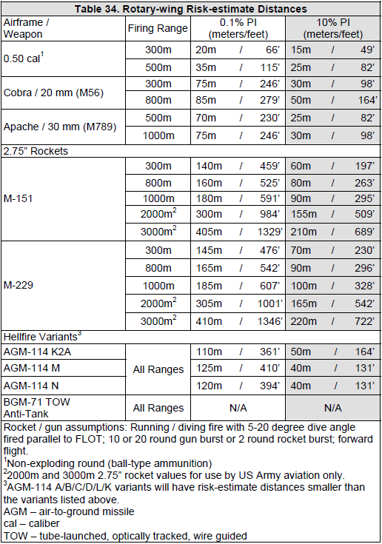
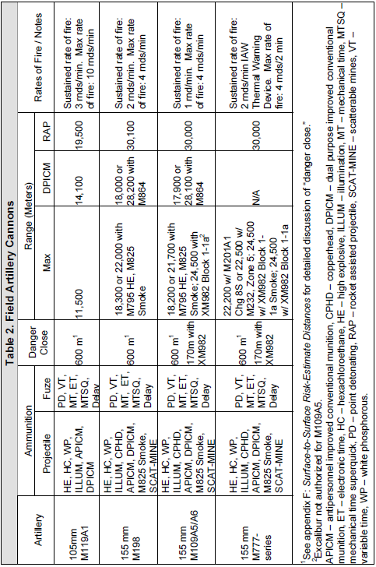
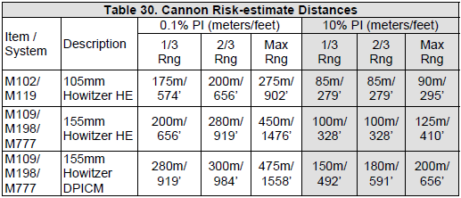
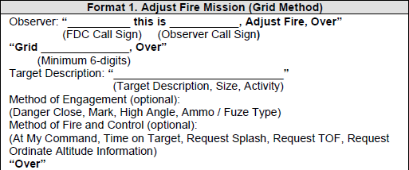
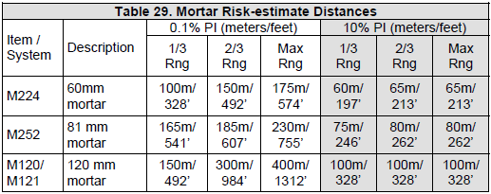
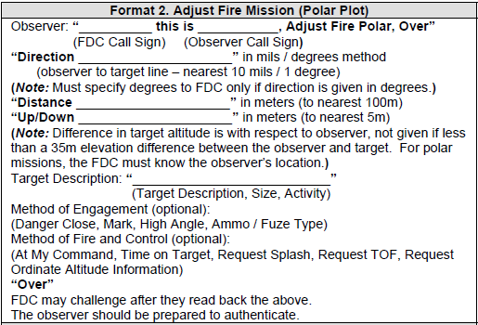
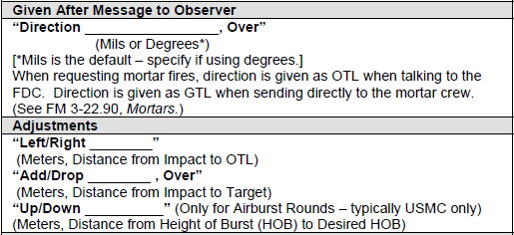
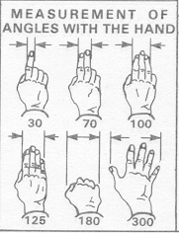
5-Line Call for Fire (CCA)
Abbreviated SOF Call For Fire
AC-130 / ARSOA
(2 Transmissions)
FOR COMBAT USE ONLY
1. Observer / Warning Order
“_______________, this is ______________, Fire Mission”
(Aircraft Call Sign) (Observer Call Sign)
2. “From my pos____________, marked by _______________”
(TRP, Grid,etc) (IR strobe, panel)
“Bearing: ___________ Distance:______________”
(degrees mag/cardinal direction) (Meters)
“TGT:___________ Marked by:_____________________”
(description) (IR sparkle, tracer, smoke)
AS REQUIRED:
State “At my command” or “Danger Close, initials:______”
***Otherwise a call for fire is clearance itself to engage targets
AS REQUIRED:
• If significant miss distance or wrong target, adjust round impact by giving cardinal direction (north, south, east, west) and range to target (meters)
• Marking/confirming targets can also be accomplished using
covert illumination (Burn) or with the laser pointer (Sparkle).
• To move Burn or Sparkle, say, “MOVE BURN/SPARKLE 300M
WEST” or “ROLL BURN/SPARKLE 100M EAST”.
• Once burn or sparkle is over target, say "FREEZE BURN/SPARKLE“
(If you say "STOP BURN/SPARKLE" the gunship will turn it off)
DON’TS:
1. Do not ask the gunship to identify colors
2. Do not reference clock positions.
3. Do not pass run-in headings/no-fire headings (give no-fire areas
and friendly troop positions only)
4. Do not correct left/right or short/long
1. Observer / Warning Order
“_______________, this is ______________, Fire Mission”
(Aircraft Call Sign) (Observer Call Sign)
2. Friendly Location / Mark
“My position _____________, marked by _______________”
(TRP, Grid,etc) (IR strobe, panel, etc)
3. Target Location
“Target Location _______________________________________”
(Bearing [magnetic] and Range [meters] from you, TRP, Grid, etc.)
4. Target Description / Mark
“____________________, marked by _________________”
(Target Description) (IR Pointer, Tracer, etc.)
5. Remarks (Danger Close Clearance, Restriction, At My Command) “Over”
ADJUSTMENTS
Left / Right (meters)
Add / Drop (meters)
Mark the target each pass**
AS REQUIRED:
1. Clearance: Transmission of the 5-Line CCA Brief is clearance to fire (unless danger close.) For closer fire, the observer/commander must accept responsibility for increased risk. State “Cleared Danger Close” in line 5. This clearance may be preplanned.
2. At My Command: For positive control of the aircraft, state “At My Command” on line 5. The aircraft will call “Ready for Fire” when ready.
FOR COMBAT USE ONLY
Adjusting Fire
To adjust fire onto the target the FDC must have three pieces of information:
1. Direction to the target (OT Direction – The direction from the observer to the target)
2. Deviation correction (Left or Right – The distance to the left or right the adjusting round must be moved to impact on the target) (# mils left or right of the target x the OT Factor) (Minimum correction is 30)
3. Range correction (Add or Drop) (Minimum correction is 50m)
OT factor is simply the distance to the target expressed in thousands.
Example: 800m = OT factor .8; 1400m = OT factor 1; 1800m = OT factor 2, etc.
Example Deviation Correction: Distance to target is 500m = OT Factor is 0.5, the adjusting round impacts 60 mils right of the target, the deviation correction is Left 30
Example Range Correction: The adjusting round must be moved to impact on the target. If round impacts short of the target, send an “Add” correction. If round impacts over the target, send a “Drop” correction
Example Correction:
Observer: Direction 5500, Left 80, Add 100, over
FDC: Direction5500, Left 80, Add 100, out
HIMARS | RED 0.1% PI
M31 GMLRS | 130m
M57 ATACMS | 43m
M48 ATACMS | 58m
Immediate Suppression (one transmission)
__________________ immediate suppression,_________________, over”
(Firing Unit Call Sign) (TGT grid/ ALT)

