Slide 1
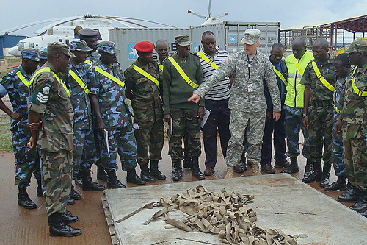
Regionally Aligned Forces
HQDA G-35
SSO
Security Cooperation
Policy and Concepts
Unclassified/FOUO

Slide 2
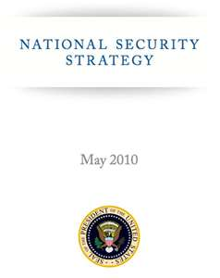
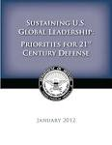
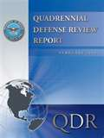
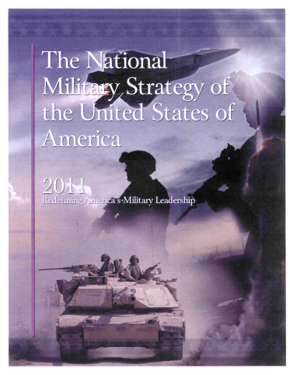
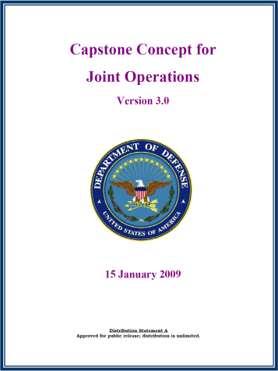
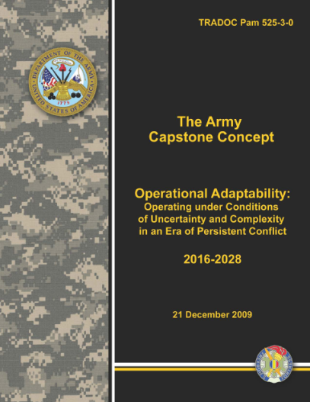
Strategic Guidance
National Security Strategy: Engagement is the active participation of the U.S. in relationships beyond our borders… (it) begins with our closest friends and allies… America’s national security depends on these vibrant alliances, and we must engage them as active partners in addressing global and regional security priorities and harnessing new opportunities to advance common interests.
DoD Strategic Guidance: Across the globe we will seek to be the security partner of choice…pursuing new partnerships with a growing number of nations…whose interests and viewpoints are merging into a common vision of freedom, stability, and prosperity. Whenever possible, we will develop innovative, low-cost, and small-footprint approaches to achieve our security objectives, relying on exercises, rotational presence, and advisory capabilities.
QDR: Perhaps more than ever before, the United States requires joint military forces able to function and succeed across a wide geographic and operational spectrum. Moreover, military forces must be capable of working effectively with a range of civilian and international partners…. U.S. forces…will continue to treat the building of partners’ security capacity as an increasingly important mission.
NMS: The Joint Force, Combatant Commanders, and Service Chiefs shall actively partner with other U.S. Government agencies to pursue theater security cooperation to increase collective security skills with a wider range of partners.
Capstone Concept for Joint Operations: …it will be increasingly important to develop cooperative security by maintaining or strengthening the global security framework of the United States and its partners…
Army Capstone Concept: “Continuous engagement and emphasis on strengthening existing relationships with partners will remain essential to developing mutual trust and common understanding .”
Unclassified/FOUO
Notes:
Army’s response to U.S. and DoD national security imperatives:
- Assures allies and regional partners of U.S. commitment
- Promotes partner responsibility for land force leadership; shares and reduces U.S. security costs
- Improves lines of communication with partners
- Assures GCC access and freedom of movement
- Improves U.S. and partner ability to participate in multilateral/coalition operations

Slide 3


Regionally Aligned Forces
Those Army units assigned to combatant commands, allocated to a combatant command, and apportioned for planning. Aligned forces maintain proficiency in wartime fundamentals, but also possess a regional mission and training focus that includes an understanding of the languages, cultures geography and militaries of the countries where they are most likely to be employed.
Assigned (COCOM)
Allocated
Apportioned
By Capabilities
Apportioned
GFMIG-Forces For
GFMAP
OPLAN/CONPLAN
-
GLOBAL FORCE MANAGEMENT IMPLEMENTATION GUIDANCE
Allocated Forces
Unit capabilities approved by the SECDEF and codified in the GFMAP to execute validated GCC requirements while in the Available pool
Priority IAW Joint and Army guidance
OPCON to the GCC upon deployment
Apportioned Forces
Service retains control
The Service Force Provider aligns capabilities, by UIC,
to a CCDR for contingency planning while in the
Available pool.
These units have a regional mission and training focus and are the “first sourcing solution”, if the capability matches the requirement, to the CCDR to whom the unit is aligned.
Alignment of Army Conventional Forces
(by UIC)
AC and RC
GFMIG: Global Force Management Implementation
Guidance
GFMAP: Global Force Management Allocation Plan
GEF: Guidance for Employment of the Force
Unclassified/FOUO
Notes:
CSA approved definition.
Why RAF:
- Request for Forces (RFF) is the current sourcing system, but it doesn’t provide the predictability and flexibility that would better support GCC TSC.
- SOF have capability, but not capacity
- Conventional forces have proven their ability to work with partners
RAF benefits:
- Experience will provide and improve land forces that are trained and ready for multilateral Unified Land Operations
Supports persistent engagement
Maintains an expeditionary mindset
Stresses greater cultural awareness (but won’t produce linguists or geopolitical experts - expectation management)
Helps the Army to maintain more comprehensive command and control over Forces in theater (as opposed to individual RFFs from multiple units and personnel sourcing solutions).
Some Forces are already regionally aligned: SOF, that includes Special Forces (SF), Civil Affairs (CA), Military Information Support Operations (MISO)
Regionally aligned forces will not replace SOF, SPP, or other ongoing Army component programs and activities
RAF aligns Corps, Divisions. All is currently pre-decisional.
HQDA addressing BCT challenges of Rotational Readiness and Bog:Dwell
Beneficiaries
GCCs
ASCC planners
Generating force institutions
Commanders
Soldiers

Slide 4
RAF Explained
What is a Regionally Aligned Force?
  In FY13 a Conventional Army brigade will be aligned to a Geographic Combatant Command (GCC) (AFRICOM) through Global Force Management, and generated through the Army Force Generation process.
  The Brigade will be regionally focused but capable of decisive action; remains globally available to meet emergent needs.
  - Receives decisive action training at the Combat Training Center – a requirement for all Army combat-ready units.
  - Receives additional, regionally focused training: Language, Regional Expertise, Culture (LREC)
  The brigade will be sourced primarily from the Active Component
  The brigade represents a personnel sourcing solution, not a new mission:
  - Regional alignment does not change how the Army performs theater security cooperation activities
  - The Army performs security in in support of planned, validated GCC SC requirements
  - Brigade employment, not deployment, in support of GCC security cooperation requirements
  - Will not subsume existing missions habitually supported by other Army components
  - Receives no new authorities, funding, programs, missions or overseas basing
  Advantage: Qualitative improvement toward supporting a CCDR’s TSC requirements by providing predictable sourcing of regionally focused Army personnel.
Unclassified/FOUO
Notes:
Benefits:
Predictability to GCCs
Predictability to ASCC planners, ISO GCCs
Planning and leadership within brigade – better Command and Control
Coherent teams
Coherent training
Allows for emergent tasks and late change to task – this flexibility is a tremendous improvement over the previous RFF process, and will much better serve GCC requirements.
Training will remain within statutes of U.S. Law: Security cooperation teams, exercise support personnel and other Army personnel working with Host Nation forces will work within the authorities of the Foreign Assistance Act and the Arms Export Control Act. In accordance with U.S. law, particularly the Leahy Law, the Army will follow DoS procedures to ensure it does not train or equip units or individuals that have committed human rights violations.
Regional alignment is not a new mission. Army relations with Partner Nation Forces, GOs/NGOs, GCCs, and Country Teams will continue as before. Combatant Commands will continue to work with DoS, Country Teams, and the Host Nation to generate a demand signal for security cooperation. Brigades aligned to support GCCs, and other regionally aligned Army personnel, will provide some of the personnel to support that demand.

Slide 5
2/1ID Employment
2/1ID Employment: March 2013
  Home Station: Ft. Riley, KS
  Mission: Provide support to U.S. Africa Command Theater Security Cooperation requirements
  Rotation begins in March 2013
  85-100 potential security cooperation/partnering missions in first two quarters of employment, will
  employ 1200-1500 personnel
  Potential missions include:
  - Mentor support to ACOTA
  - Support to ADAPT (linked to ACOTA support)
  - Military intelligence training
  - Training support: Programmed, validated 1206/1207 activities; PREACT; TSCTP; FMS/FMF
  - Command and Control Headquarters for two Joint DoD exercises (Accord series).
  - Provide forces for other DoD component exercises (ex: MARFORAF’s African Lion/Morocco)
  - Provide forces, as directed, for potential training and partnering missions in DR Congo and South Sudan.
  - Provide mentors to the USMA CULP-CELTT program
  - Assist personnel sourcing in support of Military-to-Military Serve as a partial sourcing solution for M2M-TCT (2-3 personnel per activity)
Unclassified/FOUO
Notes:
- Timeline: FY13 – 1; FY14 – 3; FY15 – up to 5/6(?); future years TBD.
- Why the 2/1ID? Is this a “specialized” unit? No, 2/1ID was in the ARFORGEN window and had the capabilities requested by AFRICOM
- Languages for AFRICOM, in order of precedence - French, Portuguese, Modern Standard Arabic and Swahili
Acronym/Authority Cheat Sheet:
Section 1206 (Global Train and Equip): Pooled fund, used to train and equip foreign military forces for counterterrorism and stability operations. DoD must have DoS oversight and concurrence.
Section 1207 (Global Security Contingency Fund): The GSCF provides resources for training and other support to enable foreign military and security forces to conduct security and counter-terrorism operations and participate in coalition operations, as well as for justice sector, rule of law, and stabilization programs. Jointly administered and funded by DoS and DoD. Although decisions are made jointly by the Secretaries of State and Defense; Secretary of State maintains the lead.
ACOTA – Title 22: The Africa Contingency Operations Training and Assistance (ACOTA) program is a U.S. Department of State (DOS) funded and managed initiative designed to improve African militaries’ capabilities by providing selected training and equipment required to execute multinational peace support operations. U.S. Africa Command (USAFRICOM) supports the ACOTA program by providing military mentors, trainers, and advisors at the request of the State Department.
ADAPT – Title 22: The Africa Deployment Assistance Partnership Team (ADAPT) is a Theater Logistics Engagement activity that helps build deployment capacity for African partners who conduct peacekeeping, counterterrorism, or humanitarian relief operations in Africa.
PREACT – Title 22: Partnership for Regional East African Counter-Terrorism
TSCTP – Title 22: Trans-Sahara Counter-Terrorism Partnership: multi-faceted, multi-year U.S. Government (USG) program aimed at defeating terrorist organizations in the African Sahel. DoD supports AFRICOM through Operation Enduring Freedom – Trans Sahara (OEF-TS). This program works with partner nations to provide training and support to partner nations with an emphasis on preventing terrorism and helping to enhance the stability of OEF-TS countries.
FMS – Title 22: The Foreign Military Sales (FMS) program is the government-to-government method for selling U.S. defense equipment, services, and training. Responsible arms sales further national security and foreign policy objectives by strengthening bilateral defense relations, supporting coalition building, and enhancing interoperability between U.S. forces and militaries of friends and allies.
FMF – Title 22: Foreign Military Financing, the U.S. government program for financing through grants or loans the acquisition of U.S. military articles, services, and training, supports U.S. regional stability goals and enables friends and allies to improve their defense capabilities
USMA CULP: Title 10: The Cultural Understanding and Language Program (CULP) (not exclusively USMA - other ROTC programs also engage)
USMA CELTT: Title 10: Cadet English Language Training Team (CELTT) (not exclusively USMA - other ROTC programs also engage)
M2M TCT: Title 10 (usually) Military-to-Military Traveling Contact Teams

Slide 6
Continuing Challenges
Terminology: RAB/RAF
Practical aspects of Force alignment
Authorities: are they sufficient to support NSS guidance?
  Global Security Contingency Fund (GSCF)
  Title 10/22
  Current limitations on SFA being worked through (Police /Internal Security forces)
SC Resources: are they sufficient to support NSS guidance?
LREC: how much is enough? (expectation management)
Mission requirements: Sr. leaders vs. enlisted personnel
Assessments:
  brigade preparation
  brigade employment
Perceptions: maintain focus on Theater Security Cooperation
Unclassified/FOUO
Notes:
Challenges for Army Planners:
Terminology has become confusing
Practical aspects of force alignment: The Force will be regionally focused, but globally available: HQDA planners are determining how to maintain,
employ and retain members of the Force within this regional alignment construct. Will the Force maintain habitual alignments?
Authorities: frequently described as “patchwork”; can be challenging to make a plan based on multiple authorities and funding sources, appropriated on a year-by-year basis.
Resources: to train/prepare soldiers from brigades ID’d for alignment with GCCs (OCO, 162nd, etc); and for GCCs, DoS to support their employment in theater.
LREC: discussion concerns level of linguistic/cultural proficiency is required, attainable, and retainable
Mission requirements: generally require officers and sr. NCOs. What is the appropriate level of employment for enlisted soldiers?
Assessments: how to quantitatively measure a qualitative activity? 2 parts: (1) Army ability to train and prepare brigades/RAF; (2) Effectiveness of regional alignment ISO GCC TSC
Perceptions: continuing strategic communication. Have largely overcome the notion that brigades won’t deploy for security cooperation; still facing assumptions that it may go beyond TSC to participate in operational activities (DoD perception). Initial stories about RAF continuing the “militarization of U.S. policy” have ebbed, but HQDA depending on 2/1ID and USARAF to continue positive public affairs outreach.
In General:
Will regionally aligned forces maintain habitual relationships?
Perception management, for all audiences (Army, DoD, USG, Partner Nations): Maintain message that regional alignment is not a new mission, and brigades won’t deploy in support of security cooperation. It is a personnel sourcing solution only.
Expectation management:
-- LREC training will not produce fluency or cultural/geopolitical experts – this is not the Army’s intent.
-- Regional alignment is not a new mission, with new programs, authorities or funding. This is a personnel sourcing solution only.
-- Brigades aligned to GCCs are rotational and lengths of individual deployments are limited, so personnel will not develop very long-term relationships.
-- Regional alignment will support planned, programed theater security cooperation activities. For operational requirements, GCCs must submit an RFF.

